Slide 1
A smart solution for personal
safety of employees
Notes:
"good safety and health is good business" as prevention of work related injuries not only reduces costs, but also contributes to improve a company’s performance.

Slide 2
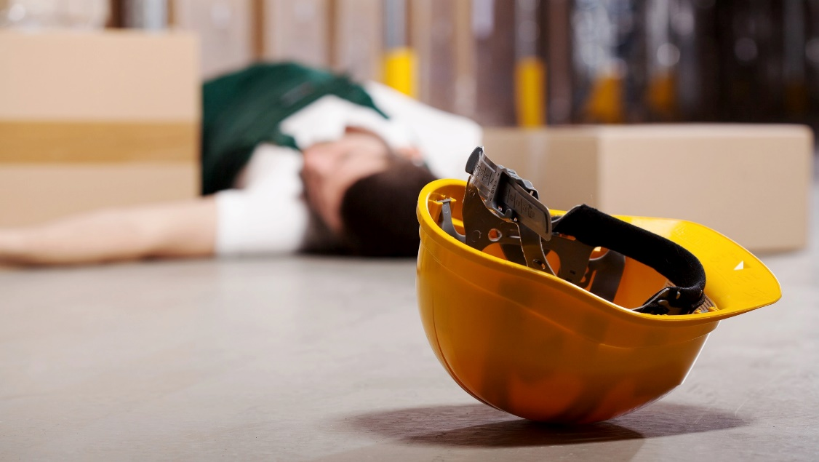
Problem
Employee safety and accident prevention
Field communication

Slide 3
Challenge
Call for help ability
Accurate location
Accurate problem description
Security helpdesk
No visual
No signal

Slide 4
Situations of accidents
Type of occupation
Characteristic of work
Security policy
Technology and personal protective equipment
New - Unknown environment
Age and experience of employee
Notes:
According to the European Statistics on Accidents at Work (ESAW), every year in the
15 Member States of the EU before accession about 5 million workers are victims of
accidents at work leading to more than three days of absence from work;
furthermore, about 5000 workers are killed in accidents at work. Besides the human
suffering, these accidents have a strong economic impact on business.

Slide 5
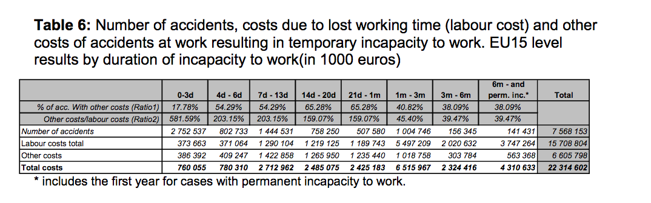
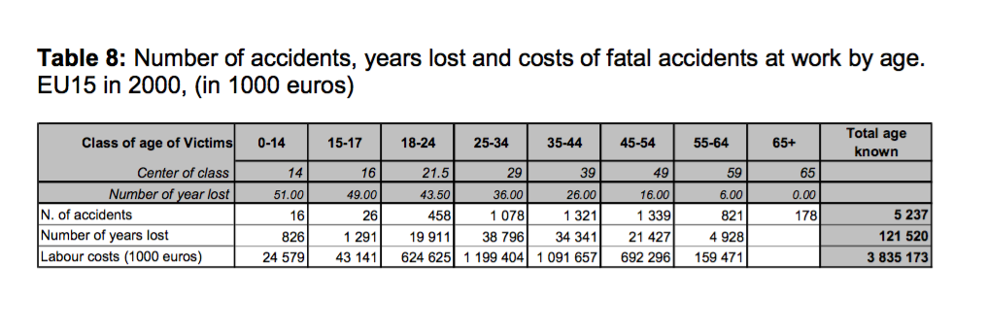
Numbers and Facts
Source: Eurostat

Slide 6
Work Accidents Consequence
Injuries with temporary or permanent consequences
Impact on HR
Financial consequence
Lost of working time
Poor public image
Notes:
- Material damage (i.e. products and raw materials destroyed at the time of the accident);
- Damage of the structures (i.e. machines, equipment, buildings, vehicles destroyed at the time of the accident);
- Repair costs;
- Rental costs of temporary equipment, machines, buildings or vehicles;
- Production losses due to a production stop or slow down;
- Replacement of persons: - Extra salary costs;
Replacement of persons: - Costs of training and adaptation of a new worker;
- Loss of customers or orders;
- Court expenses;
- Administrative costs (expenses to facilitate the return to work, costs reporting the accident, costs of reorganising the production after the accident);
- Loss in terms of image;
- Other costs.

Slide 7
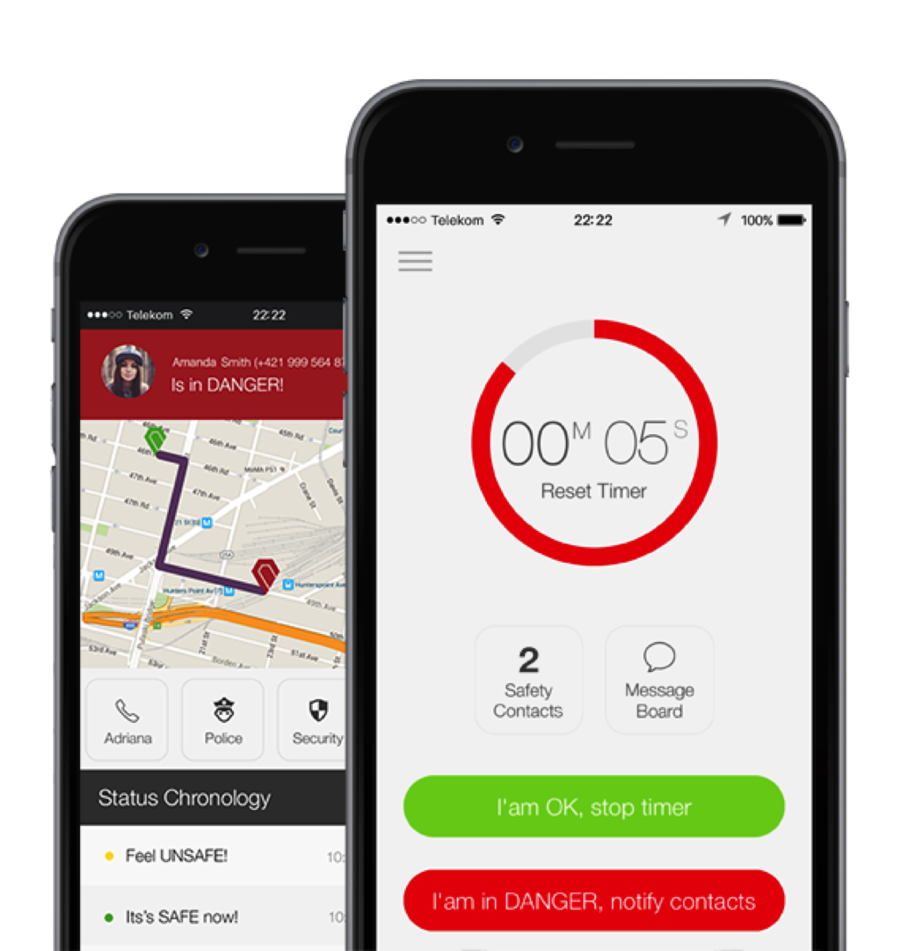
Call for help ability
Automatic
1 to many
Custom radio

Slide 8


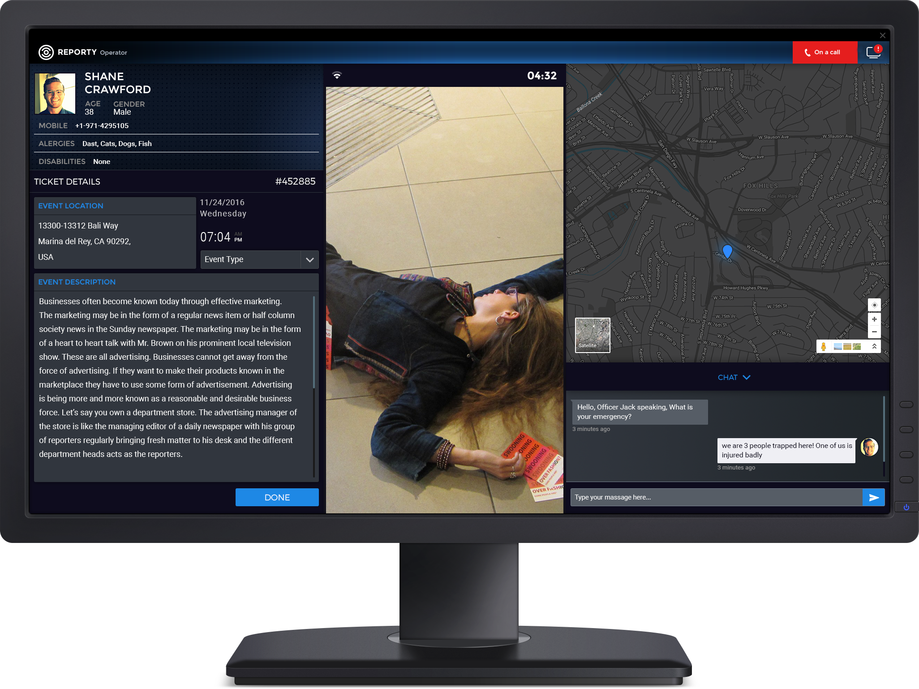

Accurate location
Outdoor
Indoor
Elevation

Slide 9
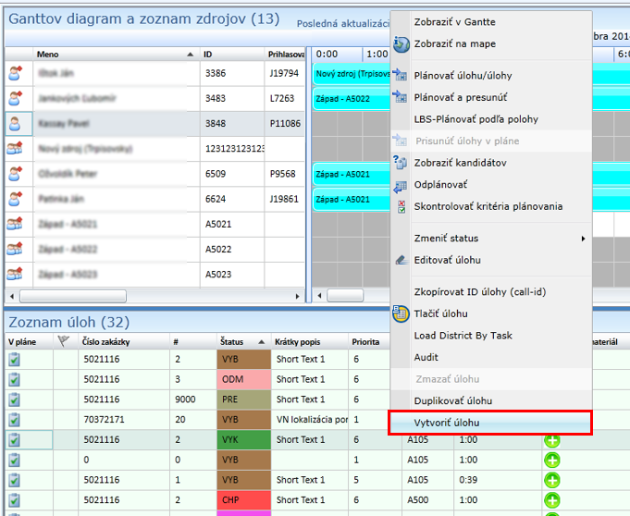
Accurate problem description
SAP workflow
Planning
Task attributes

Slide 10
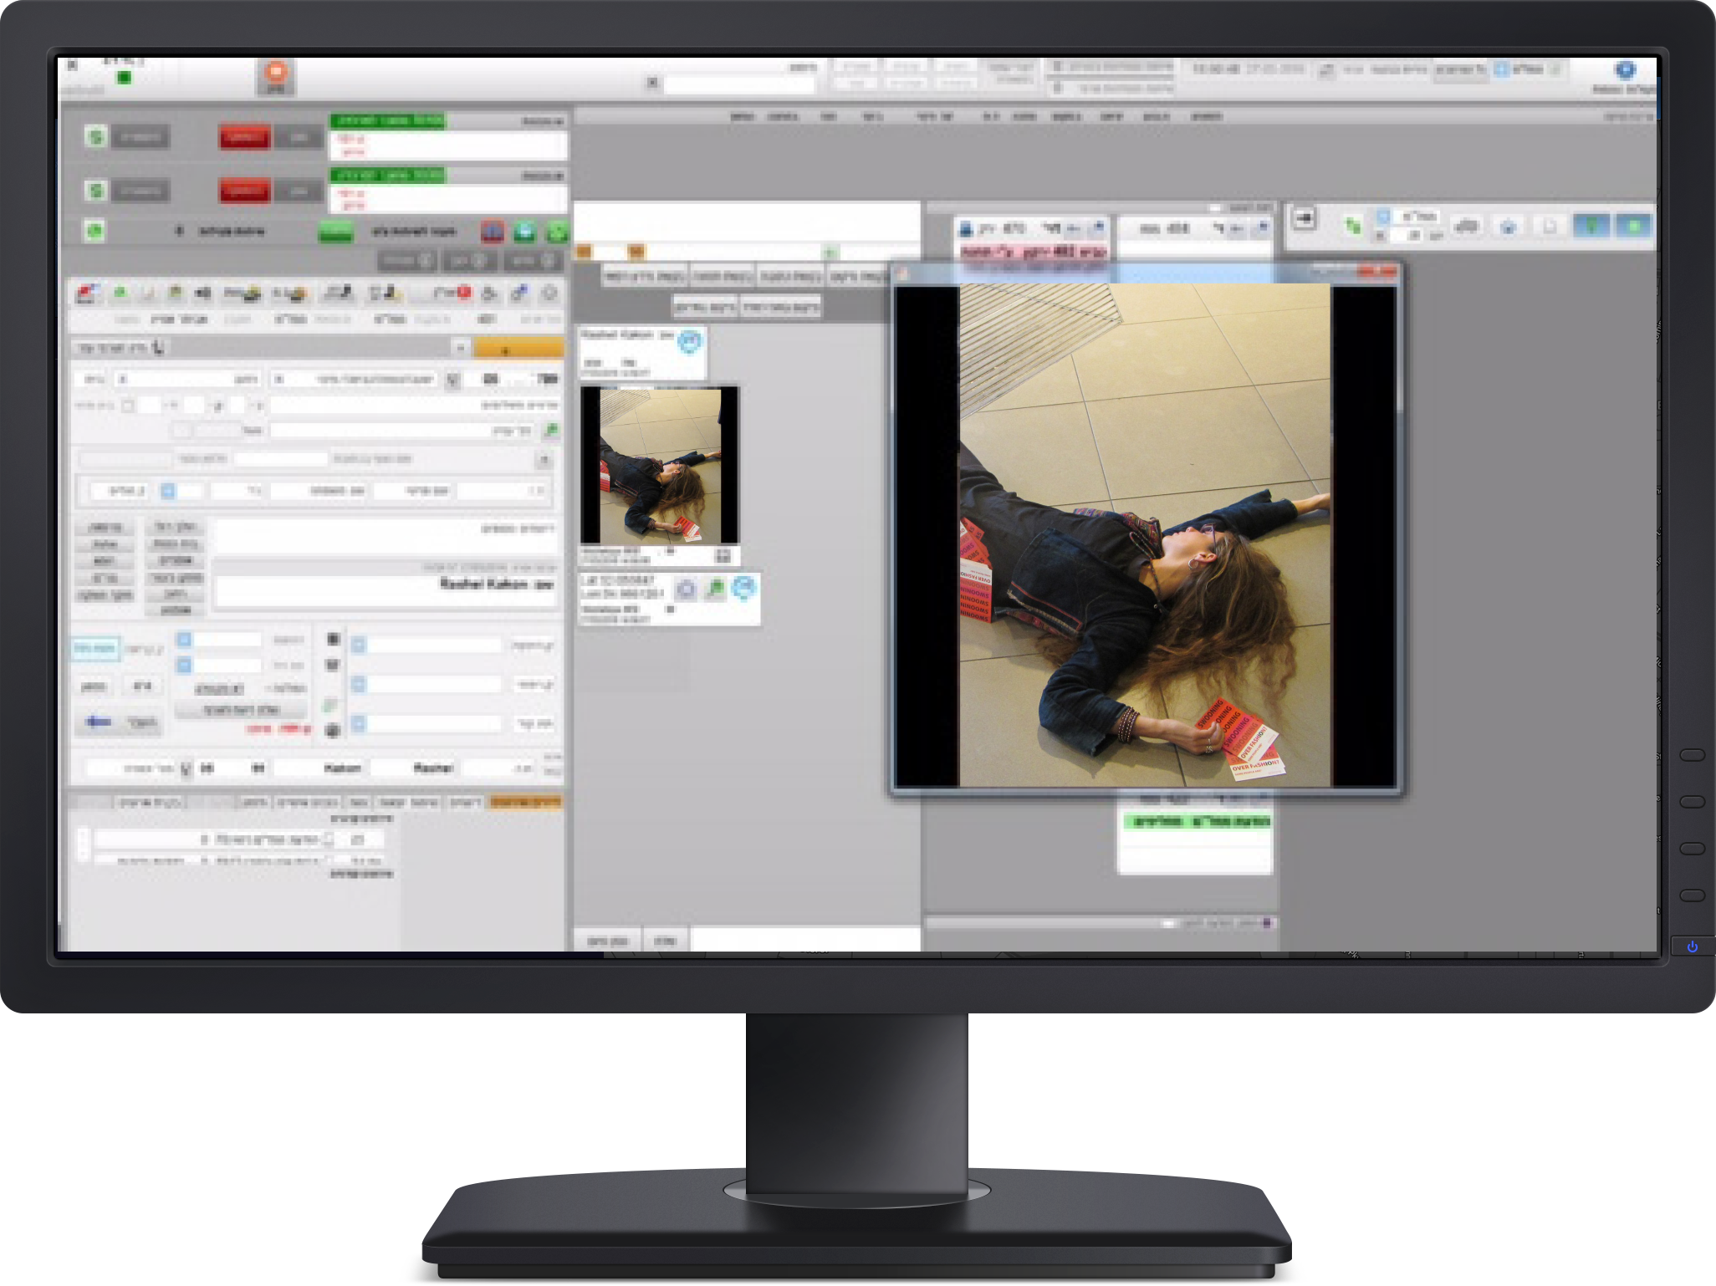
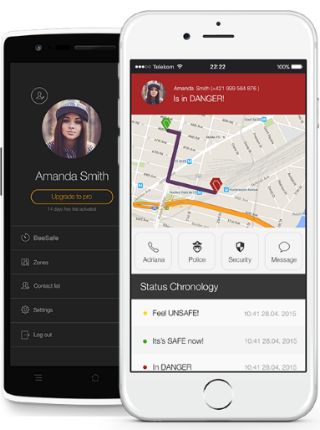
Security helpdesk
Operator
Integration
Real time

Slide 11
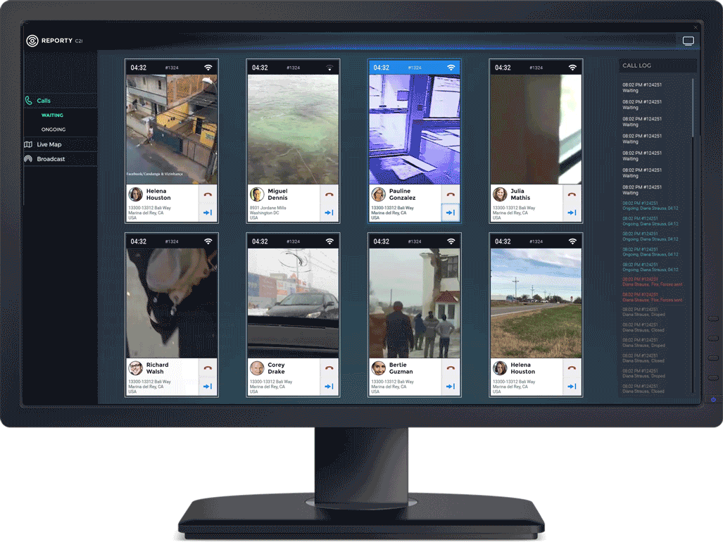
Visual
Incident overview
False alarm prevention
Imidiate help

Slide 12
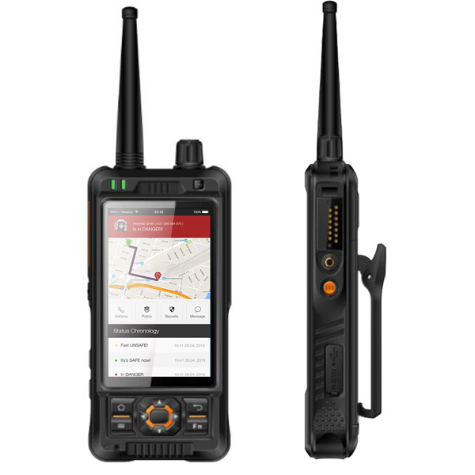
No signal operations
WiFi
Radio
Custom networks

Slide 13
A smart solution for personal safety of employees
Automated call for help
Cost saving
Communication
Effectivity

Slide 14
Pilot project
Environment Safety Analysis
Workflow and Process
Pilot Platform deployment

Slide 15
www.beesafe.me
Tailor made security platform
Safety
Monitoring
Communication
Cost savings
+421 948 220 309
contact@beesafe.me

