Slide 1
TECHNICAL SLIDE – please do not include in final presentation.
General information. User manual.
Application pitch presentation template
This tool will help you convince us that your technology is the right one to support and invest in. It is only an example and a suggestion - if you have better one which contains the most important information from below please use it. Feel also free to redesign the slides, adjust them to achieve a better final effect. Also if you have your corporate presentation template you are welcome to use it. Have in mind that the goal you want to achieve is to communicate your idea in a simple and accessible way.
Keep the following assumptions to be able to build a successful application:
1. Remember that that your customer is the most important. Always.
2. Simplify the message – explain like you would have an audience of non-specialists.
3. Use graphics, charts, info graphics. Provide comparisons with already existing technologies.
4. Briefly explain what your technology does and why you think it should be applied.

Slide 2

TECHNICAL SLIDE – please do not include in final presentation.
General information. User manual.
Your pitch should allow you to highlight:
• The Problem/The Need
• The Solution
• Target Market
• Competitors/Alternatives
• Competitive advantages
All the instructions/comments are provided in the notes box throughout the presentation.
Please delete them once the presentation is ready. Headlines in blue need to be edited for the purpose of your project.
Ask for our assistance, if something is unclear (send us your draft for initial check).

Slide 3


KIC LED bulb
LED bulb industries.
Initial Pitch Presentation
bringing new light
Energy efficient, state of the art LED bulb.
16-05-2016
Notes:
Please make sure to provide all the information, indicated in blue.
* Please provide product/company logo if possible.

Slide 4
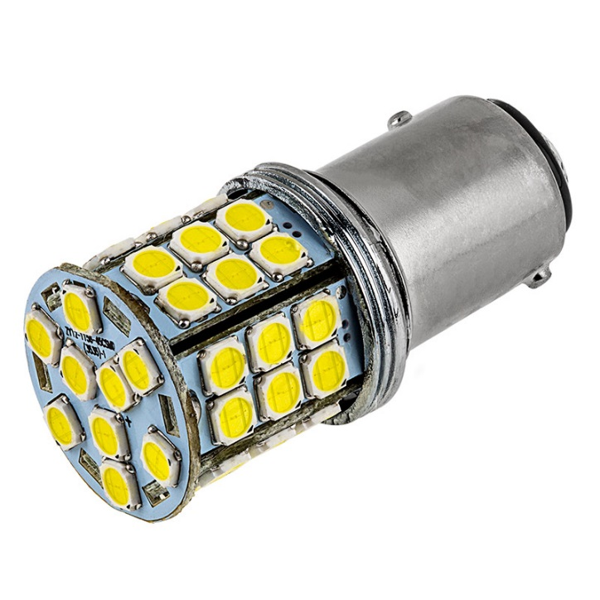
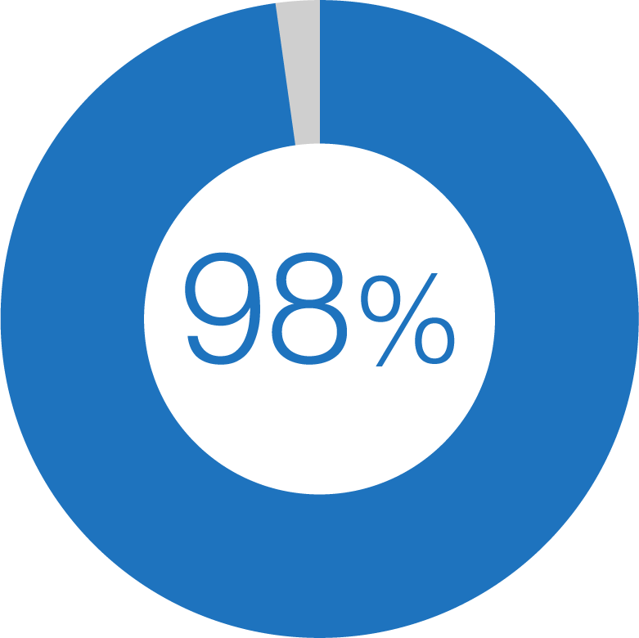

Executive summary. Value Proposition and Unique Selling Points.
Value Proposition | Energy efficient, state of the art LED light bulb.
Unique Selling Point | By utilizing laser soldering our LED bulbs have the lowest failure rate and highest efficiency.
overall
efficiency
Wholesalers
Consumers
KIC LED - the most energy efficient LED bulb.
Project goal - develop a family of LED bulbs.
Total Addressable Market - 208 M EUR/year.
KIC LED bulb provides over 150 EUR savings per 10 year operating period.
KIC LED team – 12 implemented projects; 10 M EUR generated revenue.
Notes:
Try to explain in clear, concise, way what your company does. Also address the following: what is your company’s Value Proposition and Unique Selling Points (these may be the result of building your Business Model Canvas, elements of which can be found on slide [...]). Use graphics and keep it simple.

Slide 5




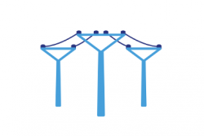





Basic eligibility criteria.
ICON SET.
(Thematic fields)
 | Criterion | Criterion met | Comment
1 | The Technology is in the priorities in one of the 8 Thematic Fields of Sustainable Energy |  | Energy efficiency.
2 | Compliance with key KIC goals. |  | Decreasing energy cost
3 | Equivalent product not available in EU. |  | LED bulb with such features is not available in EU market.
4 | Defined product or service |  | Fully operational prototype is developed.
5 | Time to market is less than 5 years |  | We are few steps before mass production.
Notes:
Please fill the provided table. Use icons on the left-hand side of the slide.
*Use pictograms correlated with thematic fields
** Use check/uncheck icon. B

Slide 6

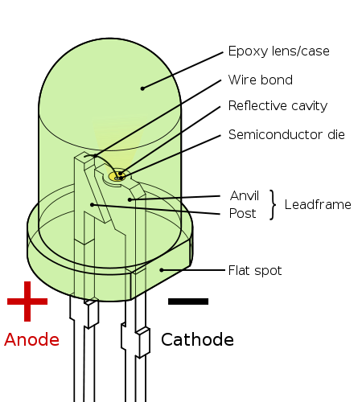
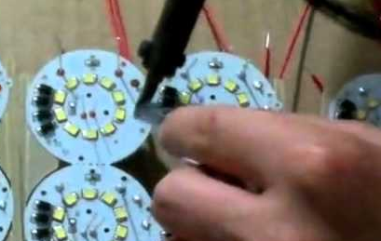
The Underlying Technology
Our goal: sustainable energy
Silicon semiconductor emits a monochromatic light.
Junction allows the current to pass in a forward biased direction.
Electrons pass through crystals and fill holes.
Electrons emit photons (light).
LEDs converts electical energy into light energy.
Notes:
Please present your idea in the most simplistic way. It is up to you to decide how, however, we recommend using graphics rather than words. Feel free to use a technical diagram – if you choose to do so please simplify the modules and avoid technical jargon. B

Slide 7
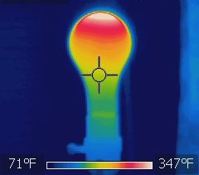




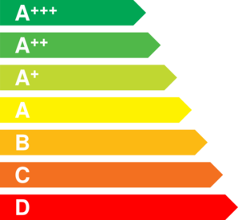
The Problem
What is the problem or need?
High energy prices.
Low efficiency of classical bulbs (~3%).
High failure rate of classical bulbs.
Heat emitted by bulbs.
Heat distribution in a classical bulb
19%of electricity produced
worldwide is consumed by
lighting installations.
Who faces the problem?
Offices
Households
455 EUR/year
Is a typical electricity bill for a standard
household - considering
using 10 classical bulbs.
Costs of problem
Inconvenience
Operating
cost
Inefficiency
Notes:
Pleas answer the following questions.
What is the problem or need?
Who has the problem or need
Why it is important to solve it and what is the cost to the one who has the problem or need
The slide is just an example, feel free to alter the conent to your own preferences

Slide 8


Venture status. Future development.
Venture stage:
Idea
Identified idea components
Proof of concept
Prototype
Product
Acquired investors/external funding: if applicable please provide detailed information regarding name of investor/investment program, value of investment etc.
LFY turnover: if applicable please provide with the turnover from Last Fiscal Year
Ownership Structure:
Name the type of legal entity to indicate shares distribution
Future development
Full company name | KIC LED
Venture stage | Prototype
Creation date | 1961
Number of employees | 12
Ownership structure | Limited Liability Company (LLC)
Acquired investors | Texas Insturments - €120k Norwest Venture Partners - €880k
Acquired external funding | SME Instrument - €500k
LFY turnover | €1.3m
Our goal is to develop a full family of products.
Power range: 1 – 60 W
Color range: at least 16 colors
Future color palette
Notes:
If possible on the left hand side please provide the required information. Use legend on the left for guidance. On the right hand side, briefly provide the future development plan and indicate which key resources (financial, HR etc.) you need in order to achieve the target. Try to be as specific as possible.

Slide 9

The designed product/service. What you want to sell.
General product characheristics:
Class: A++ Certificate: CE
Cost of manufacturing: 7 EUR
Market Price: ~15 EUR
Socket type | E27 (standard)
Light type | Warm white (2700-3300K) 1600lm
Voltage | 230V, 50Hz
Power consumption | 20W
Equivalent in standard bulb power | ~100W
Lifetime | Up to 50 000h (~6 years of constant light)
Notes:
Using blank space please describe the end product/service you would like to sell. Describe its physical characteristics, functionalities, and put in context how it will be used by the end customer. Point out the assumed price range you target. Describe future developments of your product or service. Keep it simple.

Slide 10

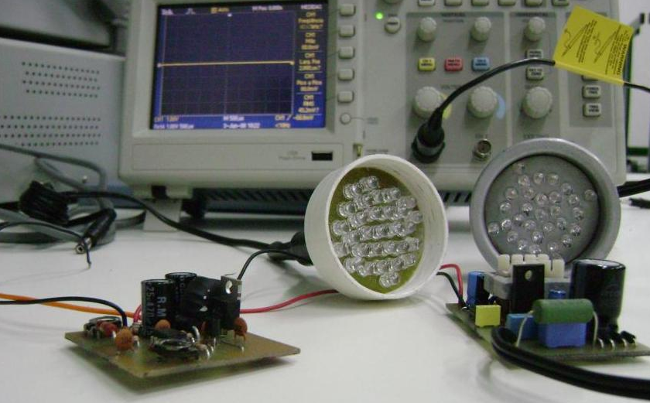

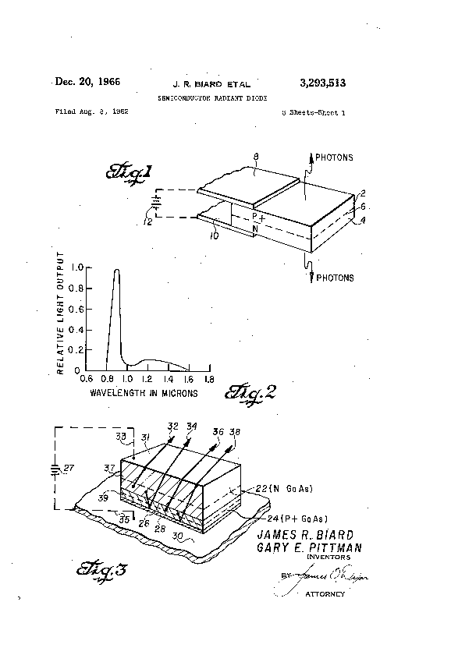
The Prototype. What you have.
The prototype
Completed prototype testing in a high-fidelity laboratory environment.
Test and demonstration of the KIC LED Bulb in operational environment scheduled next month.
Intellectural Property
August 8, 2013, James Biard and Gary Pittman - 50/50 ownership - GaAs Infrared (IR) light-emitting diode (EU3293513).
Future protection mechsnisms:
IPR
control over complementary assets (heat shedding and dissipation mechanisms)
Notes:
The purpose of this slide is to show what you have now – the prototype or current, higher status of technology. Please describe what is you IP situation and the strategy for protecting the value of your innovation from possible immitators going into the future – how do you plan to retain your competitive advantage long-term?

Slide 11



Business model. How do you plan to get the revenue?
Value Proposition
Unique Selling Point
Customer Segments
Wholesalers (B2B)
Distribution centres (B2B)
Real estate developers (B2B)
Real estate managers (B2B)
Municipalities (B2B)
Households (B2C via online platform)
Value for money – extremely efficient and reliable LED lightbulb which is affordable, well designed and durable.
By utlizing laser soldering our LED bulbs are cheaper to manufacture and have the lowest failure rate when compared to bulbs on the market (99,8% of tested bulbs proven to work over 50 000h)
Energy efficient, state of the art LED light bulb.
We forsee expansion of product family to over 20 products varying in power, light type and resistance to specific working conditions.
Notes:
Using blank space/provided business model canvas blocks please describe the means and methods you want to emply in order to earn the revenue and make profit from operations. Remember the components and functions of the business.
As we believe that at the beginning the most important parts of BMC are Value Proposition, Unique Selling Point and Customer Segments, for purpose of this slide please fill those blocks.

Slide 12
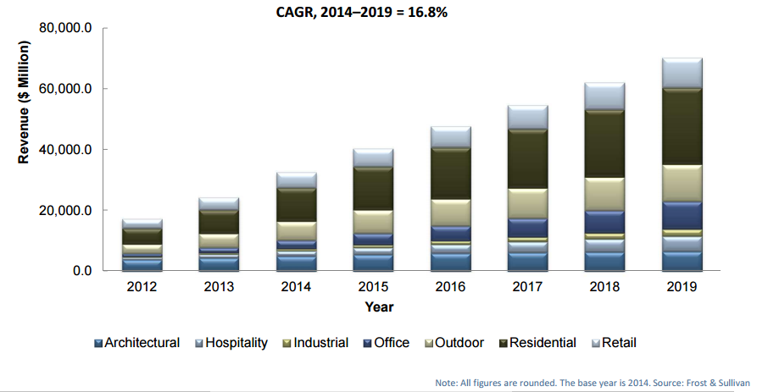
The Customer. Asses the Total Addressable Market.
Assumption | Size (Million €)
The Current Global LED Market | 41 544
Global LED Market 2017 | 47 743
Europe = 20% market size | 9 549
Target Segments (Industrial, Office, Residential) = 50% market size | 4 774
66% of sales originate from wholesale/retail distribution | 3 151
Total Addressable Market | 2 080
TAM/Year | 208
Residential uptake is related to the concept of ’zero emission’ houses, falling prices and increasing end-user awareness.
Offices retain a potential in new smaller offices and retrofit.
Industrial has large potential but relatively low penetration. The purchasing criteria is creating the best environment for assembly and precision works.
YOUR SOLUTIONS
€2 080 M
Total Addressable Market
Notes:
Please use this slide to describe everything you know about your target customer segment. Who are they and what is their main purchasing criteria. If you spoke to/interviewed potential customer please mention how many. If possible please calculate TAM (Total Addressable Market Size in units of currency)

Slide 13
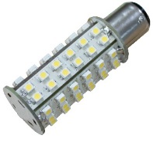

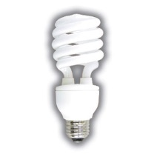
Competitive Advantage
General competitive advantages, functionality
YOUR SOLUTIONS
 | Efficiency | Failure rate | Lifetime | Heat emission | Instant ,,on” | Toxic materials
KIC LED | 95% | 1 in 100 000 | ~10 years | Low ~ 60 ºC | Yes | No
Incadescent bulb | 3% | 1 in 10 000 | ~1 year | High ~ 200ºC | No | No
CFL bulb | 10% | 1 in 500 | ~ 4 years | Medium ~ 140 ºC | Yes | Yes
Failure rate through the lifetime of CFL nad LED bulbs [%]
Notes:
Please describe the benefits for the customer in his process or daily use regarding product features, as a result of your product implementation. Try to compare these with the alternative solutions the customer may choose, or if none is present on the market, with the current condition of the problem.

Slide 14


Product/service benefits
Financial benefits
Lumens | KIC LED | CFL | Incandescent | Savings €/year
500 | 7 watts | 9 watts | 40 watts | 10-15
850 | 11 watts | 13 watts | 60 watts | 15-30
1600 | 20 watts | 23 watts | 100 watts | 20-65
Other benefits
Low maintenance cost (long lifecycle).
Low failure rate.
No overheating.
Lower CO2 emmissions as a result of efficiencies.
Notes:
If the implementation of your product will give benefits for the customer (financial and other), please indicate tchem (calculate if needed) and present on the slide above. Try to compare these with alternative and currently existing solutions which are availabe for the customer. If your innovation is disruptive and cannot be compared to anything else, focus on real, measurable benefits for the end user. B

Slide 15
Competitive Advantage
Financial benefits, return on investment for the customer
YOUR SOLUTIONS
 | KIC LED | Incadescent bulb | CFL bulb
Purchase Cost | 8 EUR | 1 EUR | 4 EUR
Brightness | 1600 lumens | 1650 lumens | 1600 lumens
Lifetime | 10 years | 1 year | 4 years
Energy used | 20W | 100W | 30W
Estimated yearly energy cost | 3,79 EUR | 19,98 EUR | 5,69 EUR
Total cost over 10 years | 45,9 EUR | 209,8 EUR | 66,9 EUR
Total cost of using different bulbs through 10 year period [EUR]
Notes:
Please show how you calculated the ROI (Return on Investment). Present your assumptions if applicable. If you do not know your customer’s specific case make a basic financial comparison between using your solution vs. alternatives

Slide 16


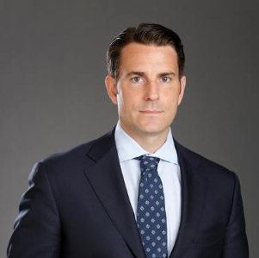

The Team
PHOTO
PHOTO
PHOTO
PHOTO
Gary Pittman
James Biard
Jeff Fleeher
Akos Armont
CEO
CTO
CFO
SALES
ENGINEERING
ENGINEERING
FINANCE
STRATEGY
BIO
BIO
BIO
BIO
Introduced 3 new technologies to the product portfolio at Texas Instruments
Awarded with 8 grants for innovators
20 years of experience in electrical engineering
Introduced 3 new technologies to the product portfolio at Texas Instruments
Awarded with 8 grants for innovators
20 years of experience in electrical engineering
Introduced 3 new technologies to the product portfolio at Texas Instruments
Awarded with 8 grants for innovators
20 years of experience in electrical engineering
Introduced 3 new technologies to the product portfolio at Texas Instruments
Awarded with 8 grants for innovators
20 years of experience in electrical engineering
Notes:
Please provide info about your team – make sure you use bullet point format for the bios highlighting individual achievements and where possible quantifying them into numbers, e.g. John Doe led to increasing the revenue of company A by X% B

Slide 17

www.kicled.com
bringing new light.
facebook.com/KICLED
twitter.com/KICLED
linkedin.com/KICLED
youtube.com/KICLED
Notes:
Please fill the data required in blue.

