Slide 1

Energy anywhere you want
Sara Plaga
CEO & Co-Founder
23rd June 2022, Future City Tech Říčany

Slide 2
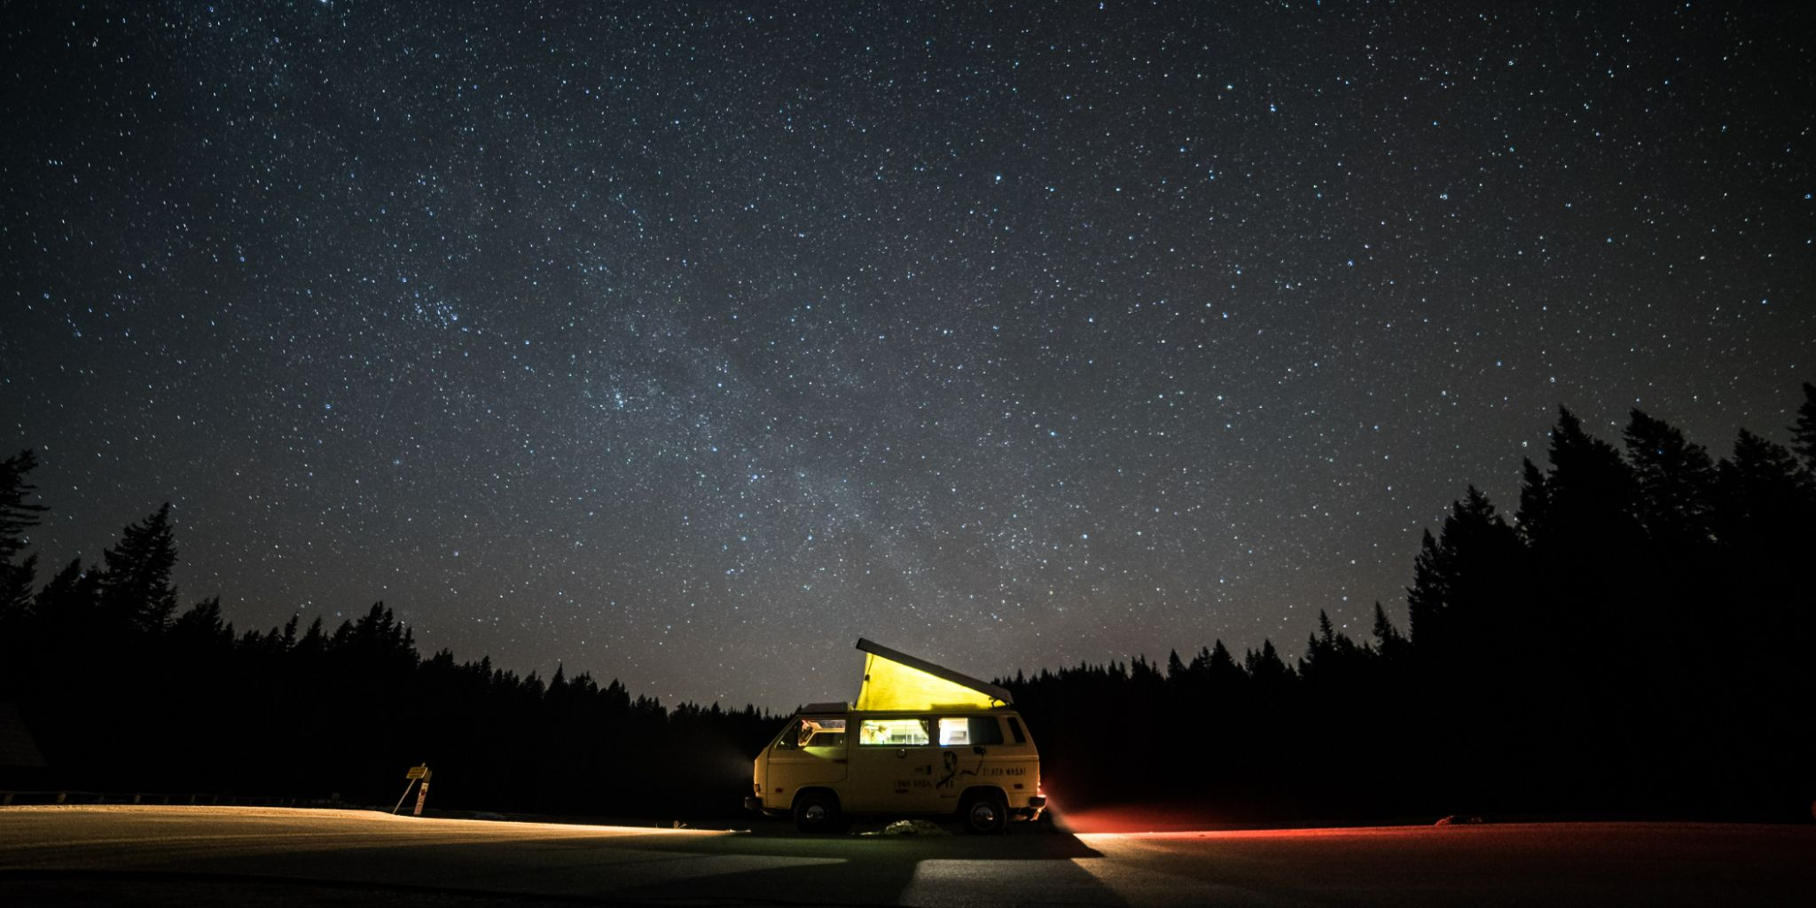

OUR VISION
Clean energy accessible anywhere
in a portable format

Slide 3
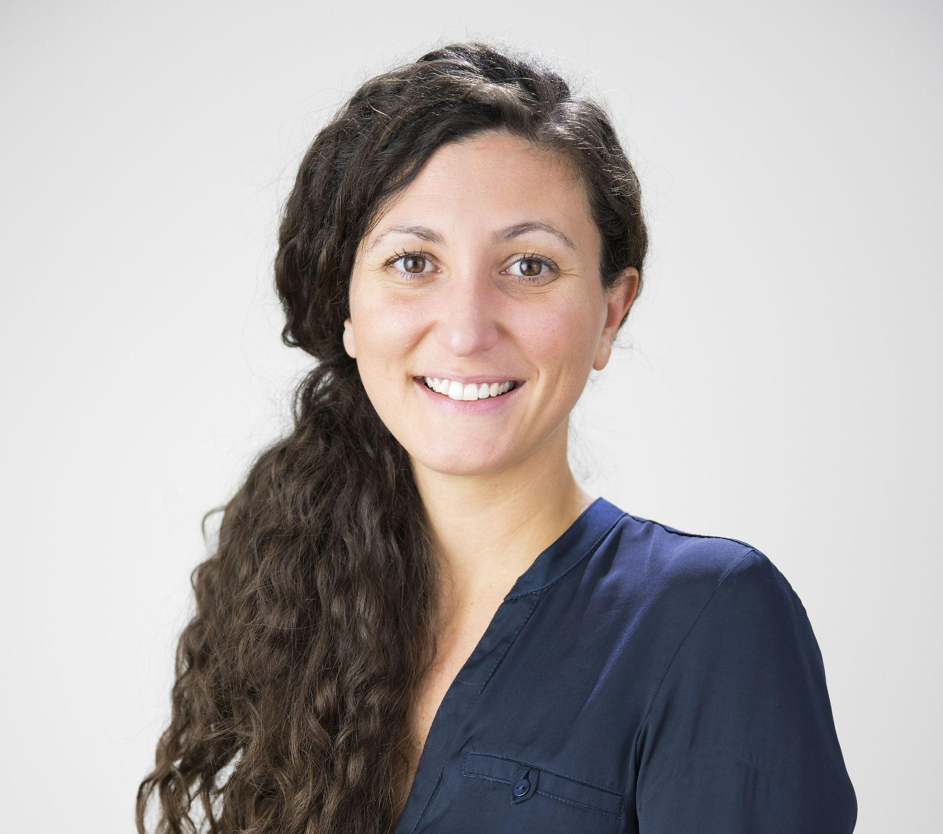
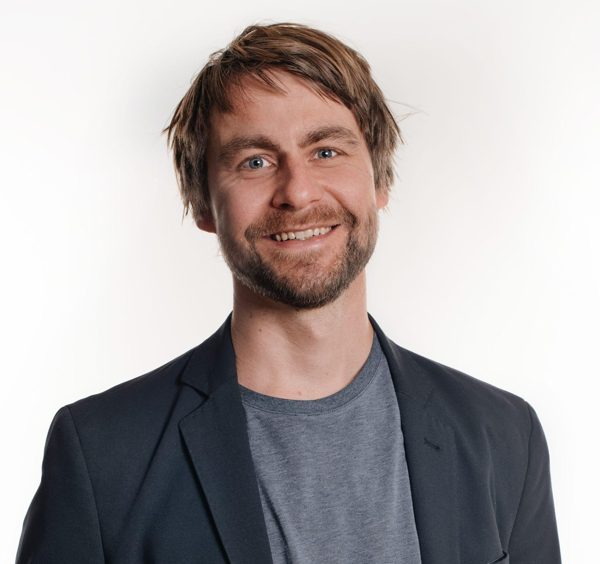


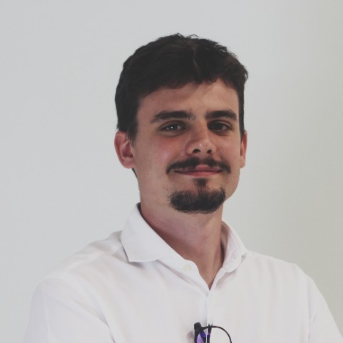
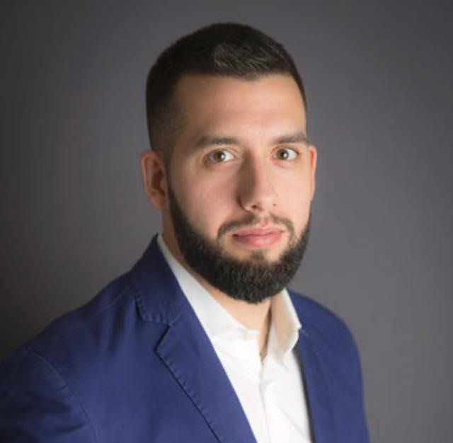

LEVANTE
TEAM
SARA PLAGA
KIM-JOAR MYKLEBUST
Founder, CEO, CMO
Business & Marketing
Ex Carl Zeiss
Founder, CTO, COO
Design & product engineering
Ex Dallara Automobili
ELISA PRATO
ISACCO ROSSI
FABIO DE MARTINO
Sustainability specialist
Master in Sustainable Business Administration
Software, Cloud & IoT expert
Advisory board member
CIO & Business Developer Manager for Pini Group
Notes:
The founders have a 10-year background in marketing and product development & mechanical engineering from the motorsport industry

Slide 4
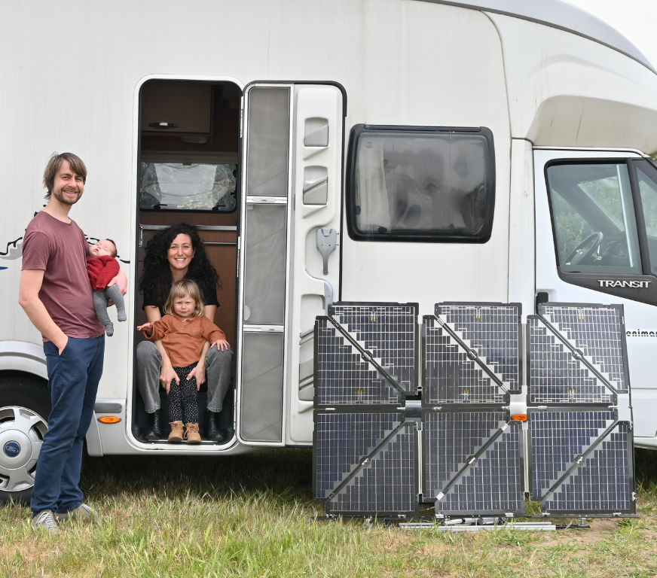
HOW IT STARTED
“
OUR IDEA IS BORN TO SATISFY A NEED
Notes:
We are Sara and Kim, founders of Levante.
We grew up with the same passion for travel and nature.
In our travels we have often faced a need that has not yet been fully satisfied.

Slide 5
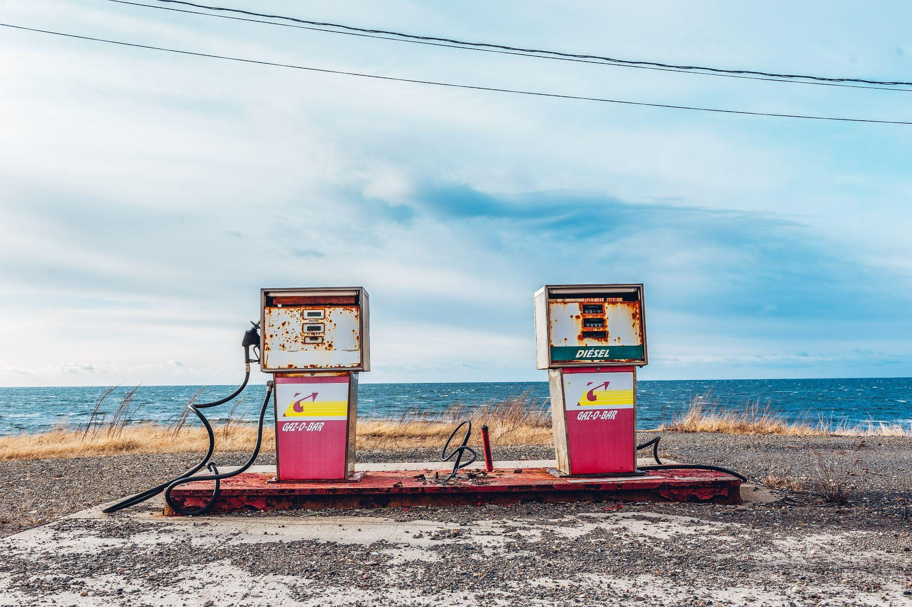

THE NEED
Clean energy anywhere anytime
Independence from fossil fuels

Slide 6
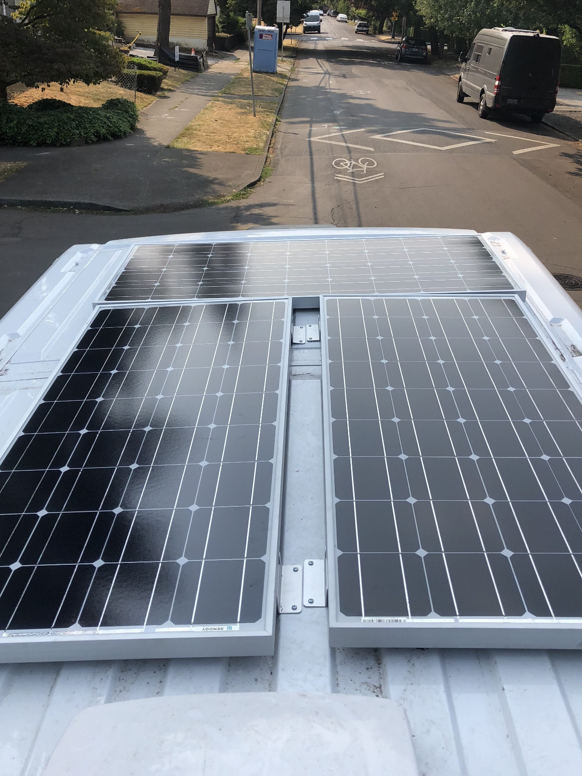
PROBLEMS WITH
SOLAR PANELS
Shading losses
Low efficiency, limited
interrupted production
Notes:
However, solar panels suffer from low efficiency because they don’t follow the sun
sun moves across the sky and solar panels don’t
they are not following / facing the sun

Slide 7
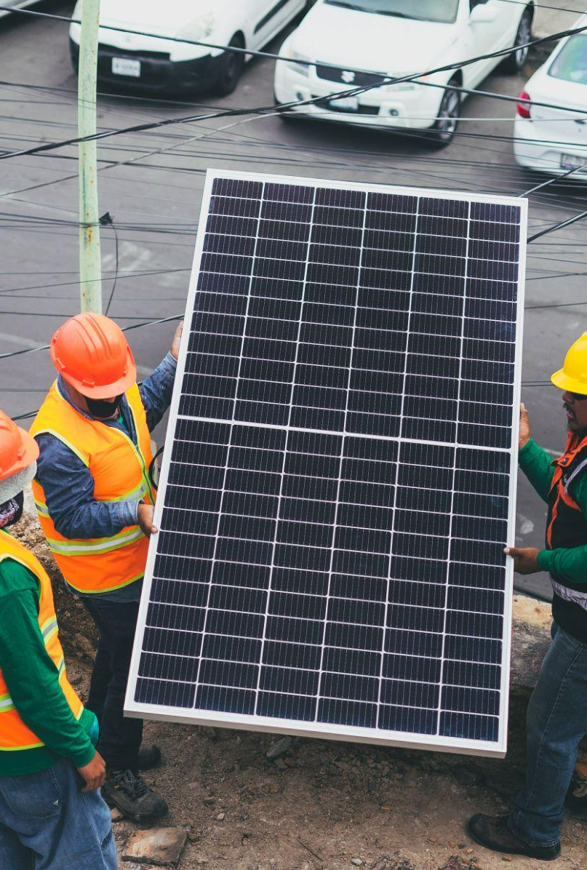
PROBLEMS WITH
SOLAR PANELS
Difficult to transport, install and maintain
Notes:
Take up lots of space for installation

Slide 8
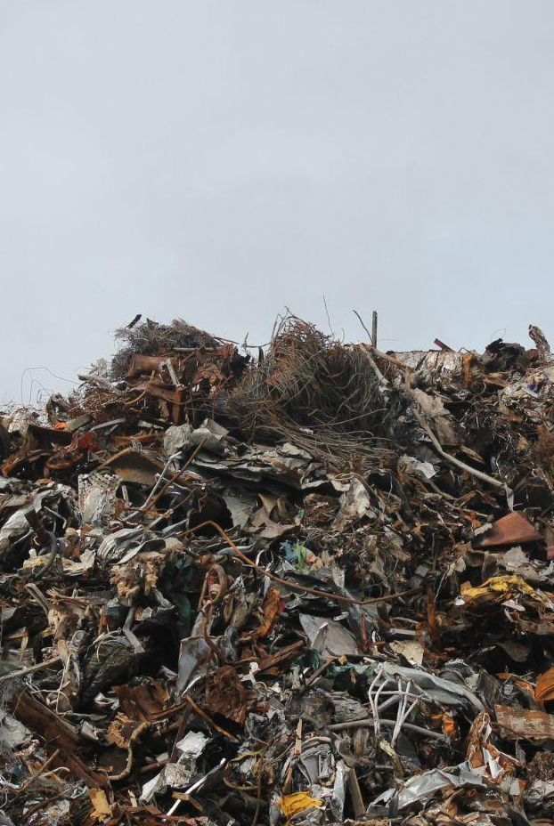
PROBLEMS WITH
SOLAR PANELS
Disposal
78 millions tons of global
PV waste by 2050
Energy Strategy Reviews
Notes:
and when we don’t use them any longer, nowadays they end up in landfills
Technology is changing fast and solar panels end up in landfills

Slide 9


THE
INSPIRATION
01
02
I Solar panels used on satellites
Functional
I LEGO®
Modular
Notes:
TO find a solution, WE TOOK INSPIRATION FROM..

Slide 10

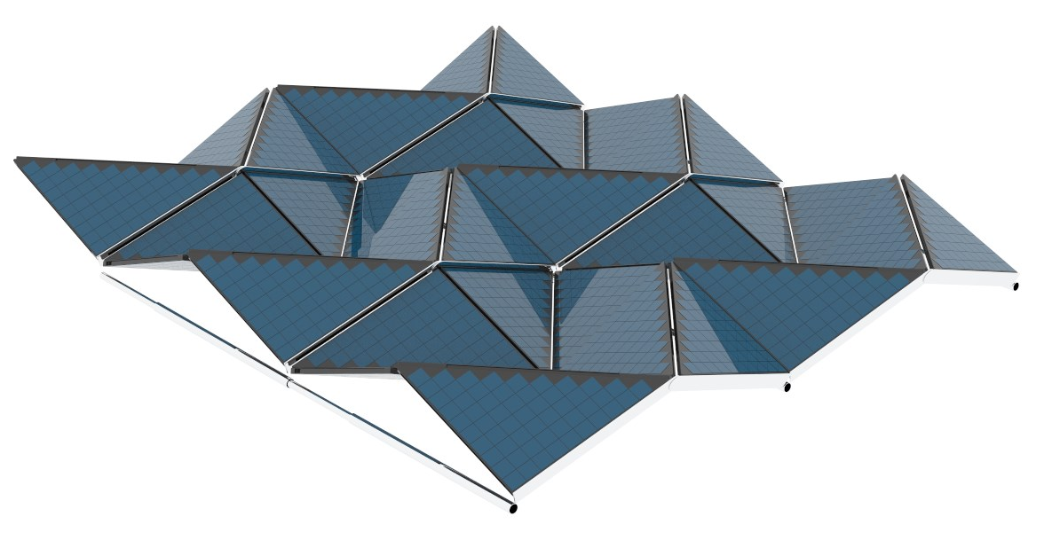
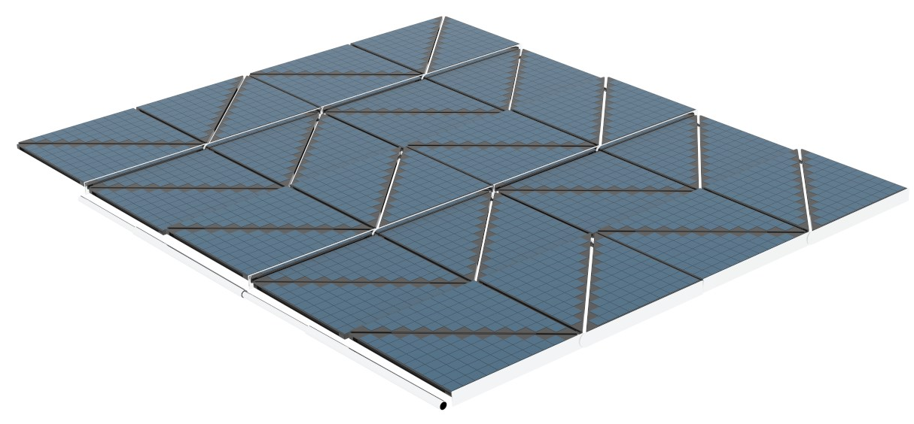
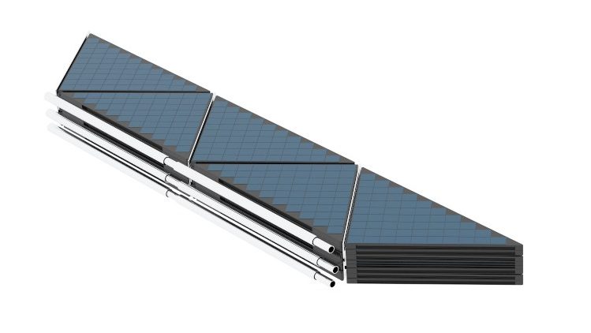
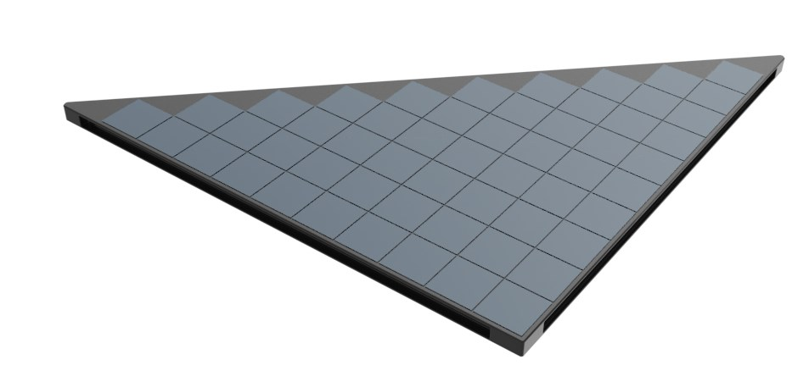

THE SOLUTION:
ORIGAMI SOLAR SYSTEM
COMPACT SMART MODULAR RECYCLED
Closed position | Opening movement | Open position | Add & detach modules
Notes:
det

Slide 11
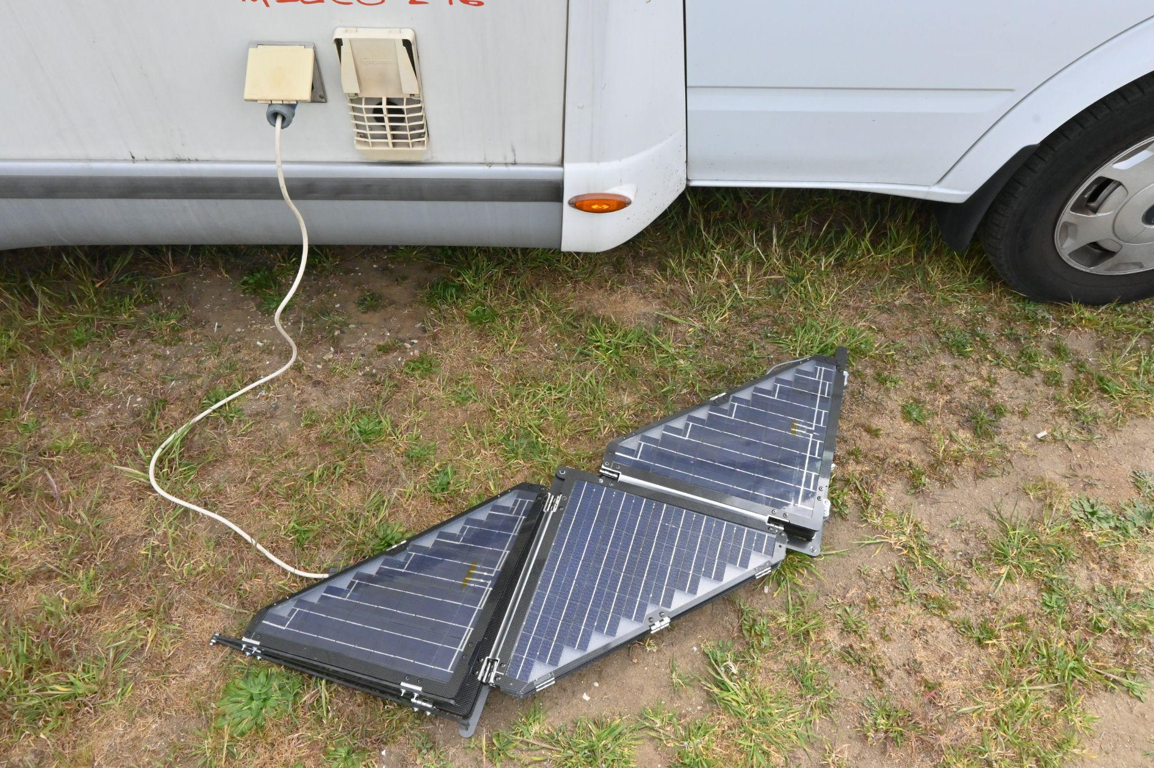
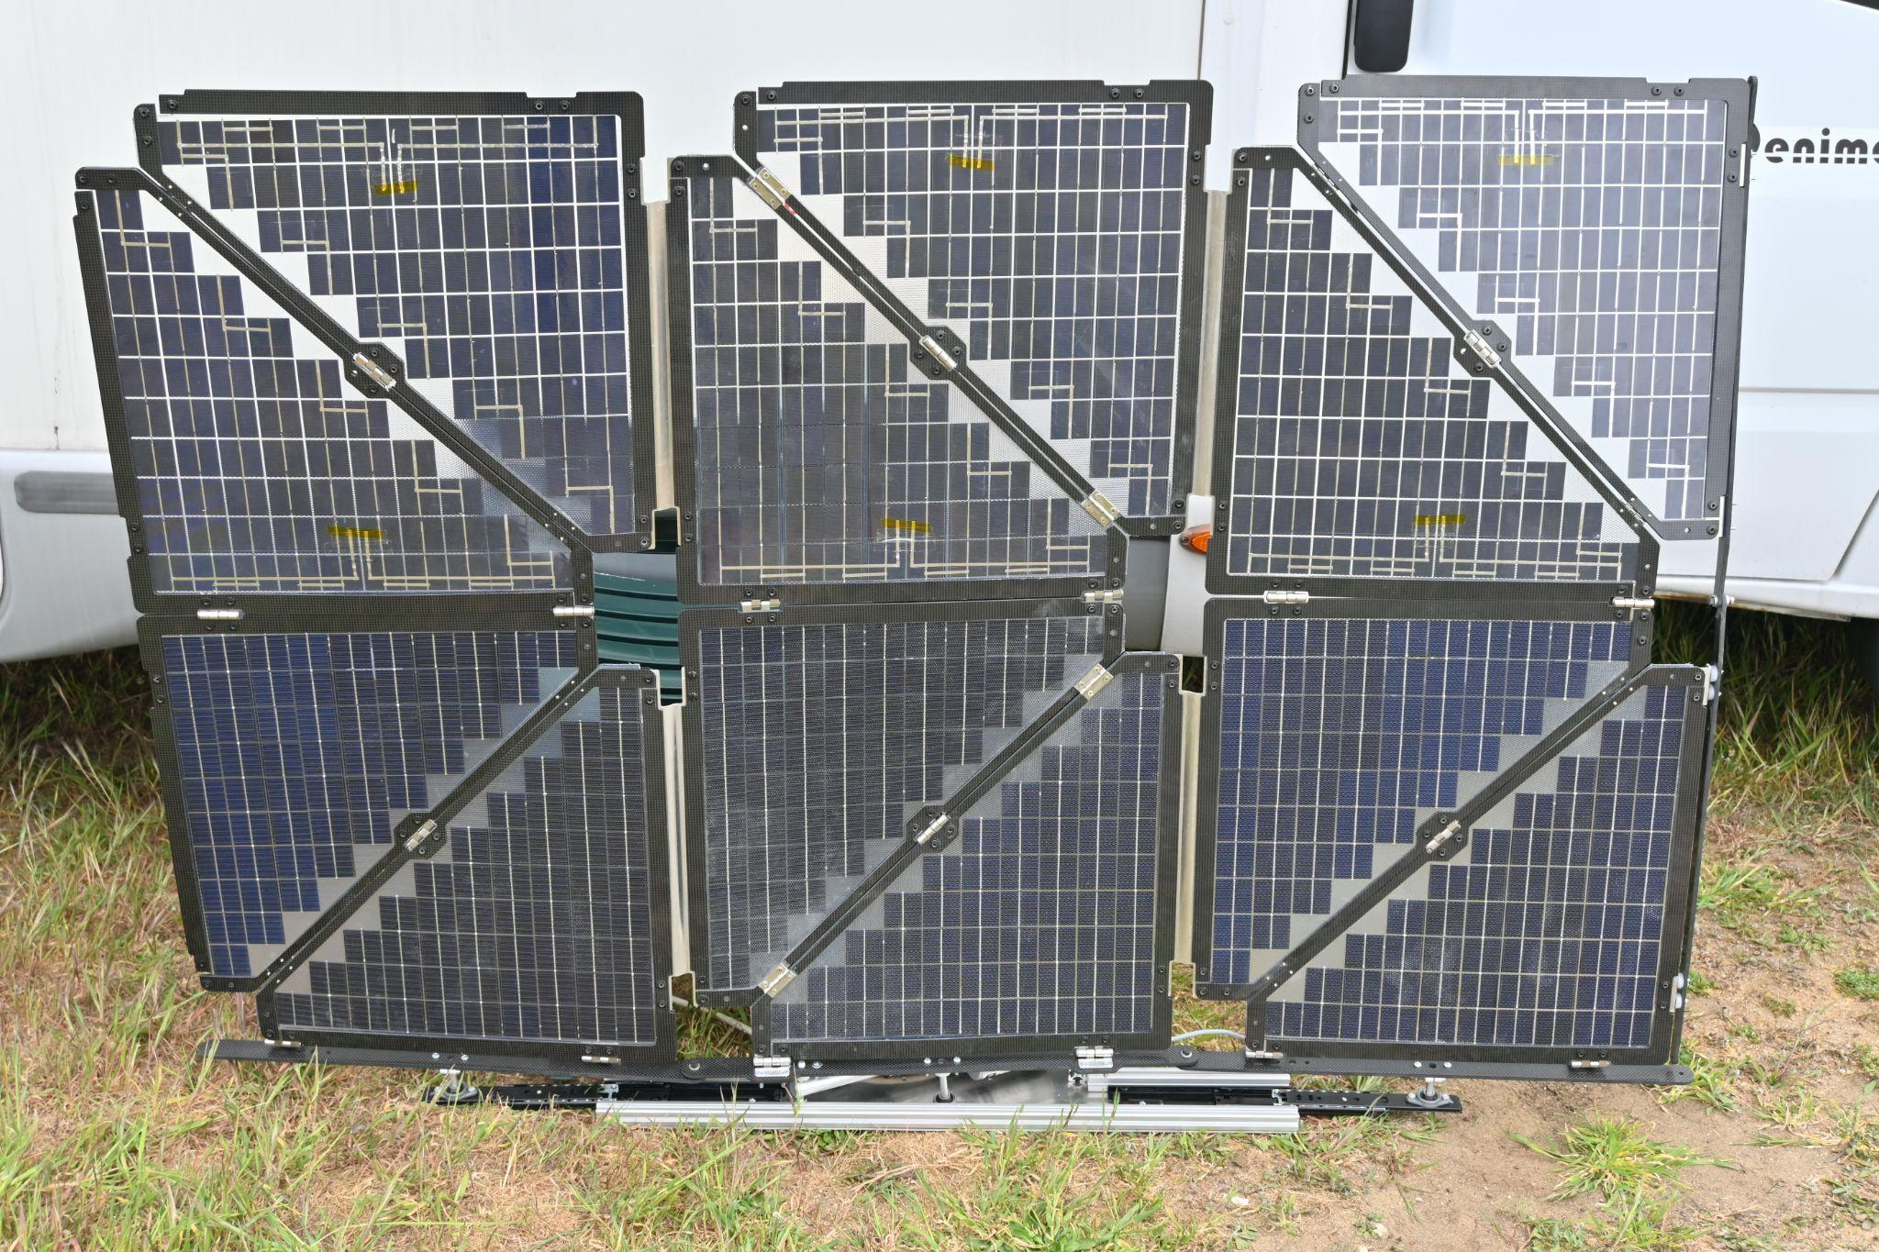
ORIGAMI SOLAR SYSTEM
PROTOTYPE
Closed | Open 500 W configuration

Slide 12
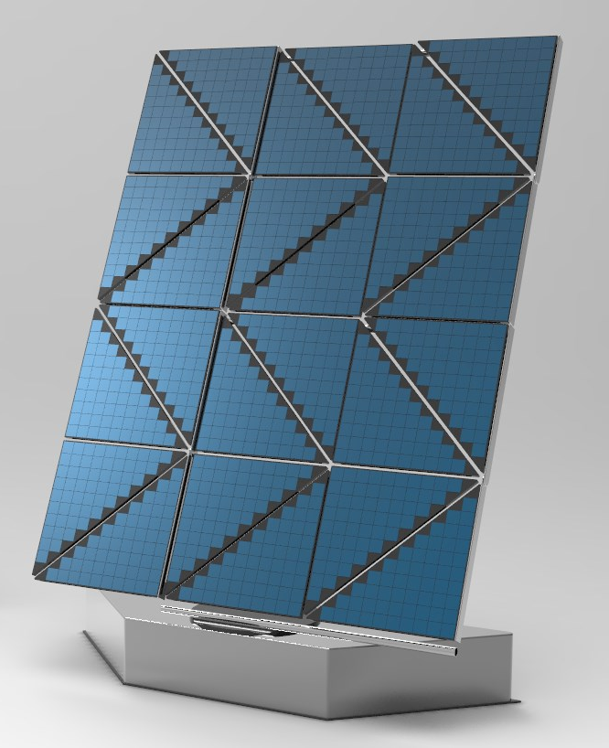
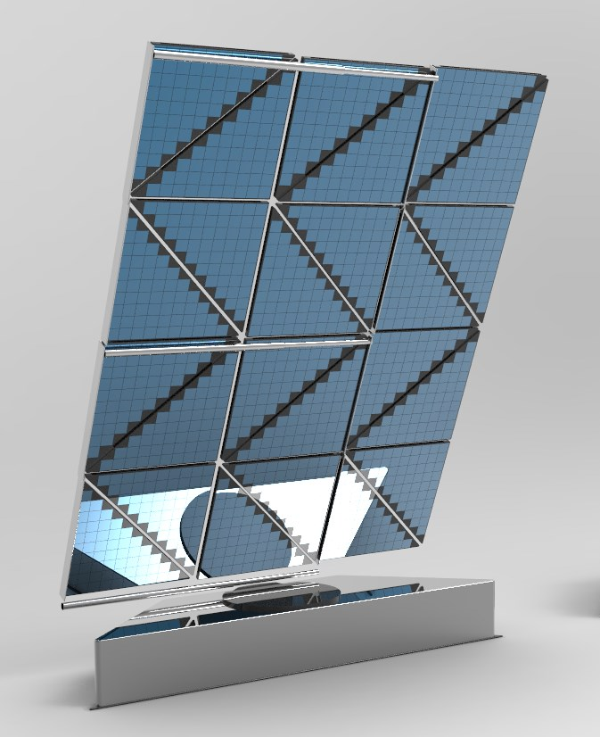
UP TO +70% ENERGY EFFICIENCY
Solar tracking system Bifacial interface
Notes:
Thanks to the solar tracking system we can guarantee up to 70% more energy efficiency compared to a conventional solar panel
This means using less panels for the same amount of energy

Slide 13
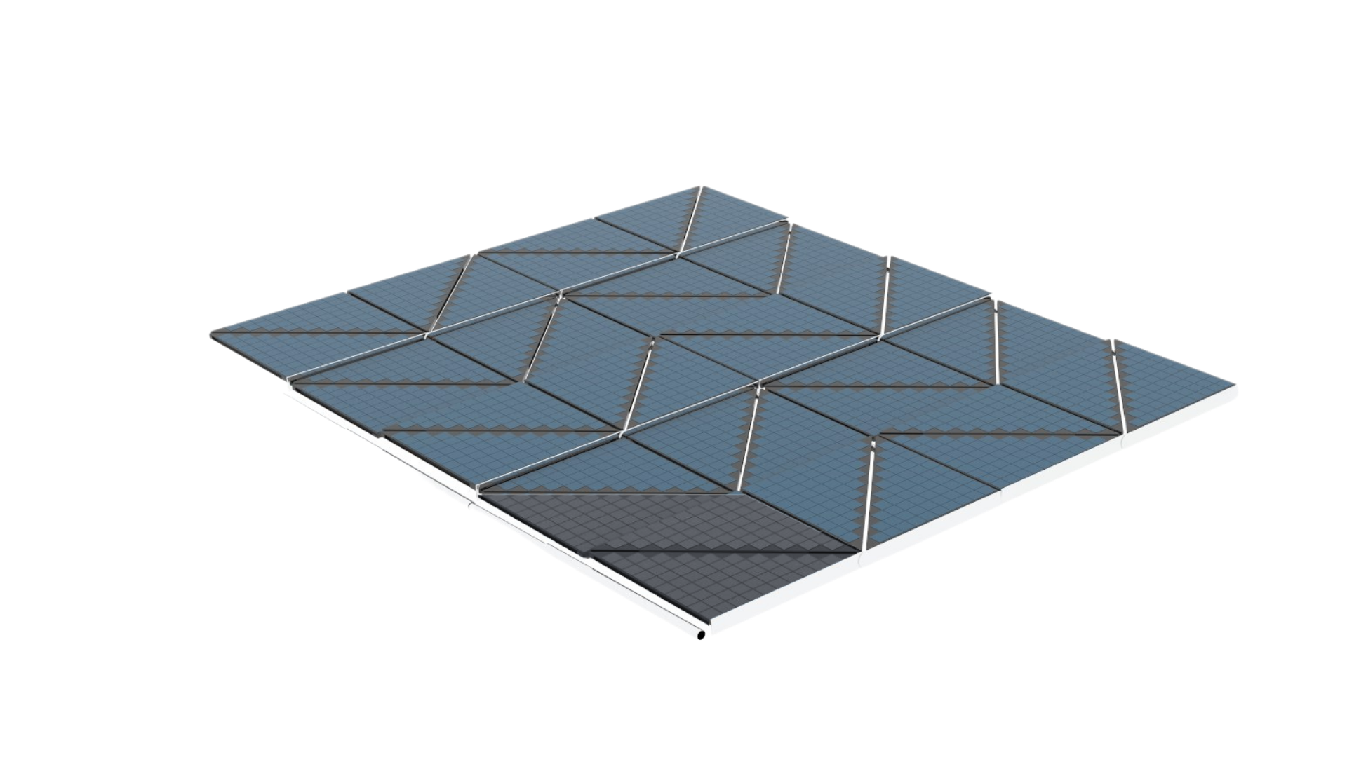
NO MORE SHADING LOSSES
Smart modules with solar charge controllers
Notes:
the panel is composed of smart modules with solar charge controllers
If it is affected by shadow, it is still providing energy

Slide 14
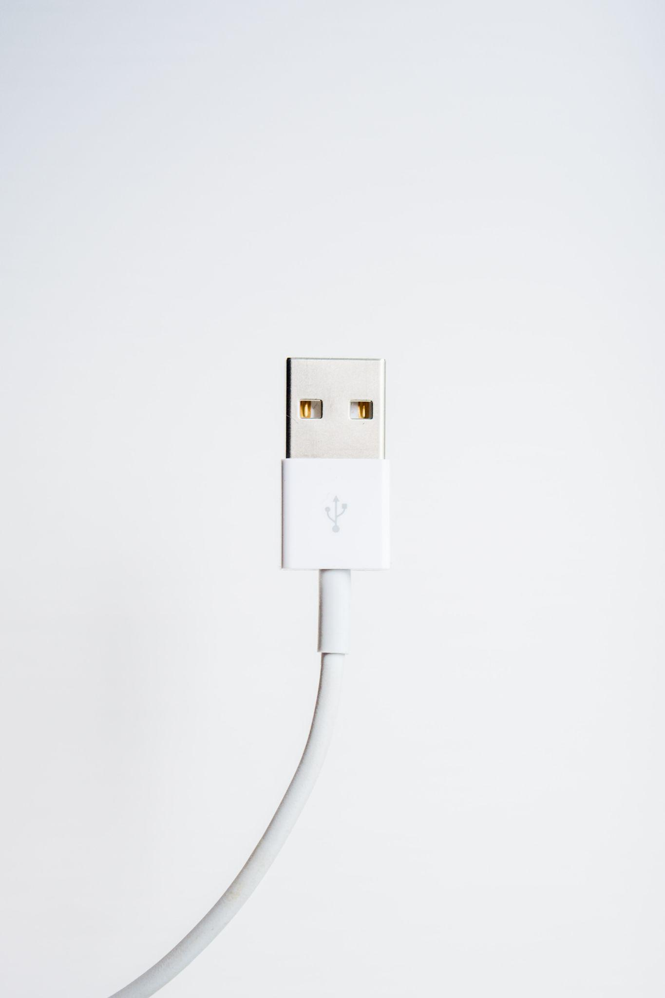



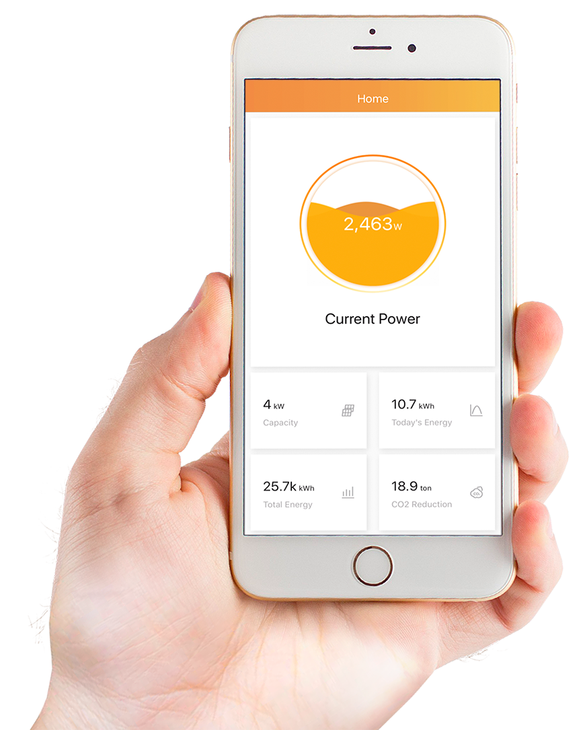
PLUG & PLAY DESIGN
IoT
Easy installation and maintenance
Remote control & assistance
Notes:
No need for local assistance

Slide 15
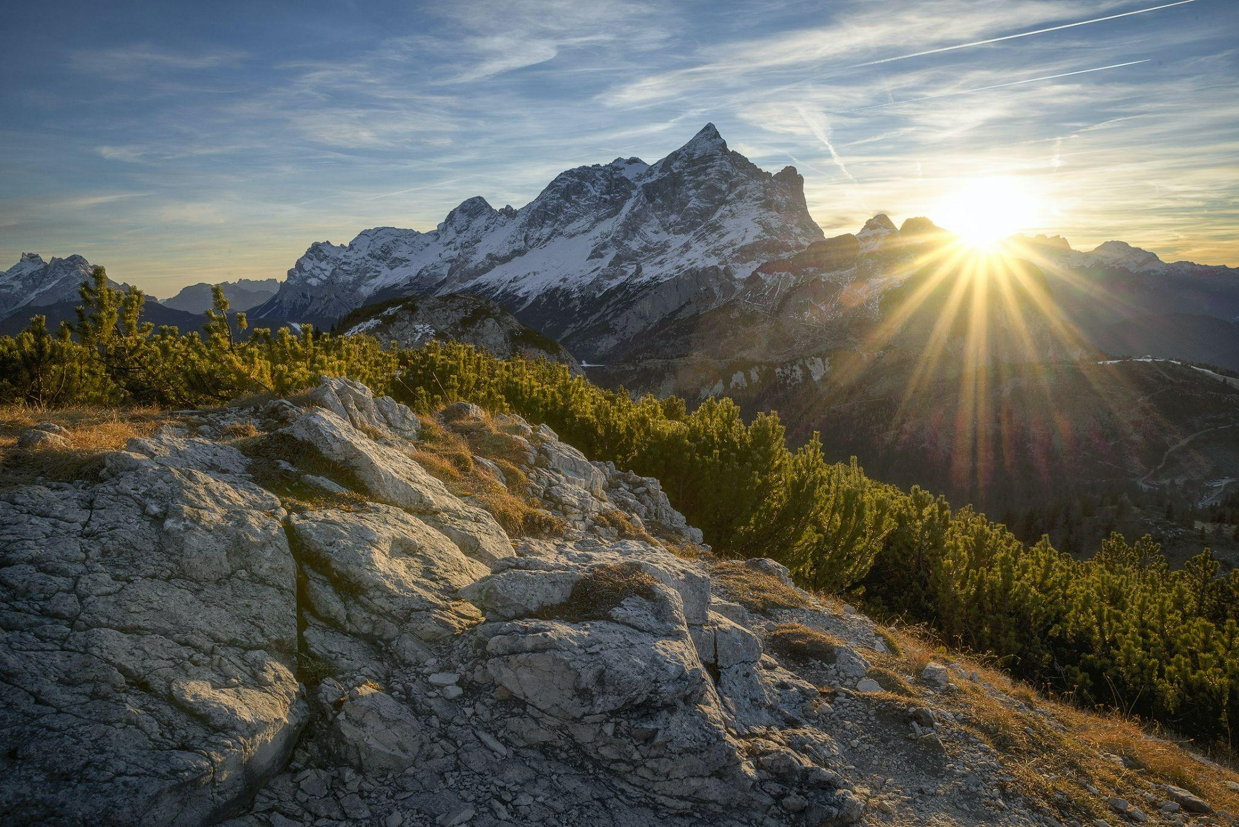
CREATING CLEAN ENERGY IS NOT ENOUGH
Notes:
Creating clean energy alone is not enough. We want to be responsible for the impact of the product we are creating.

Slide 16
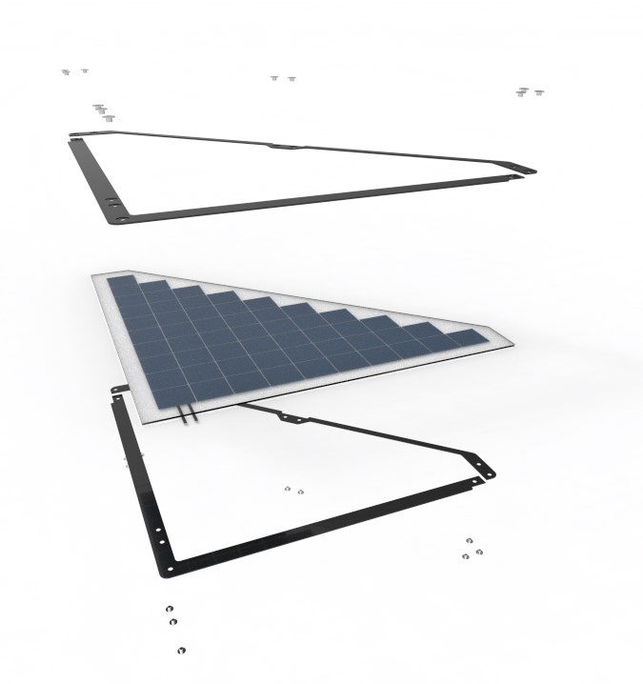
Circular model
DESIGN FOR DISASSEMBLY
Disassembly & refurbishment
Long lasting
Notes:
It is developed according to the principles of design for disassembly,
each for greater durability
regeneration of the panel at the end of its life

Slide 17
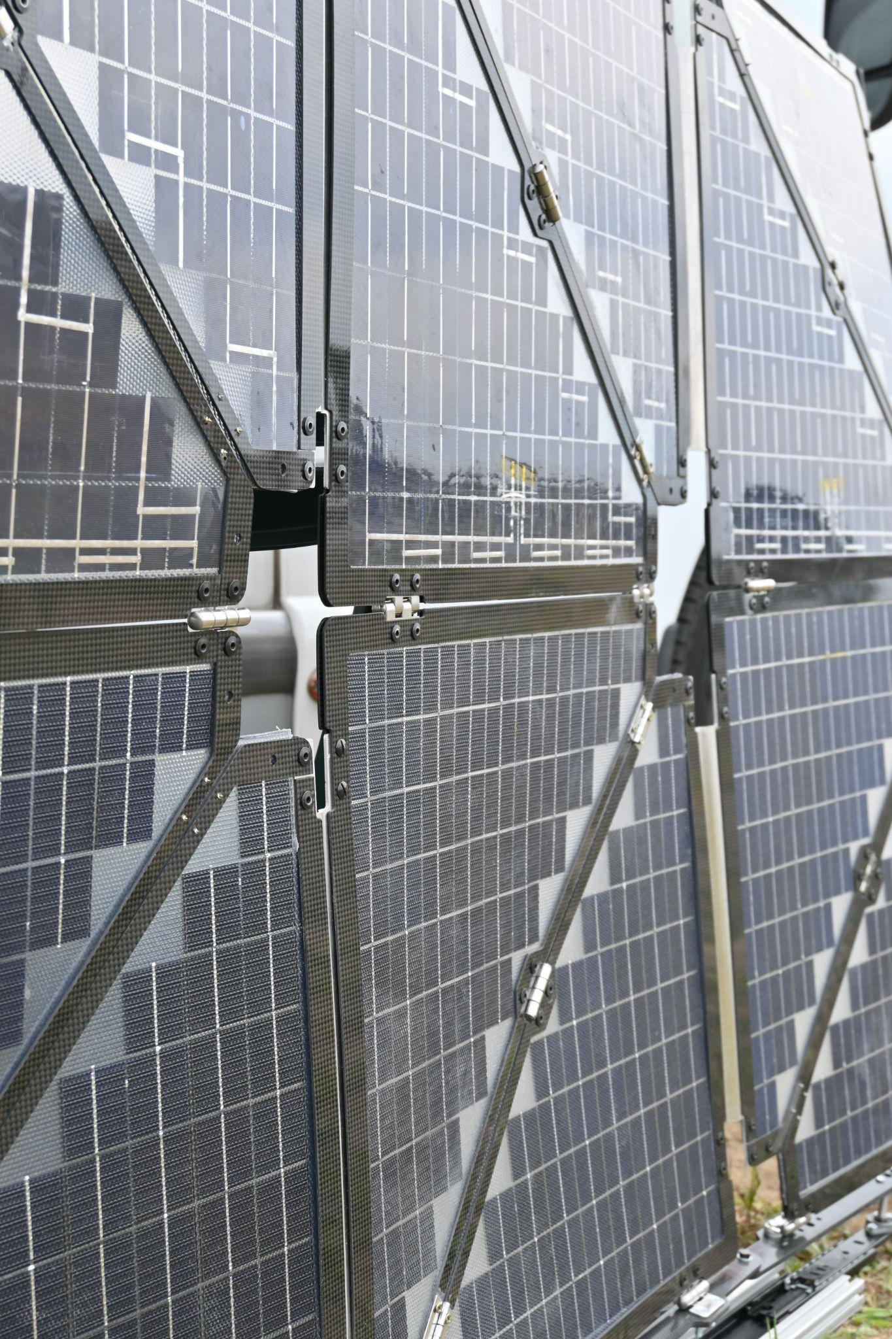

1st
in the market
30% RECYCLED MATERIALS
carbon fibre structure
RECOVER & REUSE 85% MATERIALS
Notes:
It is also produced with 30% RECYCLED MATERIALS FROM INDUSTRIAL WASTE thanks to the recycled carbon fiber thanks to our partner ACS.
At the end of the life of the panel we can recover and reuse 85% of the panel materials

Slide 18











COMPETITORS: SOLAR PANELS & GENERATORS
COMPACT & TRANSPORTABLE
ENERGY
EFFICIENCY & CONTINUITY
INEFFICIENCY
FIXED
Notes:
Our competitive advantage is the …
compared to other solar panels and generators
Compared to the market and competitors we are the first in the market that use recycled materials

Slide 19
BUSINESS MODEL
Sale & Rental of product + accessories
Basic IoT
Premium IoT, refurbishment, maintenance
in subscription
Notes:
Our business model consists
in the sale of the product

Slide 20
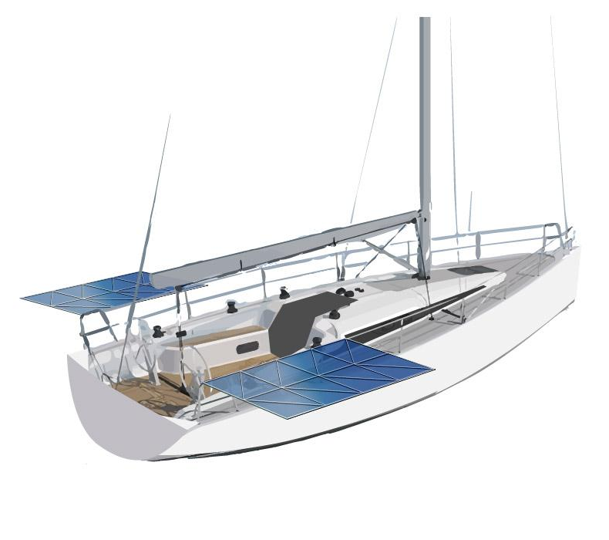
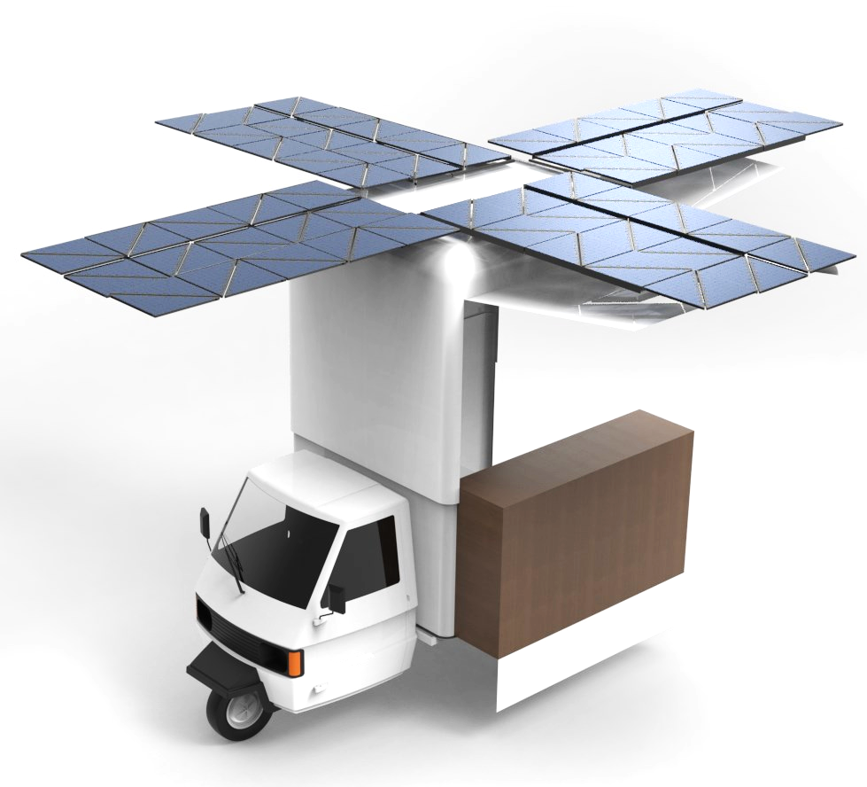
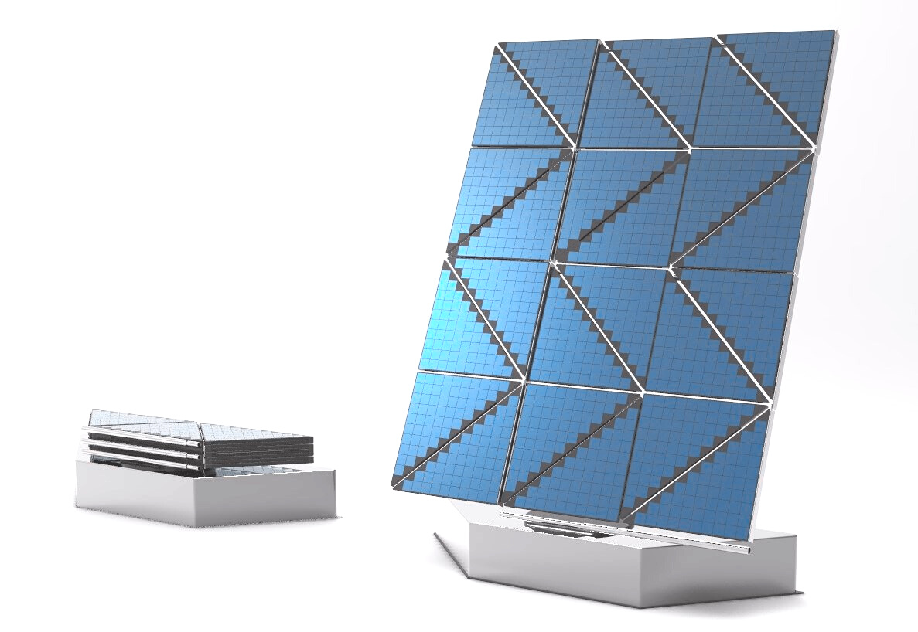
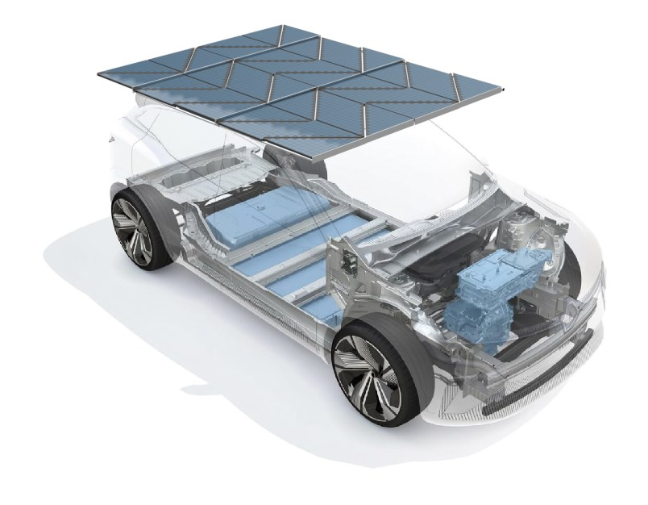
VERSATILITY OF USAGE
same product, customisable power
STAND ALONE UNIT ON A VEHICLE
WITH BATTERY
Notes:
STAND ALONE with battery included
ON A VEHICLE attached to the existing battery pack

Slide 21
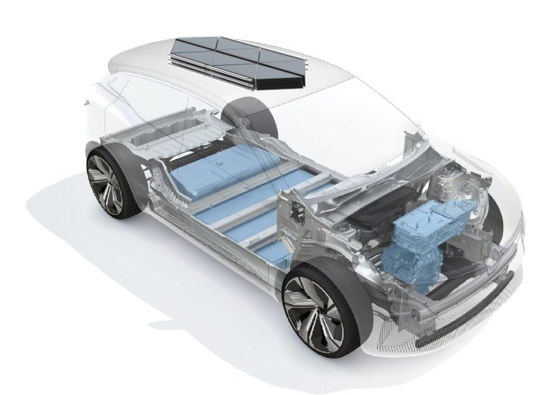
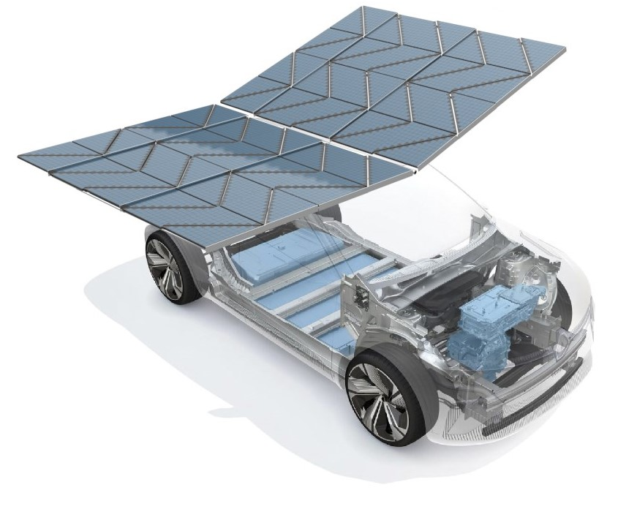
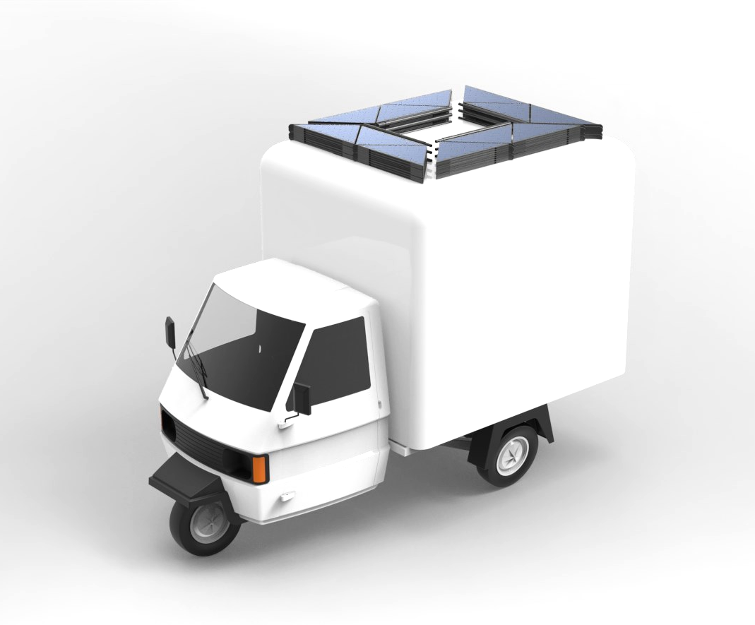
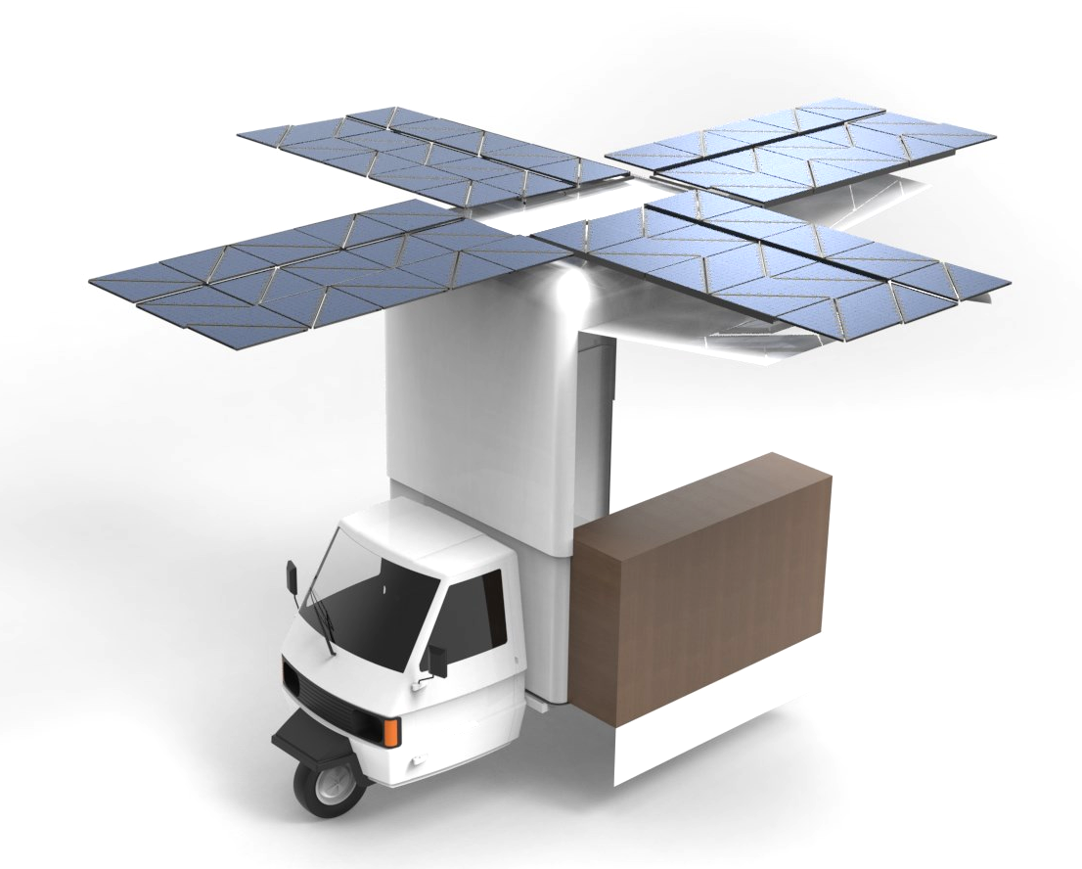

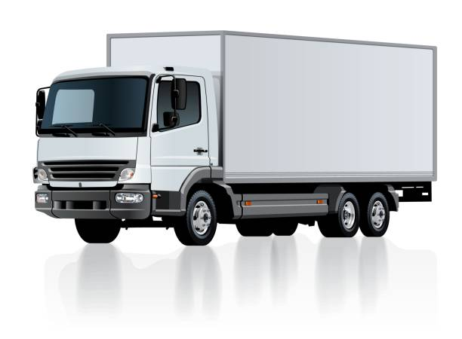
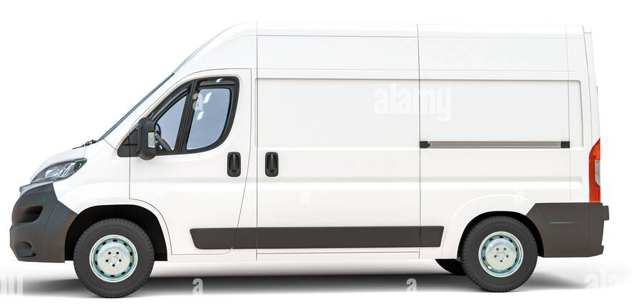
AUTOMOTIVE INDUSTRY
Charging station on the go
= less batteries needed
= less weight
= increased load capacity
= increased range
Notes:
High energy output even with small surface area

Slide 22
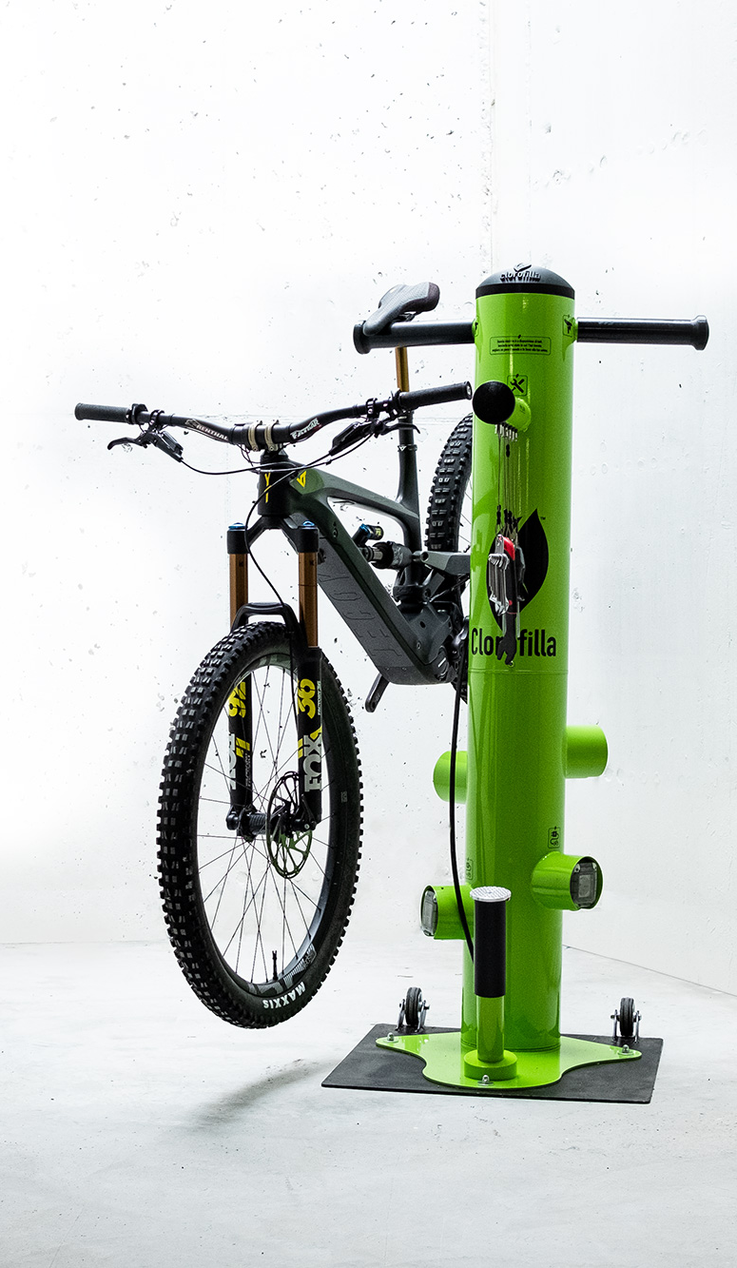
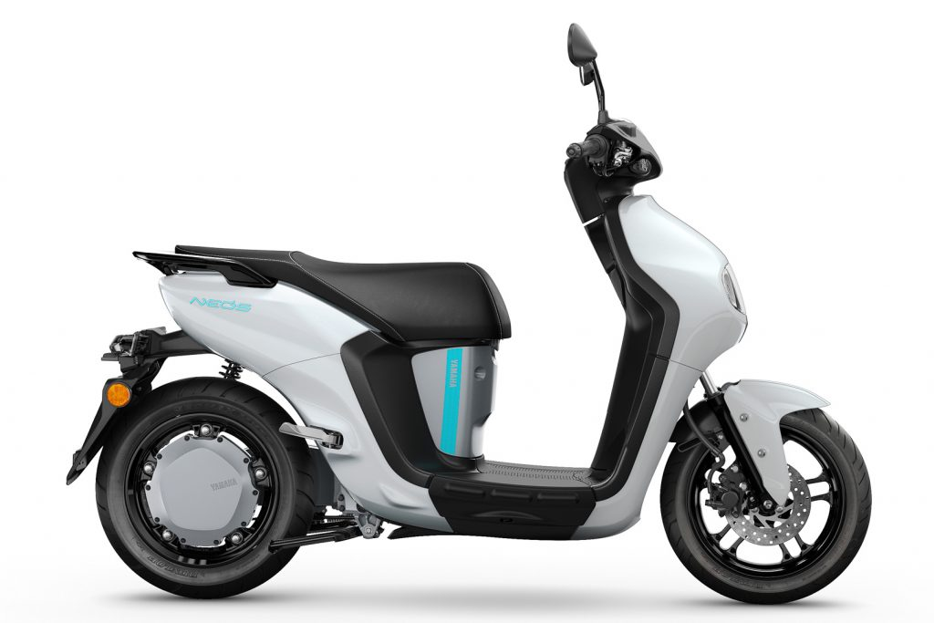
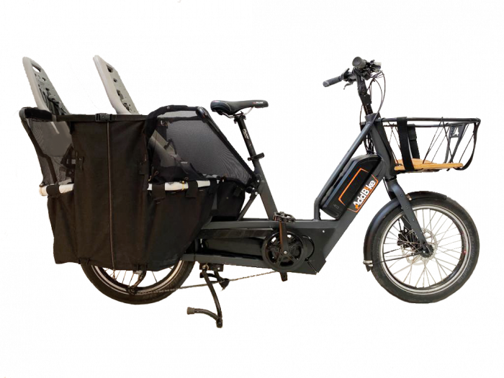
E-BIKE & SCOOTER INDUSTRY
Unlimited range while traveling
High energy output even with small surface area available
Notes:
the first markets we are penetrating are

Slide 23
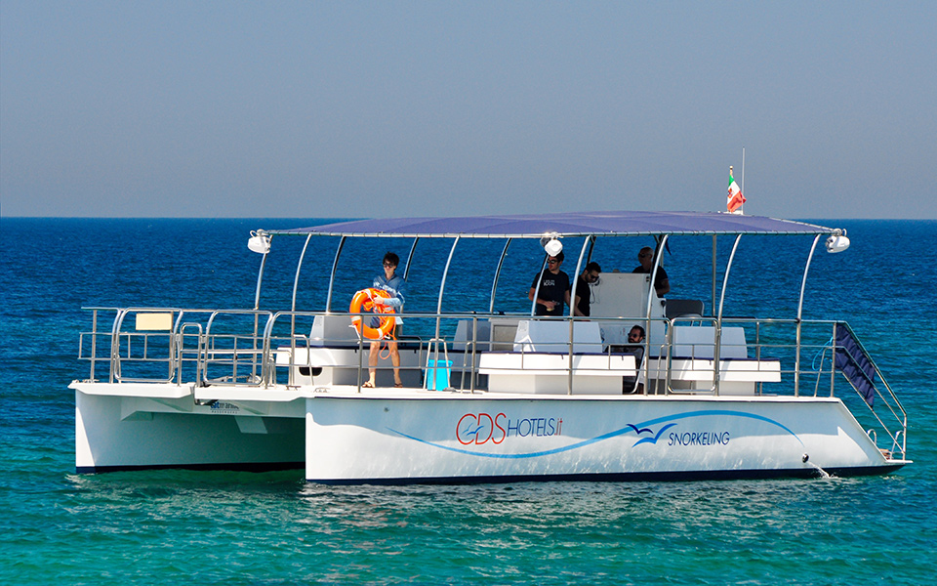


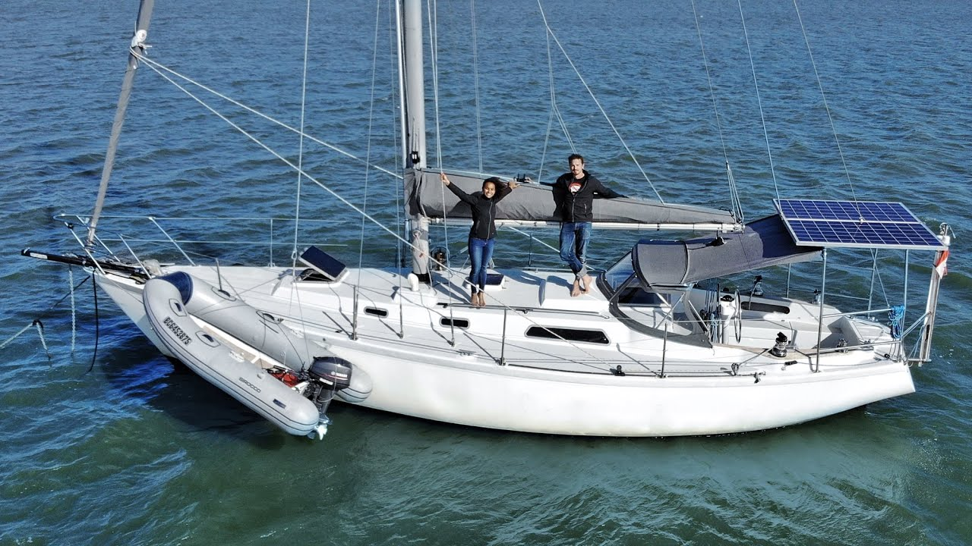

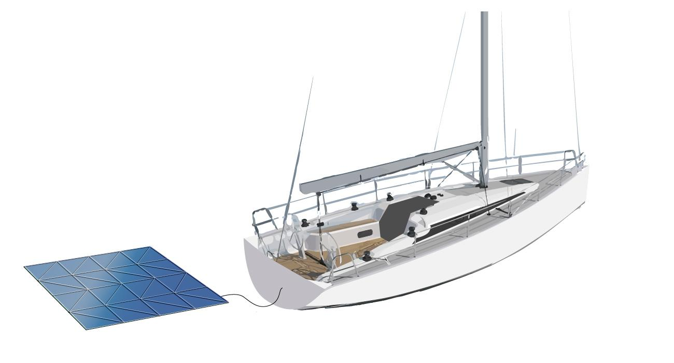
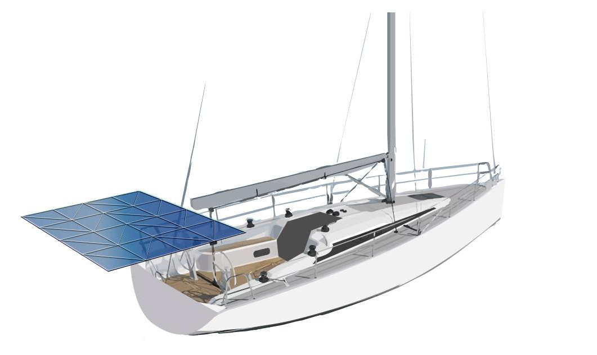
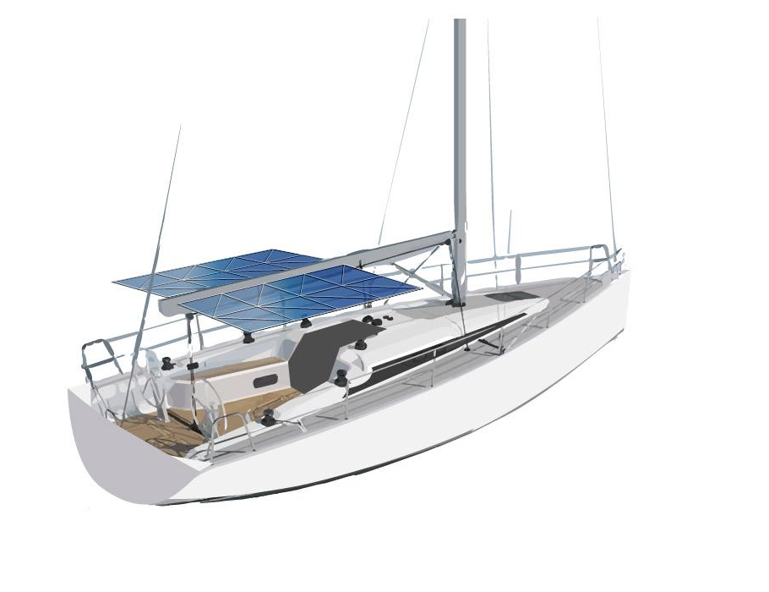
NAUTICAL INDUSTRY: BOATS & FERRIES
Replacing fuel generator
= no noise, smell, fuel
Clean, free, portable energy from the sun
Notes:
the first markets we are penetrating are

Slide 24
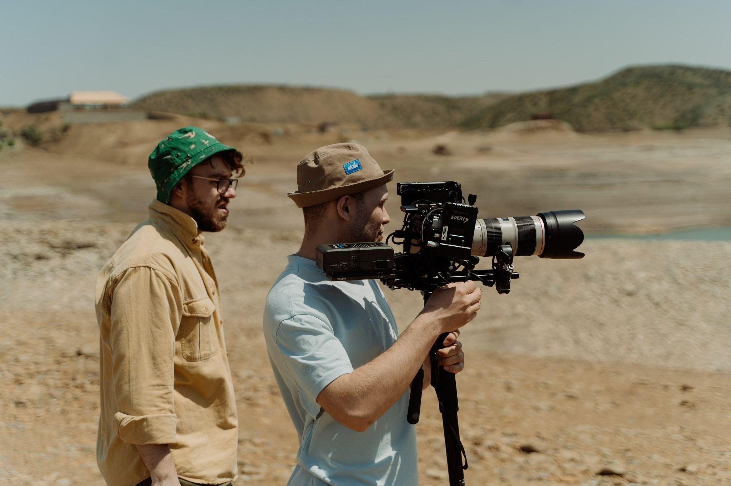


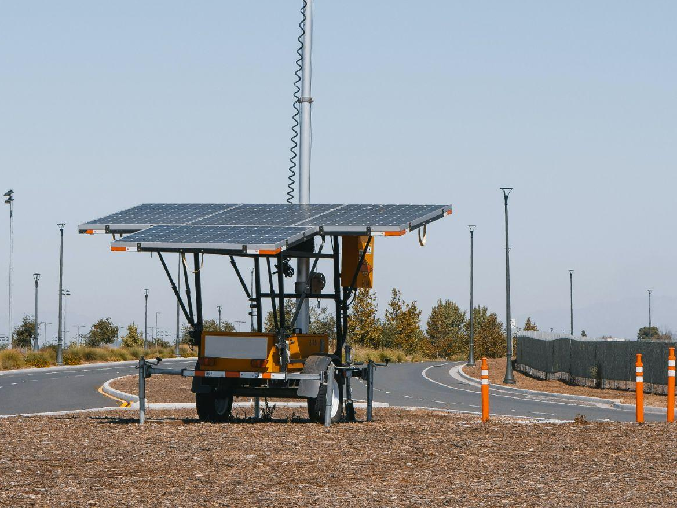
EVENTS INDUSTRY & MOBILE WORKING SITES
No CO2 emissions
Versatility of usage and portability
Notes:
the first markets we are penetrating are

Slide 25
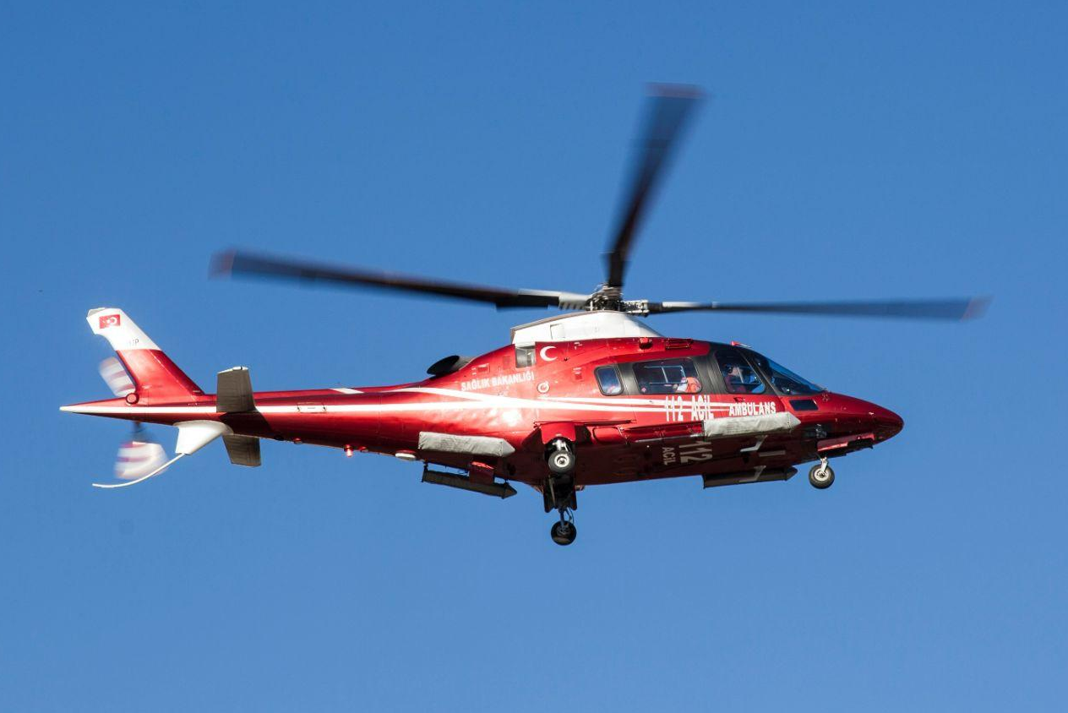
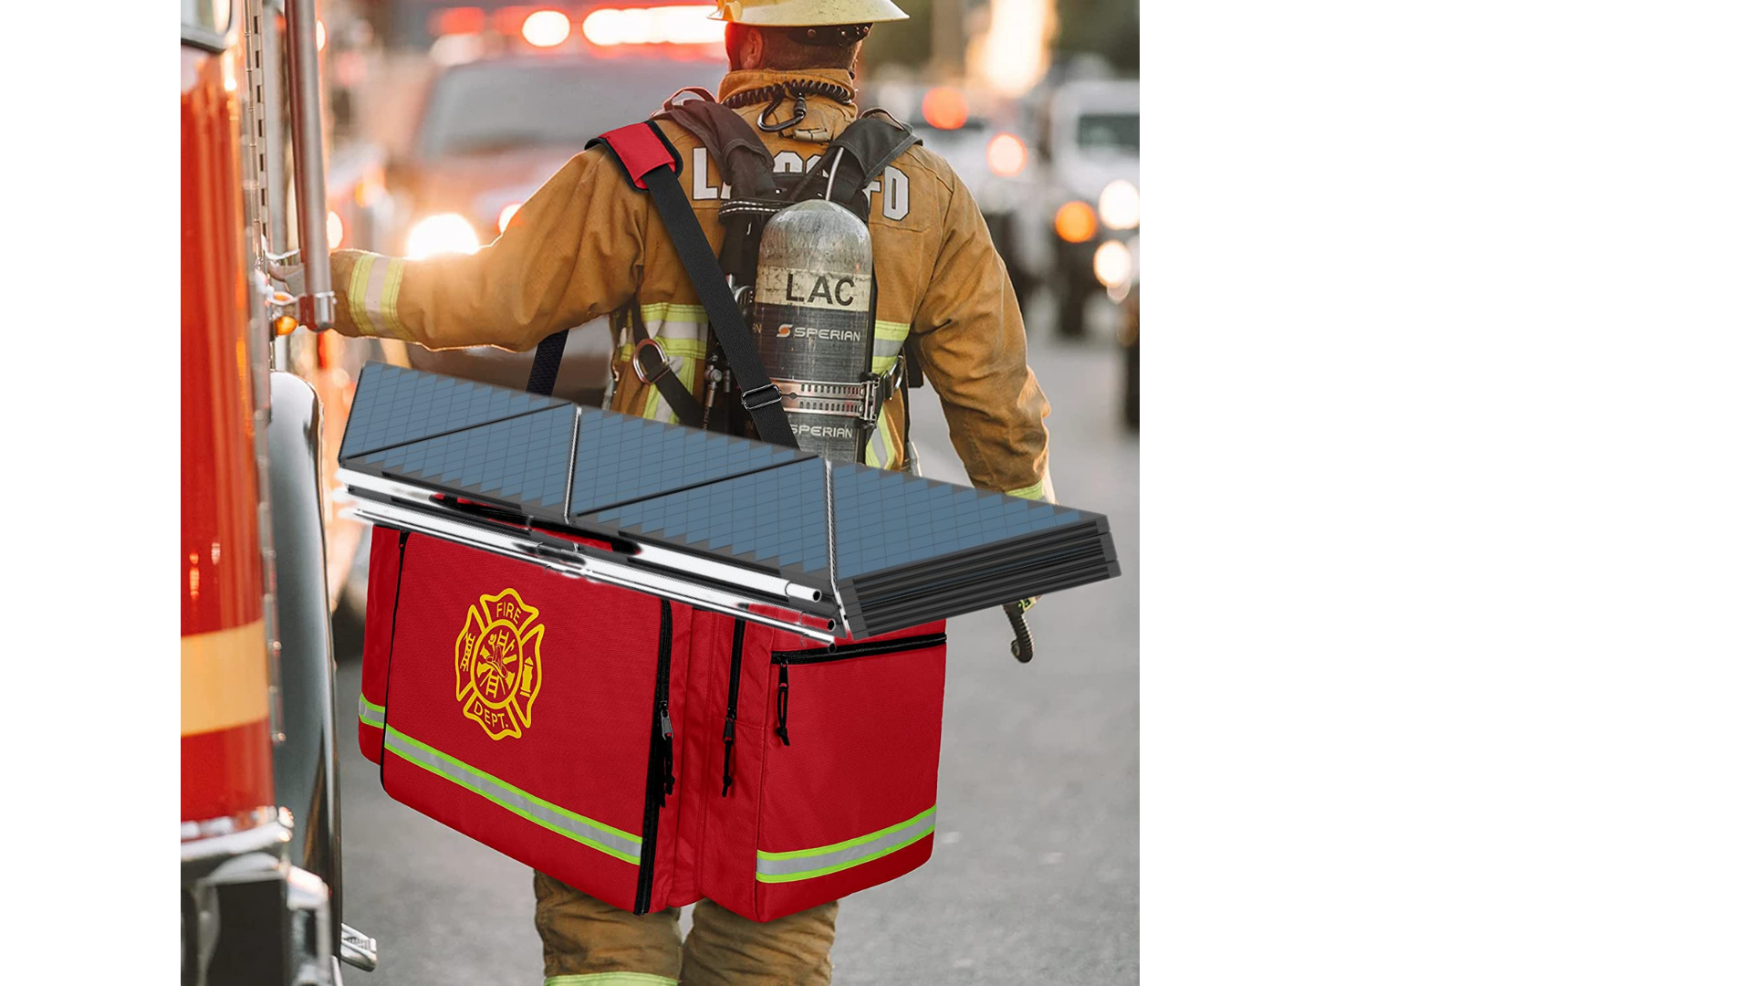
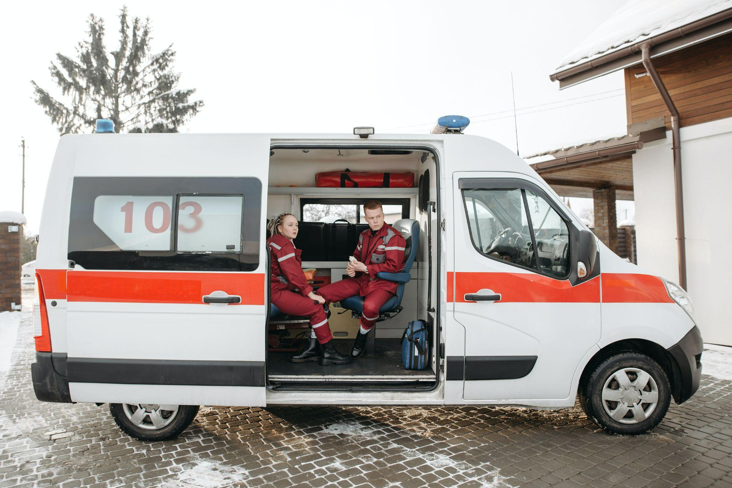


EMERGENCY RESCUE INDUSTRY
Ready to use product
Easy to use
Notes:
the first markets we are penetrating are

Slide 26

ROADMAP
2021 June 2022 November 2022 2023
PRODUCT
DELIVERY
& PRODUCTION OPTIMIZATION
LAUNCH
2.0 VERSION
PRE-SALE
PILOT PRODUCTION LINE
PILOT TESTS & PoC
PRODUCT DEVELOPMENT
& PROTOTYPE TEST
FOOD TRUCK
Notes:
PILOT TEST
PRESALE & PILOT PRODUCTION LINE

Slide 27






“BE THE CHANGE YOU WANT TO SEE IN THE WORLD”
-Gandhi
Thank You
sara.plaga@levante.eco
+39 3403213658
Levante.eco
Levante.eco
Levantedesign

Slide 28
Q&A

Slide 29
EXAMPLES OF CONFIGURATIONS
Customisable
Open |  |  | Closed |  | Weight* | N. of modules | Estimated target price*
Nominal power | Generated power | Size | Nominal power | Size
100W | 170W (+70%) | 0.5x1 m | 25W | 0.5x0.5 m | 2.5 kg | 4 | 460€
300W | 510W (+70%) | 1.6x1 m | 75W | 1.5x0.4 m | 7 kg | 12 | 1380€
600W | 1020W (+70%) | 1.6x2.1 m | 75W | 1.5x0.4 m | 14 kg | 24 | 2760€
750W | 1300W (+70%) | 1.6x2.6 m | 75W | 1.5x0.4 m | 18 kg | 30 | 3680€
1000W | 1700W (+70%) | 2.6x2.1 m | 100W | 2.2 x 0.4 m | 24 kg | 40 | 4600€
1250W | 2100W (+70%) | 2.6x2.6 m | 100W | 2.2x0.4 m | 30 kg | 50 | 5520€
*battery excluded

Slide 30

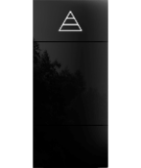


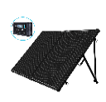



 | Smart recycled deployable solar panel | 3D energy machines | Sculptural solar flower | Flexible solar panels | Foldable solar panel suitcases | Portable generators | Portable generators | Wind generator | Portable fuel cell generator
Product
Transportable | ✔ | ✖ | ✖ | ✔ | ✔ | ✔ | ✔ | ✖ | ✔
Modular and autonomous | ✔ | ✖ | ✖ | ✔ | ✔ | ✖ | ✖ | ✖ | ✖
Ready to use plug & play | ✔ | ✔ | ✔ | ✔ | ✔ | ✔ | ✖ | ✖ | ✔
Deployable or foldable | ✔ | ✖ | ✔ | ✖ | ✔ | ✖ | ✖ | ✖ | ✖
Stand alone unit (not depending on a surface) | ✔ | ✔ | ✔ | ✖ | ✔ | ✔ | ✖ | ✖ | ✔
Smart system & IOT | ✔ | ✔ | ✔ | ✖ | ✔ | ✖ | ✖ | ✖ | ✔
Recycled components & refurbishable | ✔ | ✖ | ✖ | ✖ | ✖ | ✖ | ✖ | ✖ | ✖
Integrated battery | ✔ | ✔ | ✔ | ✖ | ✔ | ✖ | ✖ | ✖ | ✖
Made in Italy | ✔ | ✔ | ✖ | ✔ | ✖ | ✖ | ✖ | ✖ | ✖
Price/Watt | Target price: 4.6€/W | 4.6€/W (Monolite 760W) | 4,8€/W | 5.0€/W (ALLinOne 112W) | 2.5€/W (Solar suitcase 200W) | 0.9 € /w (EU 20i 2kW + fuel) | 1.8€/W (TEC29 2,6kW+ fuel) | 3€ /W | 47€/W (Mod. 140i 72W + fuel)
Price for generated power (due to +70% efficiency) | 2.35€/W | = | 3.5€/W | = | = | = | = | = | =

Slide 31
STAND ALONE UNIT with battery
example of configuration, customisable in size and power
Est. price 2.760€
Return on investment in approx. 2 years used 100 days a year
1.6m
2.1 m
40 cm
1.5 m
Closed position Open position
Power: 75W Nominal power 600W, generated power 1020W
Weight: 14 kg (battery excluded)

Slide 32
FOOD TRUCK CONFIGURATION
example of configuration, customisable in size and power
Est. price 13.800€
Return on investment in approx. 1.5 year
1.3 m
1.3m
2.5 m
1.6m
6 cm
Closed position Open position
Power: 300W Nominal power 3000W, generated power 5100W
Weight: 70 kg
Attacked to the vehicle battery pack. Included: solar charge controller, solar tracking, IoT technology, remote maintenance & assistance

Slide 33
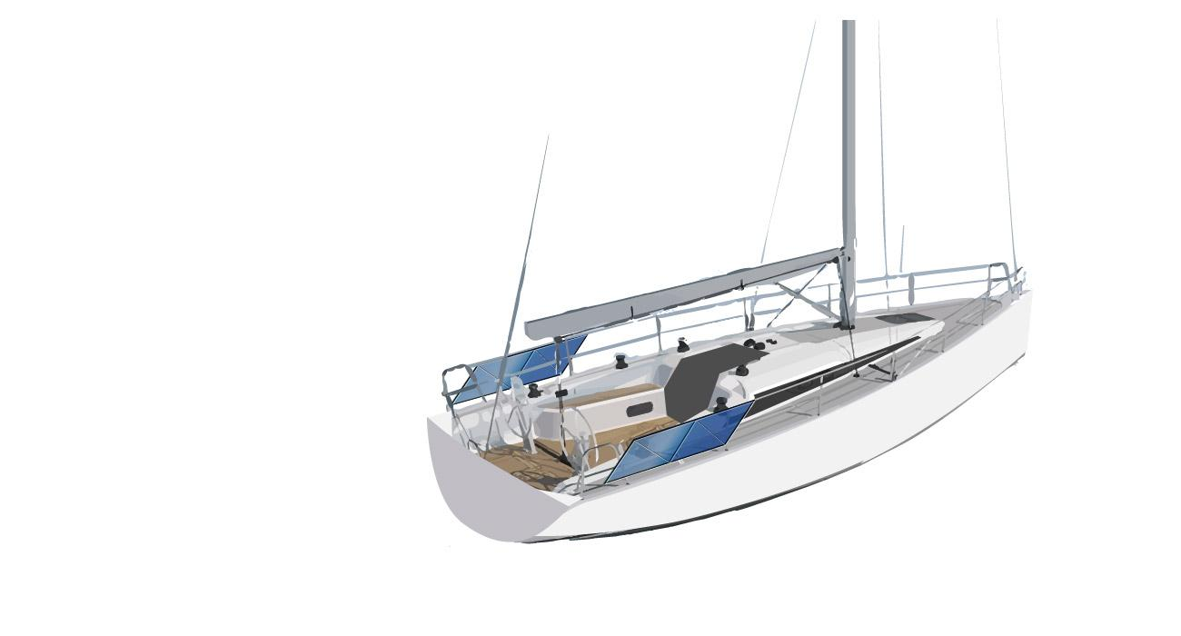
SAILBOAT CONFIGURATION
example of configuration, customisable in size and power
Est. price 3.680€
Return on investment in approx. 2 years based on a 60 day usage a year
Closed position Open position
Power: 200W Nominal power 800W, generated power 1360W
Weight: 20 kg
Attacked to the vehicle battery pack. Included: solar charge controller, solar tracking, IoT technology, remote maintenance & assistance

Slide 34
CAR CONFIGURATION
example of configuration, customisable in size and power
3m
4m
30cm
1.8m
2m
3m
Closed position est. power: 200W est. dimensions: 1.8m x 30+30cm 10 modules of 20W (45cm x 45cm) | Open position 1 est. power: 800W est. dimensions: 2m x 3m 40 modules of 20W (45cm x 45cm) | Open position 2 est. power: 1600W est. dimensions: 4m x 3m 80 modules of 20W (45cm x 45cm)

Slide 35
Increased range
on a medium size electric car (Tesla model 3 or similar)
Closed position while moving
+13% in increased range equals to 78 km
Open position 1 while stationary
+24 added km each hour of charge
Fully charged in 26 hours
Open position 2 while stationary
+48 added km each hour of charge
Fully charged in 13 hours
Notes:
In a car while driving you have 13% increased range
When you stop it will take you 13 hours to fully charge your batteries from empty, which means 48 km for each hour of charge

Slide 36







PARTNERS

Slide 37

FOOD TRUCK MARKET
€ 335 million
€ 120 million
€ 9.7 million
TAM
Total addressable market
US and Western Europe food trucks
SAM
Serviceable available market
Western Europe
food trucks
SOM
Serviceable obtainable market
16% (Early adopters) of the 50% SAM
6.8% CAGR

Slide 38

NAUTICAL MARKET
€ 1.5 billion
€ 390 million
€ 31 million
TAM
Total addressable market
500k global recreational sailing boats
SAM
Serviceable available market
Recreational sailing boats in Europe, 75% of which wants renewable energy.
SOM
Serviceable obtainable market
16% (Early adopters)
of the 50% SAM
4% CAGR marine solar power market
6.2% CAGR recreational boat market
Notes:
The nautical segment has an estimated value of 1.5 billion € globally.

Slide 39

NGOs MARKET
€ 18 billion
€ 800 million
€ 21 million
TAM
Total addressable market
Nigeria off-grid 85 million people Global 700 refugee camps
SAM
Serviceable available market
2% Nigeria off-grid people
Southern Europe refugee camps
SOM
Serviceable obtainable market
5 villages in Nigeria
7 refugee camps
5.2% CAGR

