Slide 1
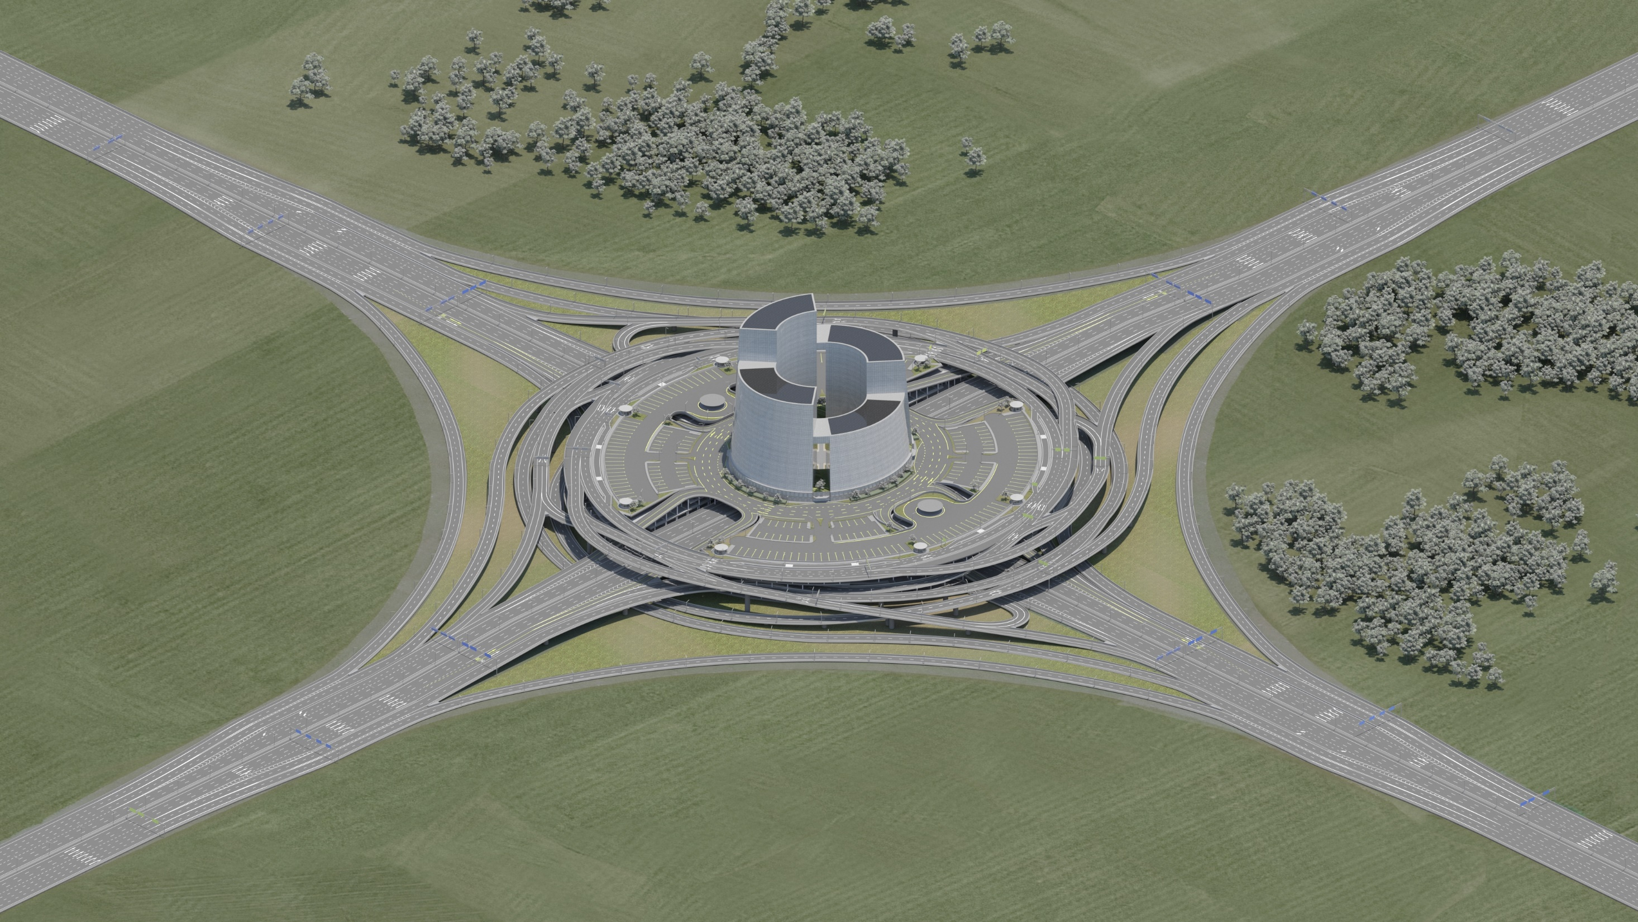



RoadHub
Redesigning The Way We Commute
How Patented Interchanges with Park & Ride Systems Can Decongest Cities
Hagai Gat | CEO | hello@roadhub.design
Notes:
- Add a background image about your product, and replace the logo with your own. - Make sure that the tagline is 5-7 words and is enough to roughly understand what your company does.

Slide 2
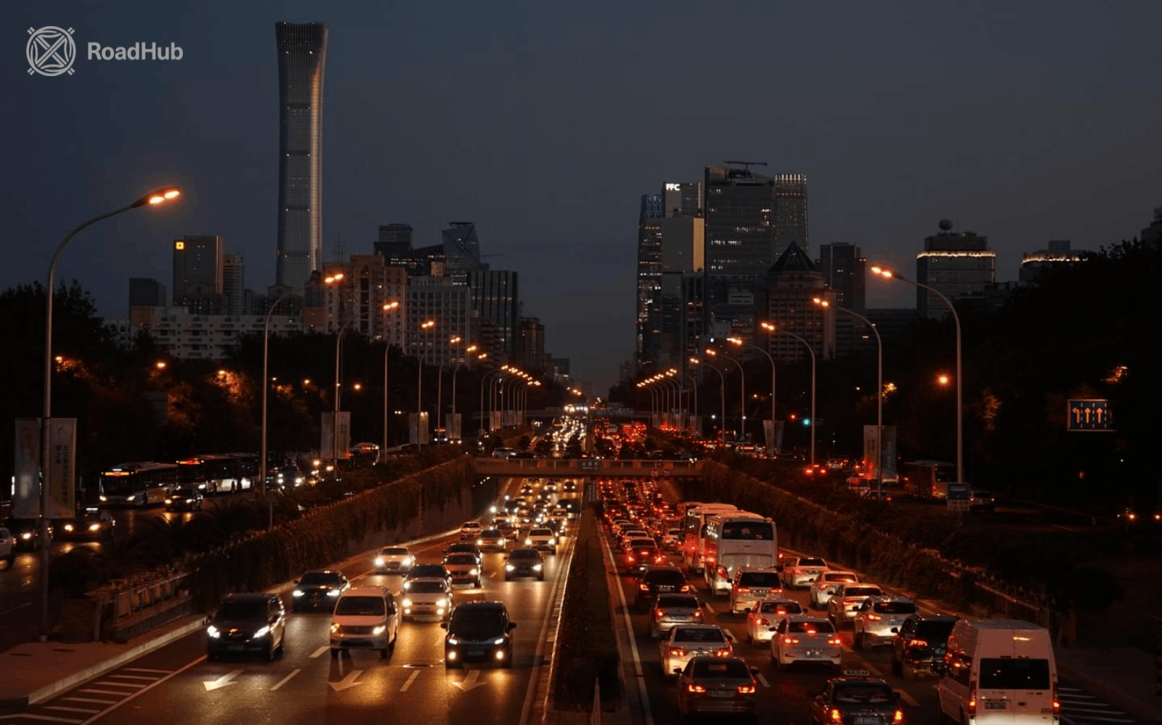


The Challenges
1. Unstable infrastructure budgets
2. Land shortage
3. Road congestion
4. Parking hunting
5. Pollution and energy loss
6. Human stress
7. Economic loss
Notes:
Describe the pain you're alleviating or the pleasure you're providing.

Slide 3



RoadHub's Solution Package
A glimpse of our scope of solutions
Spiral Ring Interchange
(SRI)
Complete Park & Ride System (CPRS)
Urban Services Hub
A patented, innovative design geometry with a spiral construction that provides minimal land footprint and maximal vehicle flow
A patented, innovative, efficient and user-friendly facility that combines parking areas, public transportation, an urban services hub, and safe pedestrian accessibility
Urban services such as logistical and industrial centers can benefit from strategic positioning at urban highway interchanges
Notes:
Explain the value of the pain you alleviate or the value of the pleasure you provide.

Slide 4
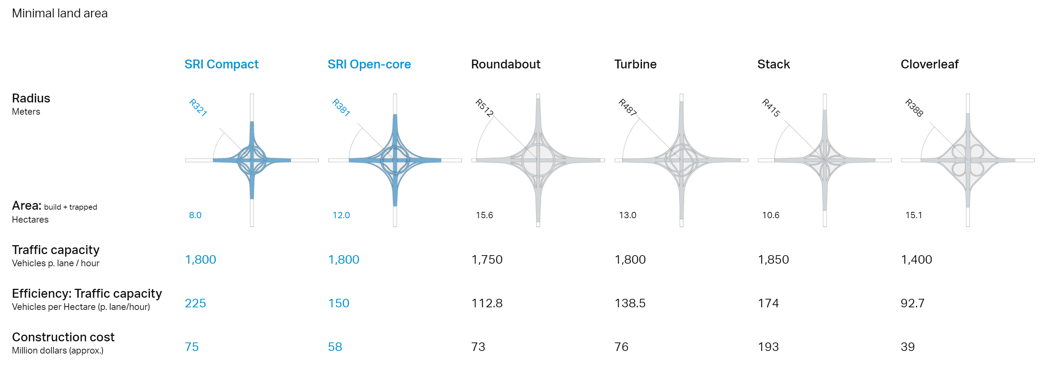
RoadHub vs. Conventional Designs
Benchmark: Minimal Land Use
SRI Compact enables a complete system interchange to be built in tight urban spaces previously considered fit only for road junctions.
SRI Open-core transforms the trapped spaces within highway interchanges into accessible land for strategic uses. In combination with CPRS, it can contain a transportation and urban services hub.
Notes:
Explain the value of the pain you alleviate or the value of the pleasure you provide.

Slide 5
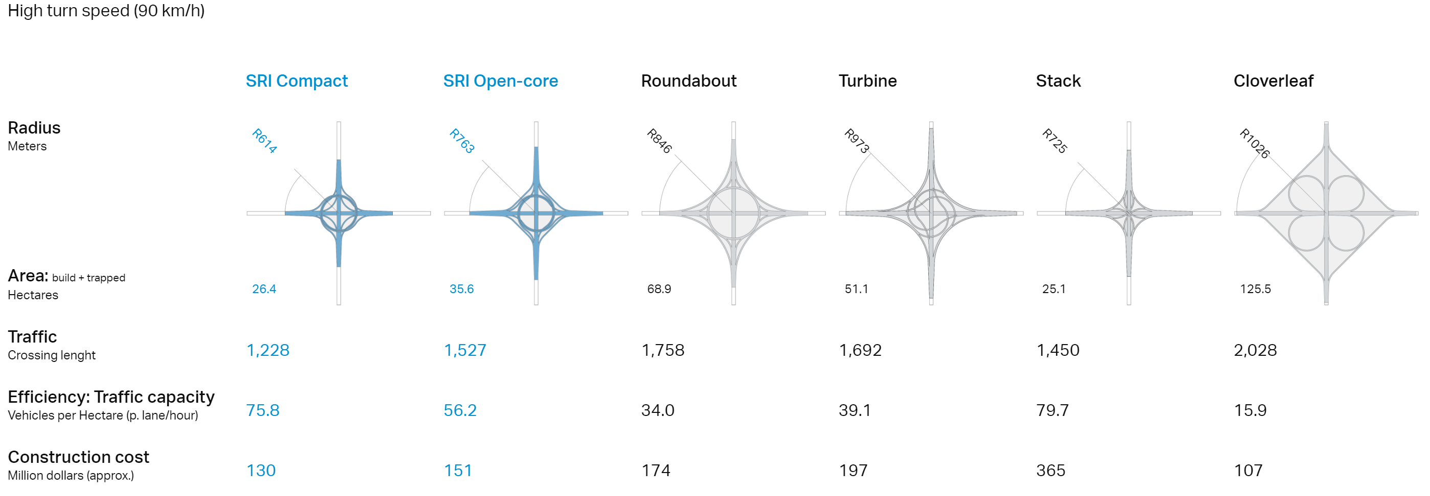
RoadHub vs. Conventional Designs
Benchmark: High Speed (90 km/h)
SRI Compact enables a complete system interchange to be built in tight urban spaces previously considered fit only for road junctions.
SRI Open-core transforms the trapped spaces within highway interchanges into accessible land for strategic uses. In combination with CPRS, it can contain a transportation and urban services hub.
Notes:
Explain the value of the pain you alleviate or the value of the pleasure you provide.

Slide 6


Underlying The Magic
As the geometry of interchanges stagnated for decades, we redesigned it with a new geometry that allows many more land-use options
Our design reduces the interchange’s footprint while allowing more cars to pass through it, as well as reducing car traffic into the city and supporting public transport
Notes:
Describe the technology, secret sauce or magic behind your product. The less text and the more diagrams or schematics, the better. If you have a prototype or demo, this is the time to transition to it.

Slide 7

Business Model
Partnering with loc﻿al planning firms and project developers
Collaborating with municipalities and public entities
Notes:
Explain who has your money temporarily in their pockets and how you're going to get it into yours.

Slide 8
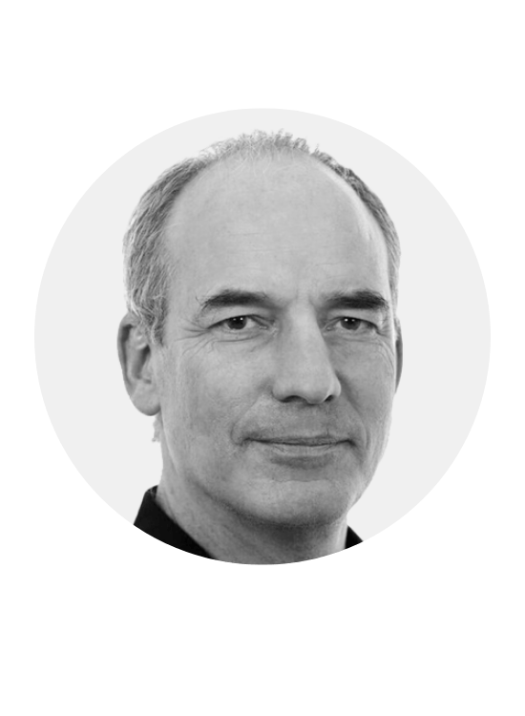



Management Team
Co-Founder & CTO: Gilead Meroz
Co-Founder & COO : Yaron Toren
CEO: Hagai Gat
Notes:
Add more team members if necessary. Try not to exceed 4 per slide.

Slide 9
RoadHub for Washington DC
Our first examination was of the 33 interchanges on Capital Beltway 495.
We found about 12 that are very suitable for the construction of the SRI interchange and the CPRS complex. In these cases, the upgrade would improve the interchange along all parameters (turning speed, parking, public transportation, real estate option).
We then checked the three civilian airports (Marshall, Dulles and Reagan).
Airports always have a huge potential, because of the need for accessibility, the need for parking, and the need for logistical centers.
Marshall Airport is relevant, with four suitable interchanges.
The most suitable is the 195/925 interchange, with the continuation of the Marc-Penn metro line and its nearby station.
Notes:
Explain the value of the pain you alleviate or the value of the pleasure you provide.

Slide 10
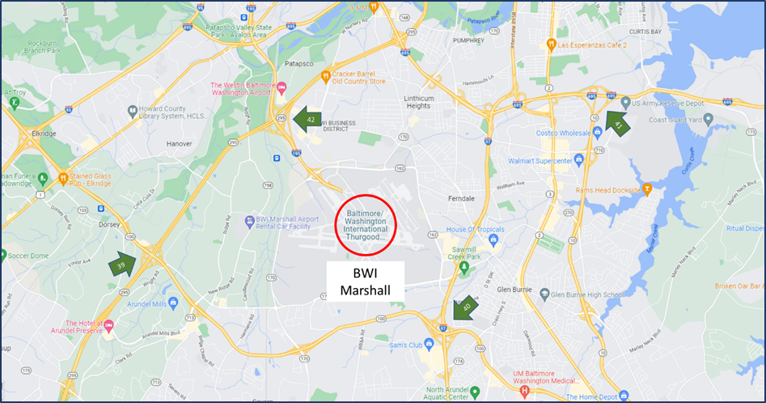
BWI Marshall Airport area: The 195/295 interchange
(the best of 4 relevant interchanges) and the Marc-Penn train line

Slide 11
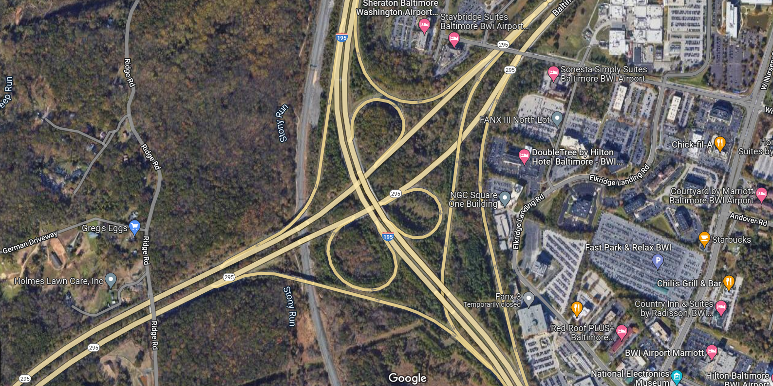
The 195/295 interchange (enlarged)
and the Marc-Penn train line (station to the South)
Train line
BWI Thurgood Marshall Marc Station

Slide 12
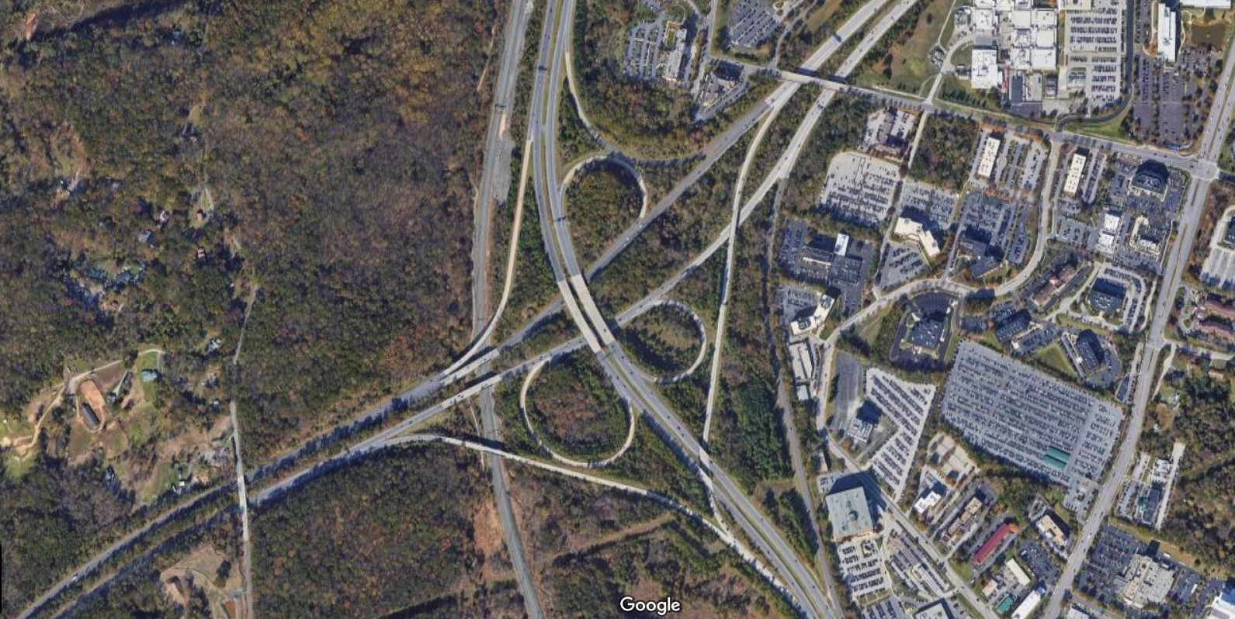
Aerial view

Slide 13
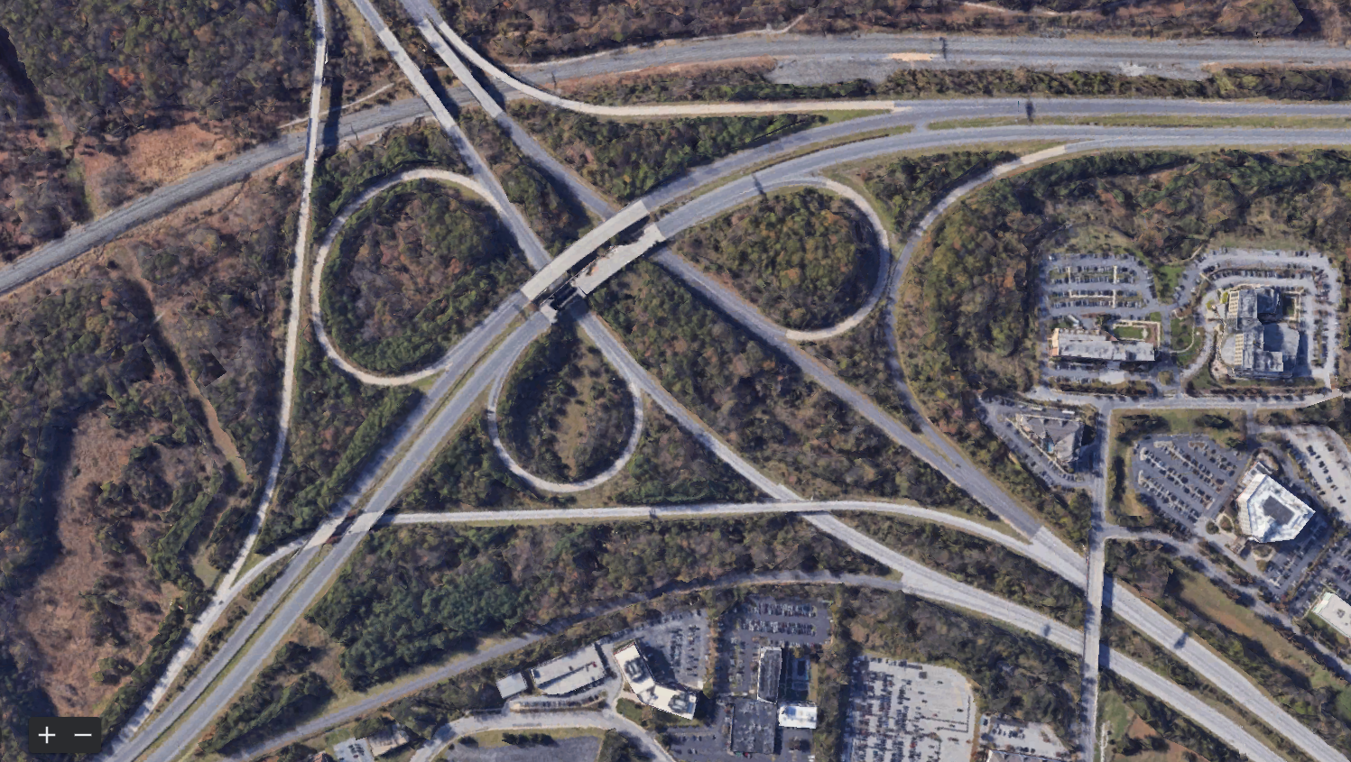
Enlarged aerial view, turned 90 deg. clockwise

Slide 14
New highway section =
Cancelled left turns
and highway section =

Slide 15
Right turns (same) =
New left turns =

Slide 16
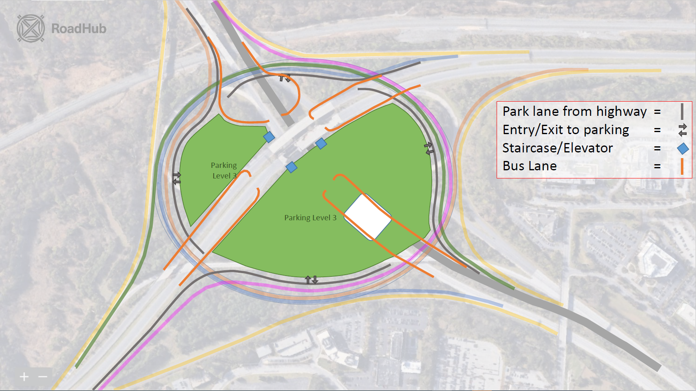
Parking Level 1
Parking
Level 1
Parking Level 1

Slide 17
Parking Level 2
Park lane from highway =
Entry/exit to parking =
Staircase/elevator =
Bus lane =
Parking
Level 2
Parking Level 2

Slide 19
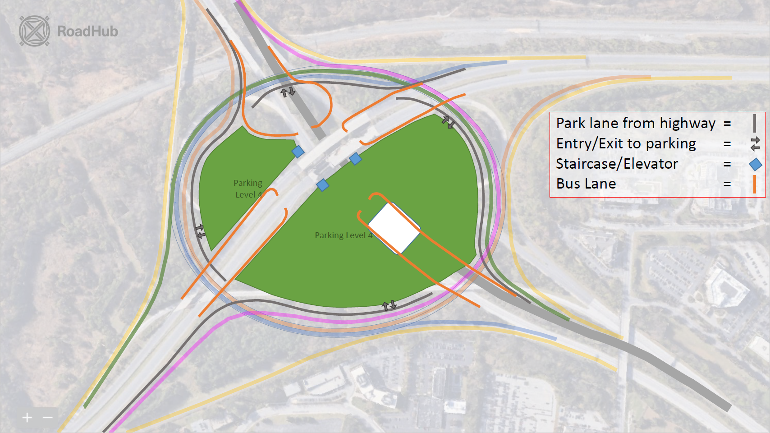

Slide 20
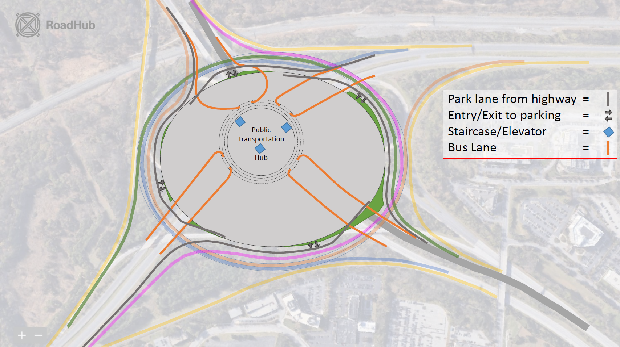

Slide 21
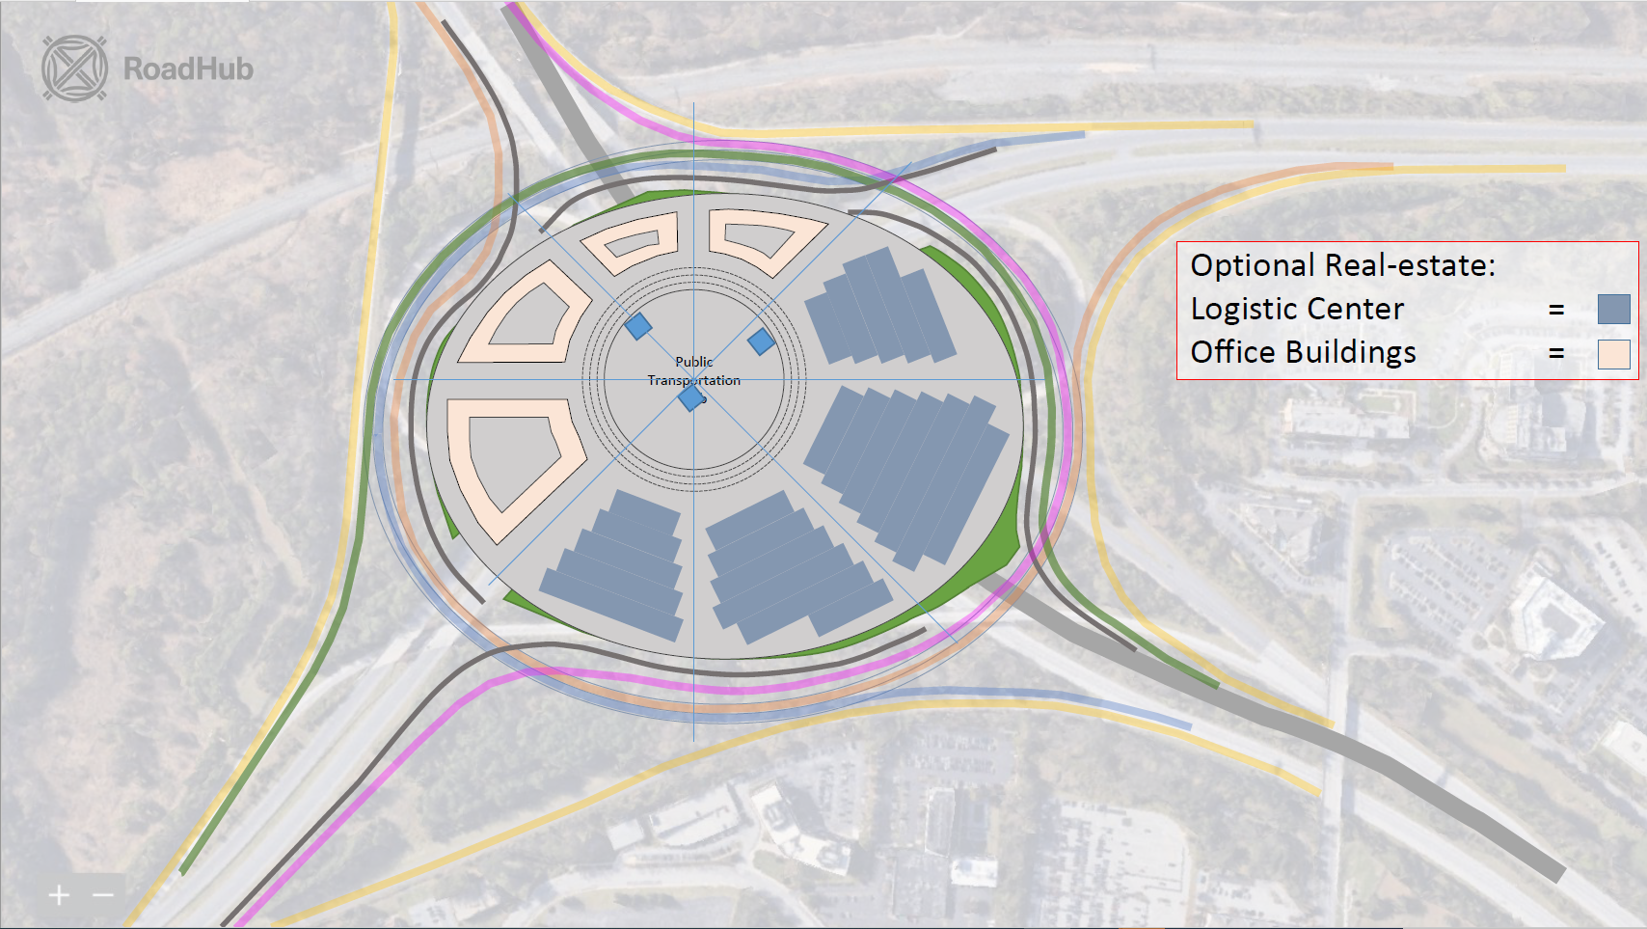

Slide 22
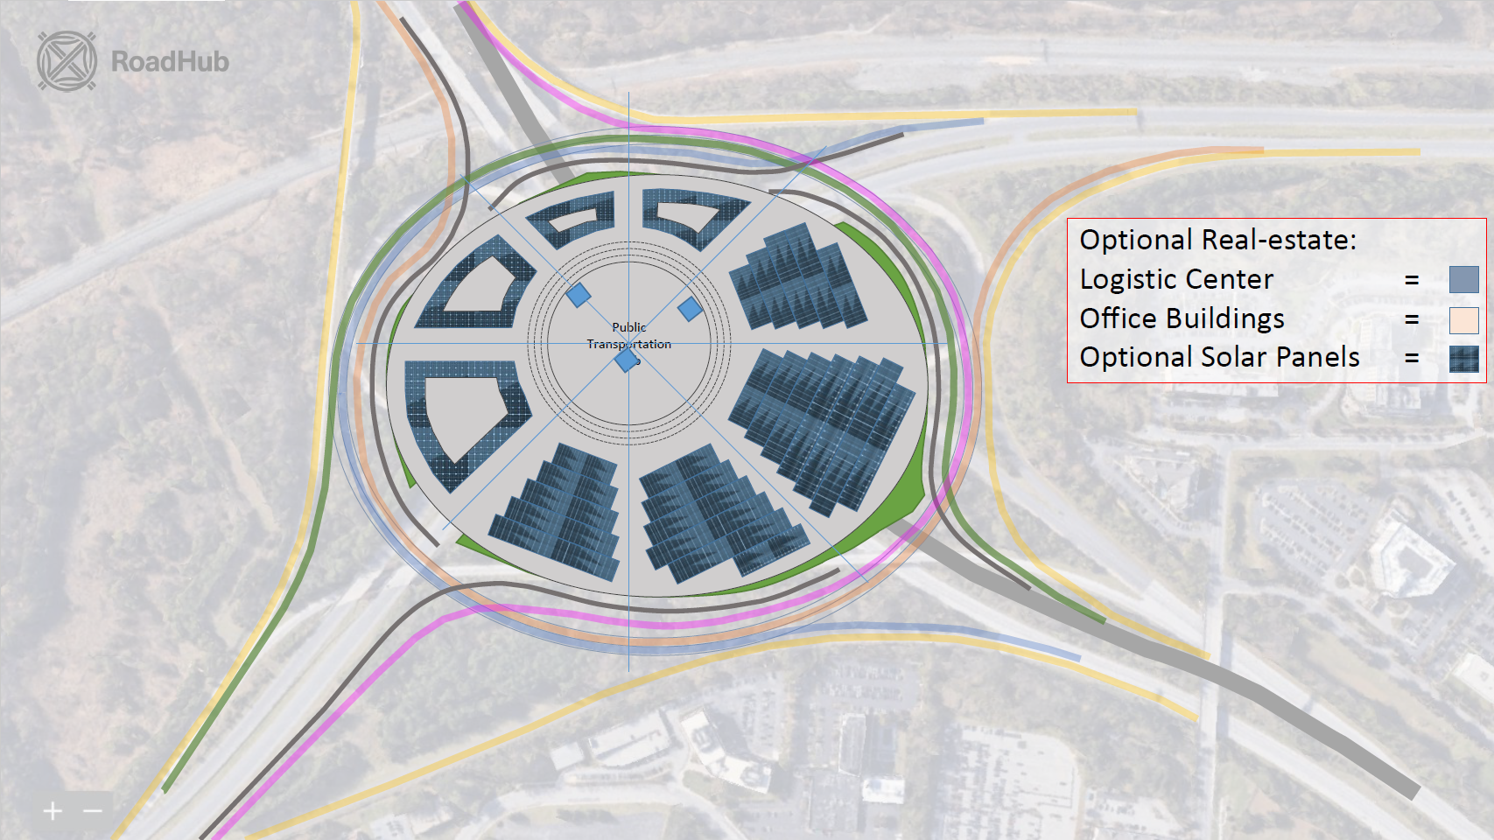

Slide 23


Let's build together!
Video:
https://youtu.be/SYUl2o8fdYA
Website:
https://roadhub.design/
Contact:
hello@roadhub.design
Notes:
Explain the current status of your product , what near future looks like and how you'll use the money you're trying to raise.

