Slide 1


Zero-Emission Bus Simulator
Accelerating the transition to sustainable public transportation with simulation software solutions.

Slide 2
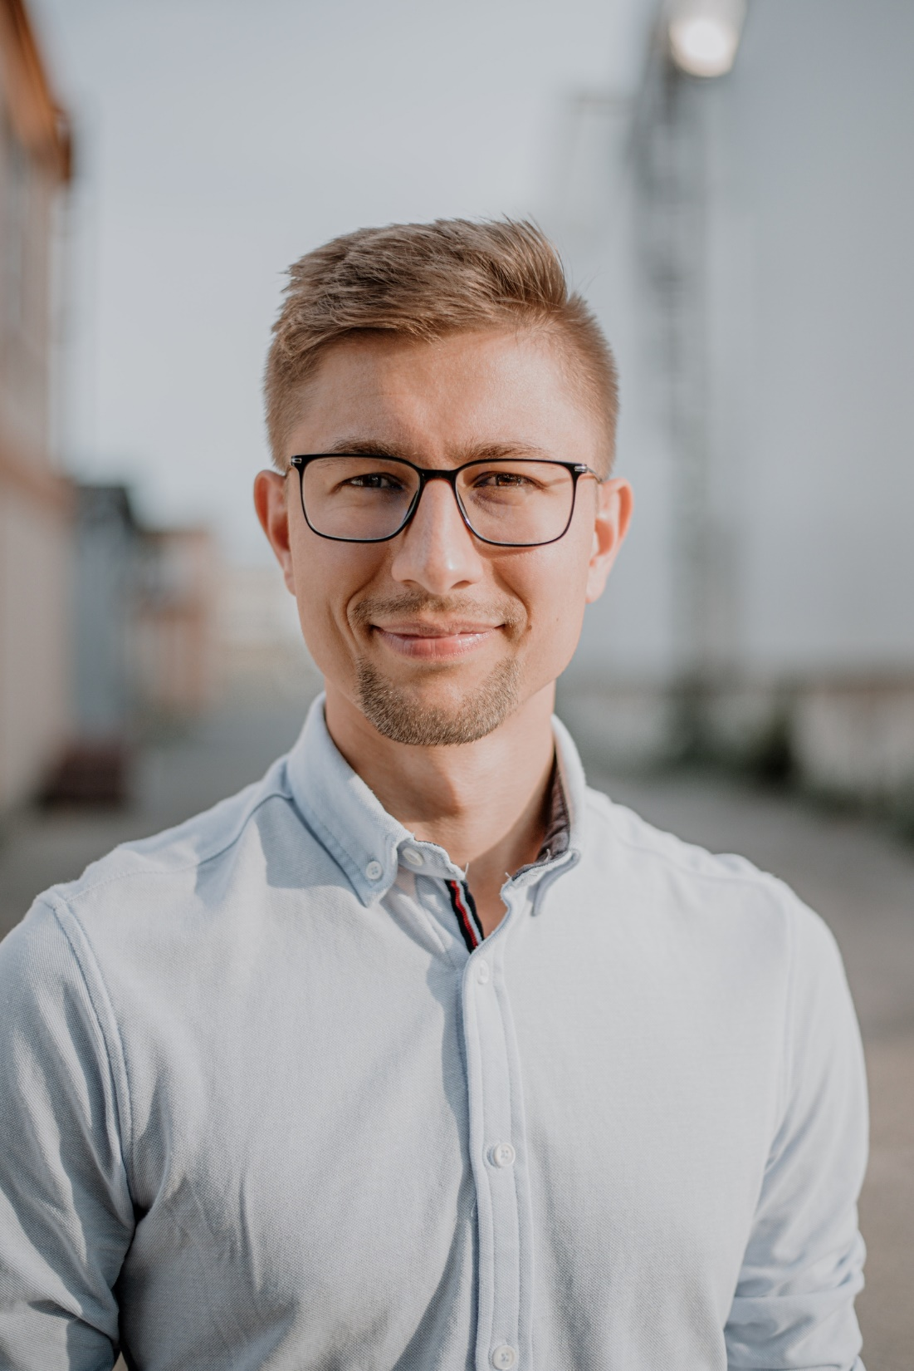
Juraj Majera, CEO
tirn technology
Founder of mobility start-up, ex-Porsche engineer, and half-marathon runner bringing simulation platform that eases and accelerates the electrification of public transport.
Notes:
*Juraj P Notes: Tu zalezi ci ta uvedo oni, alebo ty sam. Tuto cast necham na teba :)

Slide 3
It is a must to decarbonize public transportation.
However, it is an option to make the transition also efficient and economically sustainable.
Notes:
I would like to kick off with one thought: It is a must to decarbonize public transportation. However, it is an option to make the transition also efficient and economically sustainable.
Let that sink for a bit….
Why is it a must? I hope most of us know, but let’s refresh our memories together. Shall we?

Slide 4

Why are we here?
Source: https://theicct.org
Notes:
To answer that, we can also take a look at the question “Why are we here?”, sitting in this aula, listening to presentations.
Looking at the Madrid skyline full of smog, there are two numbers I would like to highlight. First:

Slide 5
Why are we here?
1% of transport sector are buses
Source: https://theicct.org
Notes:
Only a small 1% of global transport sector are buses. That is really a small fraction, but…

Slide 6
Why are we here?
1% of transport sector are buses
25% of transport sector emissions comes from buses
Source: https://theicct.org
Notes:
Whopping 25% of emissions comes from buses. By now, I hope we all understand the negatives this brings into our daily lives and how bad it is for the future of our planet.
Policy makers around the world have called for a change, same goes for EU, covering it in the clean vehicle directive.

Slide 7
Clean Vehicle Directive
Member State | 2021 - 2025 | 2026 - 2030
Luxembourg, Sweden, Denmark, Germany, Netherlands, Austria, Belgium, Italy, Ireland, Spain, Cyprus, Malta | 45% | 65%
Finland | 41% | 59%
France | 43% | 61%
Portugal | 35% | 51%
Greece | 33% | 47%
Slovenia | 28% | 40%
Czechia | 41% | 60%
Estonia | 31% | 43%
Slovakia | 34% | 48%
Lithuania | 42% | 60%
Poland | 32% | 46%
Croatia | 27% | 38%
Hungary | 37% | 53%
Latvia | 35% | 50%
Romania | 24% | 33%
Bulgaria | 34% | 48%
Notes:
In this table, we can see the plans of Clean Vehicle Directive.
I suppose we have people here from these countries, can you raise a hand if your country is on the list, or in other words, you are from EU?
Ok, now can you raise a hand if you know what is your country’s current status?
*Juraj P notes: tu si treba pripravi nieco ak sa nikto neprihlasi a nepovie ti, alebo ak tie cisla budu moc dobre
For example in Slovakia, the current status is only XX %, Czechia is XX and the leading countries like netherlands is at XX
These targets don’t seem that aggressive, yet the adoption is very slow. Why is that?

Slide 8

Adoption of ZEB and Its Challenges
Legal requirements
Notes:
First challenge is the pressure itself. As cities across Europe implement measures to achieve ambitious environmental strategies, there is pressure on the transport sector to decarbonize as fast as possible.

Slide 9

Adoption of ZEB and Its Challenges
Legal requirements
Complexity of ZEB
Notes:
Secondly, the transition to a zero-emission bus fleet is a complex process. Information on how a bus performs in different scenarios is regularly done by manual planning, physical testing, or comes from numerous internal excel files. In the past, with diesel buses, it was simple. Now you need to think about battery size, weather conditions, charging speed, charging strategy and more.

Slide 10

Adoption of ZEB and Its Challenges
Legal requirements
Complexity of ZEB
Operation Strategy
Notes:
With that in mind, it’s not only about purchasing, but operating as well: TCO, charging, uptime, insights into performance are just a few topics that might leave you puzzled. Comfortable transition to zero-emission bus fleet requires turnkey solutions needs the right data and tools.
What else, do you think is there? Please raise a hand or just shout

Slide 11

From CO2 to ZEB
From CO2
Notes:
So at tirn technology, our vision, is to accelerate the transition from CO2 past, to

Slide 12
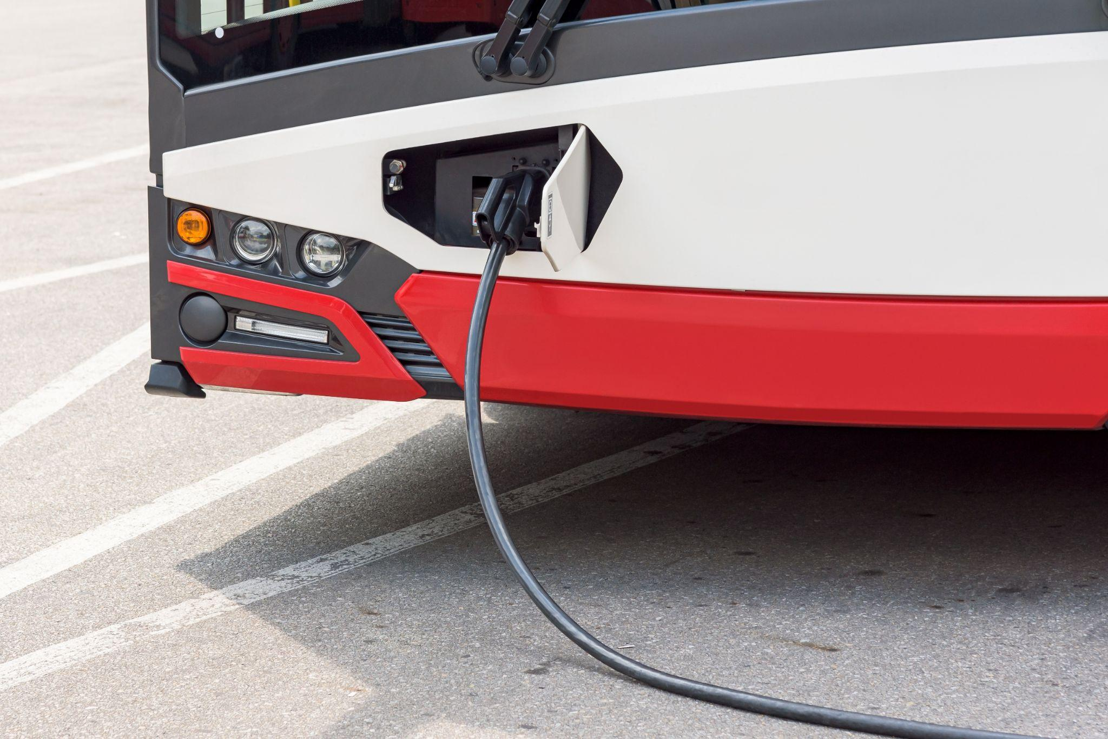
From CO2 to ZEB
From CO2
To ZEB
Notes:
To ZEB future. In our vision, our goal is to connect the right parties with the right tool.

Slide 13



Connecting the Right Parties
Municipalities
Operators
ZEB Manufacturers
Notes:
To summarize, we are creating an easy and ready-to-use simulation software for collaboration between operators and manufacturers by using the current possibilities of A.I., publicly available relevant data, and modern simulation models to shape the future of electric mobility faster.

Slide 14

Zero-Emission Bus Simulator
Digital twin of your city operation
Notes:
Our platform zero-emission bus (ZEB) simulator identifies the optimal bus model, powertrain, energy storage technology, the charging infrastructure, and its requirements. This provides the users with better predictions of the total cost of ownership and CO2 reduction.

Slide 15
Zero-Emission Bus Simulator
Digital twin of your city operation
Real-world Data
Notes:
For the predictions, we use real world data such as…

Slide 16
Zero-Emission Bus Simulator
Digital twin of your city operation
Real-world Data
Routes and Timetables
Notes:
Real routes and corresponding timetables

Slide 17
Zero-Emission Bus Simulator
Digital twin of your city operation
City Requirements
Real-world Data
Routes and Timetables
Notes:
City requirements such as…

Slide 18
Zero-Emission Bus Simulator
Digital twin of your city operation
City Requirements
Zero-Emission Bus Models
Real-world Data
Routes and Timetables
Notes:
Last but not least, the ZEB models.
Before we get to possible outputs of our software, I would like to highlight the simple journey that we created in order to come to those outcomes.

Slide 19

4 Simple Steps
Step 1
Select a city
Notes:
Firstly, you would choose a city in which you operate or want to operate in the future. Choose from any city using GTFS format maps and get an immediate overview of the city information such as population density, yearly temperatures, and more.

Slide 20


4 Simple Steps
Step 1
Step 2
Select a city
Select a line
Notes:
In the second step, select your preferred line and see the elevation, speed profile, distance and time drove in a day and stops on the visual map.

Slide 21

4 Simple Steps
Step 1
Step 2
Step 3
Select a city
Select a line
Select a ZEB
Notes:
In the third step, select a ZEB model of your choice, and immediately see valuable specs about the model such as range, length, maximum speed, capacity, and more.

Slide 22

4 Simple Steps
Step 1
Step 2
Step 3
Step 4
Select a city
Select a line
Select a ZEB
Simulate & compare
Notes:
And as the fourth steps, already knowing a number of valuable inputs, run your simulation, start tracking different zeb performances and analyze your KPIs. See which model, and where, performs the best with the results at your fingertips into:

Slide 23

Results at your fingertips
Performance
Notes:
Number one: Performance: Understand how different models perform over different bus lines. Get insights into real range, consumption and state-of-charge over a line, battery performance, discharge rate probability, and more.

Slide 24

Results at your fingertips
Performance
Charging
Notes:
Number two: Charging: Get a better understanding of the requirements for charging infrastructure, power peaks, and grid requirements. See the planning of charging times during breaks and in a depo.
.

Slide 25

Results at your fingertips
Performance
Charging
Financials
Notes:
Number three: Financials: Know what to expect for operation costs per km and per line. Understand your capital costs for the electrification process, TCO per ZEB, and the expected ROI.

Slide 26

Results at your fingertips
Performance
Charging
Financials
Carbon Footprint
Notes:
Last but not least: Carbon Footprint: See exact CO2 savings per year and understand emissions and carbon footprint with a click of a button.
As you can see, with just 4 simple clicks, you can have a better understanding on what ZEB to offer to which customer, or if you are an operator than which ZEB to get for the most efficient and economic operations.
In addition, it provides insights into charging, one of the most complex puzzles for adopting the ZEBs.

Slide 27


Our current projects
Public Transport Operator
Notes:
Recently we started to work with slovak dynamic public transport operator SKAND SKalica with a long tradition and experience of more than 30 years, providing city and suburban transportation.
In this project we provide our zero-emission bus (ZEB) simulation service to help SKAND efficiently decarbonize bus transportation, easily handle the fleet transition, and comply with legislation.
This includes identifying the optimal bus model, powertrain, energy storage technology, the charging infrastructure, and its requirements, providing SKAND predictions of the total cost of ownership and CO2 reduction.

Slide 28


Our current projects
Public Transport Operator
Public Transport Operator
Notes:
In addition we work with whippet where

Slide 29




Partners
EIT Urban Mobility
GoAscendal Labs
Virtual Vehicle
UITP

Slide 30

Thank You and Get in Touch
juraj.majera@tirntechnology.com
www.tirntechnology.com

