Slide 1




Investing in Urban Mobility
Future City Tech, June 24, 2022

Slide 2





INVEN CAPITAL is a venture capital fund backed by a major energy utility CEZ and by the EIB
EUR 430m under management
Regulated by
Inven I
Inven II
Member of
1st closing Jan22
EUR 240m
EUR 190m

Slide 3





We invest in fast growing and innovative startups with scalable business model proven by sales
Investment size: EUR 2 to 30m
Money-in
Minority stakes with co-investors
Investment period 3-7 years
Trade sale or IPO as exit

Slide 4

We support decorbonisation enabled by startups in Europe and Israel
Energy efficiency, distributed generation and smart grid
Smart city
Mobility
Logistics
Industry 4.0
Agtech/foodtech
Circular economy

Slide 5
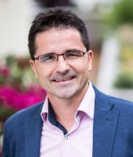
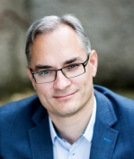
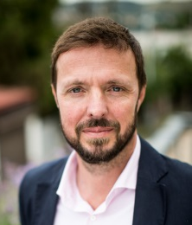


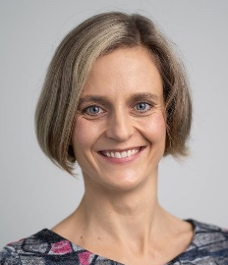

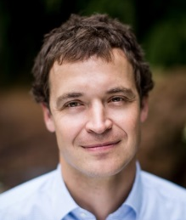

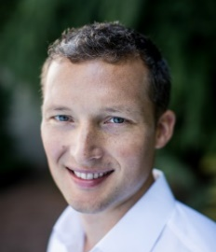







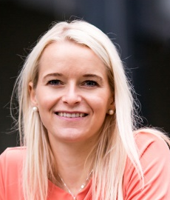
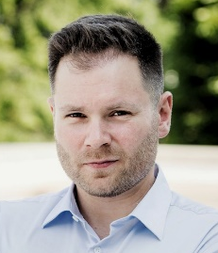

We have an international team with balanced mix of experience from energy, finance and management
Investment team
Back office
Venture partner
Benelux
Venture partner
Israel
Technical Advisor

Slide 6

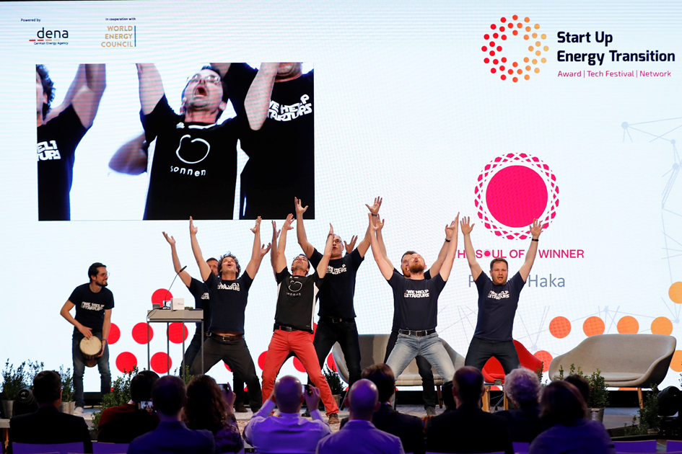

We embrace The Soul of a Winner spirit

Slide 7


We seek for chemistry and alignment among the founders, management team and investors
What we love in startups
What makes us special
The soul of a winner
Meaningful reason why they are in business
Resilience driven by inner motivation
Capacity of creating strong alignment/trust among key stakeholders
We help startups
We help to pilot, add sales, and to network
Access to corporates through Plug & Play
Leveraging our relationship with EIB

Slide 8
























We are proud of our top portfolio of globally recognized companies with three realized exits
Current portfolio in Europe and Israel
Three realized exits

Slide 9
Investing in Urban Mobility

Slide 10
Cities have an immense problem – mobility, and the problem is growing
Air pollution
  Cities generate 70 per cent of global greenhouse gas emissions, and road transport accounts for 12 per cent of them.
Congestion
  On average, motorists in Paris spend 65 hours a year stuck in traffic. In London, that number is 73 hours.
Cars in streets
    Research shows that around 50% of Stockholm is allocated to car parking and roads. This is similar across other European cities.
Energy consumption
Transport sector accounts for approximately 31.7% of total final energy consumption
Source: Tier

Slide 11
4 tech trends are expected to help us deal with city mobility problems
Connectivity and digitalization
Electrification
Autonomy
Shared mobility

Slide 12
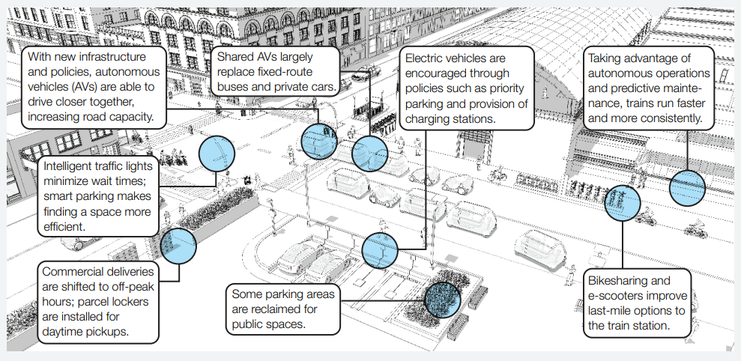
So that Seamless mobility scenario of the future is imaginable already in 2030+
Source: McKinsey 2019

Slide 13
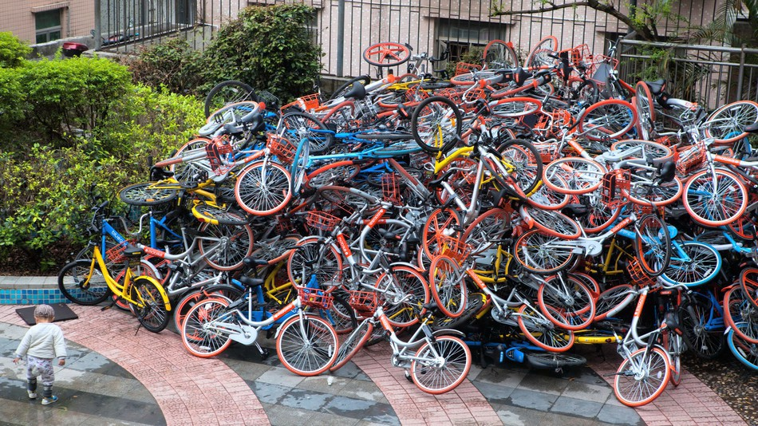
City halls play key regulatory role in optimizing transportation in a sustainable way

Slide 14
To get there, substantial collaboration with private sector is needed and that creates huge Business opportunities
Operations&Maintenance
Road maintenance
Physical operation of fleets and chargers
Rolling stock
Mass transport (bus, tram, metro, train)
Micromobility
Robotaxi
Physical infrastructure
Roads
Bike paths
Parking lots
Chargers
Mobility policy
Mobility policy
Sensors, cameras, lidars
City
Demand
(people, goods)
Global policy targets, budgets, etc.
Votes, preferences, taxes
Dynamic data collection
Parking availability
Traffic
Transportation availability
People locations
Real time visibility/control
LT planning
Mobility services
Data from mobile operators, apps
Optimization algorithms
Routing
Demand prediction
Fleet optimization
City traffic optimization
Applications/Services
MaaS
Charging
Ticketing
Traffic control
Investment planning
Static data collection
HD maps
Fixed schedules
Charger locations

Slide 15
As always we are looking for business models which are scalable and lT defensible – where are they?
KEY CONVICTIONS:
City halls will shape the rules based on inputs from private sector
Data will play key enabling role
Smart execution will be essential
It is important to grab the market fast and scale

Slide 16











Asking questions about the position of a player in the future landscape
Public transport with fixed schedules
Public transport with fixed/dynamic schedules
Micromobility
Micromobility
Conventional Taxi
Online Taxi
Autonomous electric fleets of all kinds
MaaS
On demand vans
Ride sharing
Key competencies:
Demand prediction
Dynamic routing
Charging optimization
Efficient operation
…
Car sharing

Slide 17
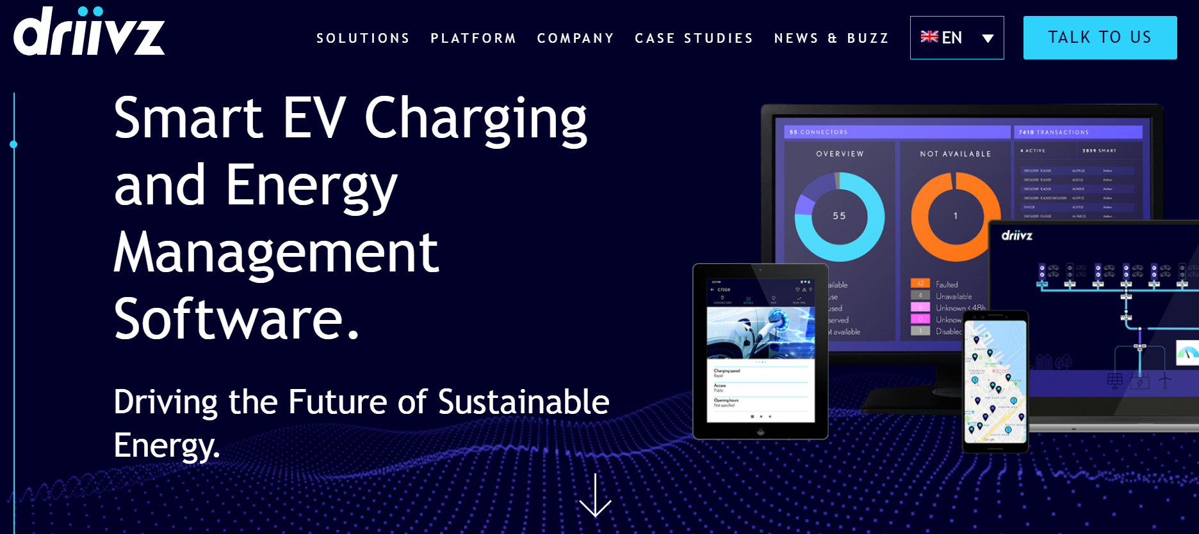
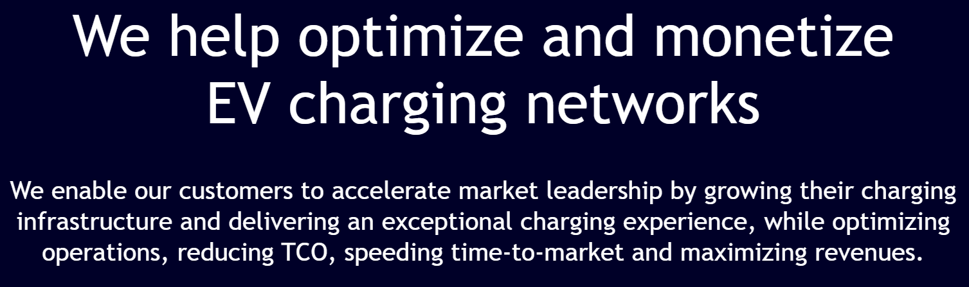
Driivz as a key enabler of ev charging at a scale

Slide 18
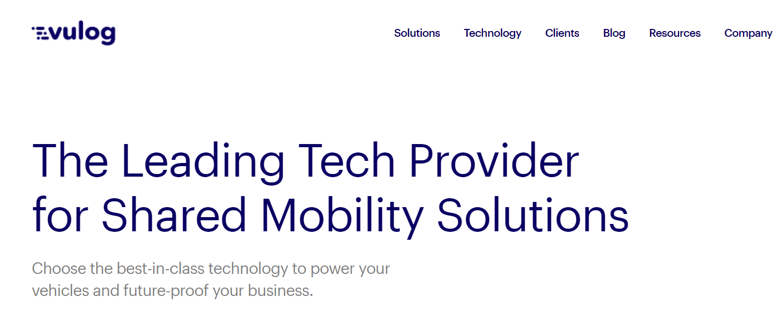
Vulog as a shared mobility expert

Slide 19
We help startups.
michal.mravec@invencapital.cz
Inven Capital, SICAV, a.s.
Pod křížkem 1773/2
147 00 Praha 4 – Braník
Czech Republic
www.invencapital.cz

