Slide 1








BICIFICATION
Annarita Leserri: leserri@pin.bike
Project partners

Slide 2

How many people
own a bike in the world?
a. 10%
b. 67%
c. 42%
d. 75%
Quiz questions from Certification for Sustainable Transportation:
https://www.erating.org/e-quiz
Notes:
According to a recent study by IPSOS, Across the 28 countries around the world, almost two-thirds (63%) of adults say they know how to ride a bicycle and 42% report owning one.

Slide 3
How many people
own a bike in the world?
a. 10%
b. 67%
c. 42%
d. 75%
https://www.ipsos.com/en/global-advisor-cycling-across-the-world-2022
Notes:
According to a recent study by IPSOS, Across the 28 countries around the world, almost two-thirds (63%) of adults say they know how to ride a bicycle and 42% report owning one. 86% think that bikes can make the difference in reducing emissions.

Slide 4
How many people
ride their bike to go to work?
a. 10%
b. 67%
c. 42%
d. 75%
Quiz questions from Certification for Sustainable Transportation:
https://www.erating.org/e-quiz
Notes:
According to a recent study by IPSOS, Across the 28 countries around the world, almost two-thirds (63%) of adults say they know how to ride a bicycle and 42% report owning one.

Slide 5
How many people
own a bike in the world?
a. 10%
b. 67%
c. 42%
d. 75%
https://www.ipsos.com/en/global-advisor-cycling-across-the-world-2022
Notes:
According to a recent study by IPSOS, Across the 28 countries around the world, almost two-thirds (63%) of adults say they know how to ride a bicycle and 42% report owning one. 86% think that bikes can make the difference in reducing emissions.

Slide 6
Would you ride your bike,
if they paid you?
Yes
No
Only if it were enough money

Slide 7
BICIFICATION
Supporting modal shift and bicycle use through gamification and rewarding
Project introduction
Project partners

Slide 8
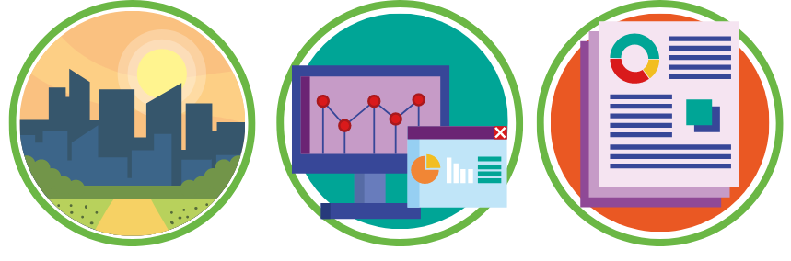
THE PROJECT IDEA AND OBJECTIVES
1,500 users in 3 cities by 2022
100,000 users in 90 cities in the next 5 years
40+ local shops where citizens can spend the credits they earned as they rode
A real time Open Data Platform with cycling trajectories and important indicators from pilot cities will be available to the public.
A guidebook for cities to be used as a roadmap towards the integration of bicycle trajectories data in their mobility planning strategies.

Slide 9
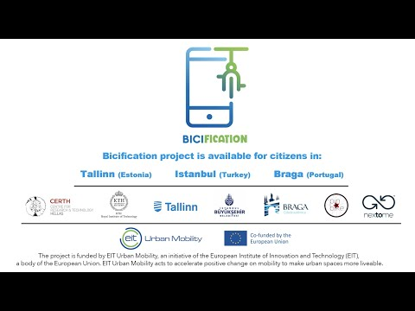
How the app and sensor work
31-Dec-21

Slide 10
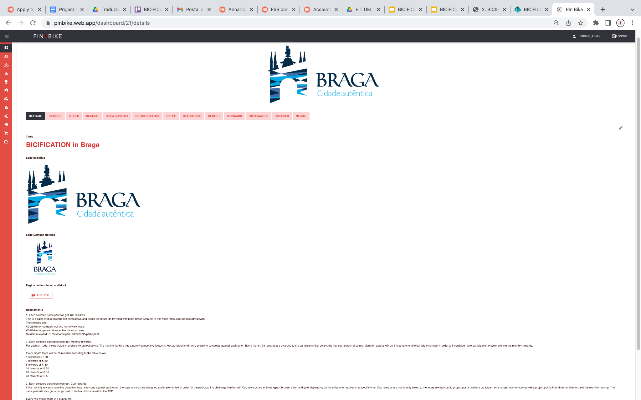
How the dashboard works
31-Dec-21

Slide 11
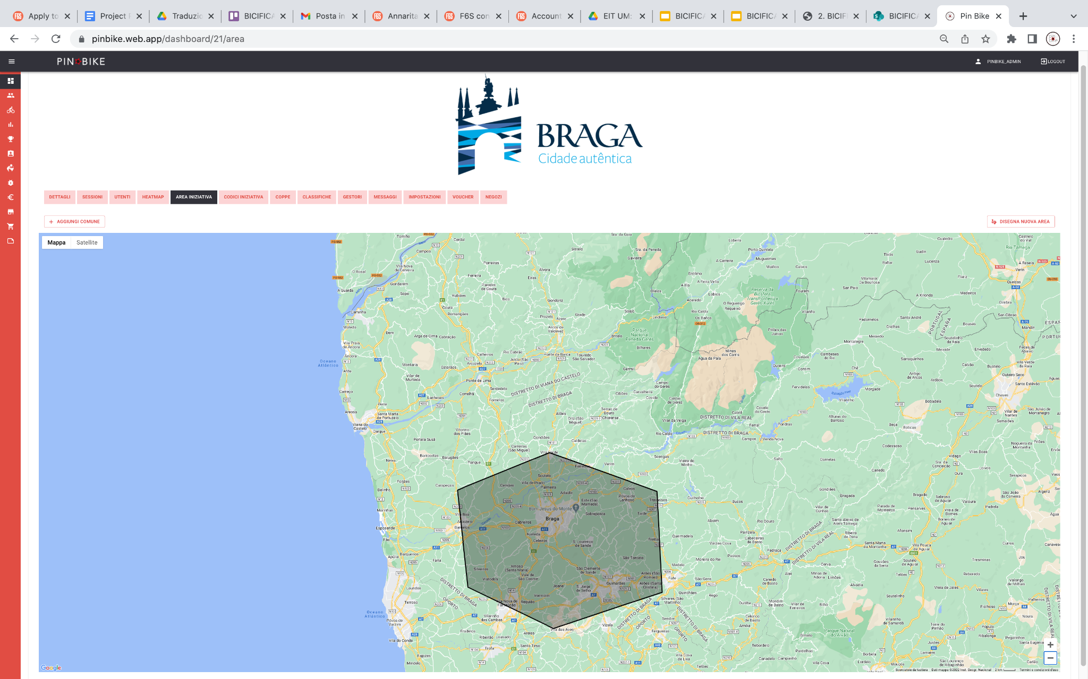
How the dashboard works
31-Dec-21

Slide 12
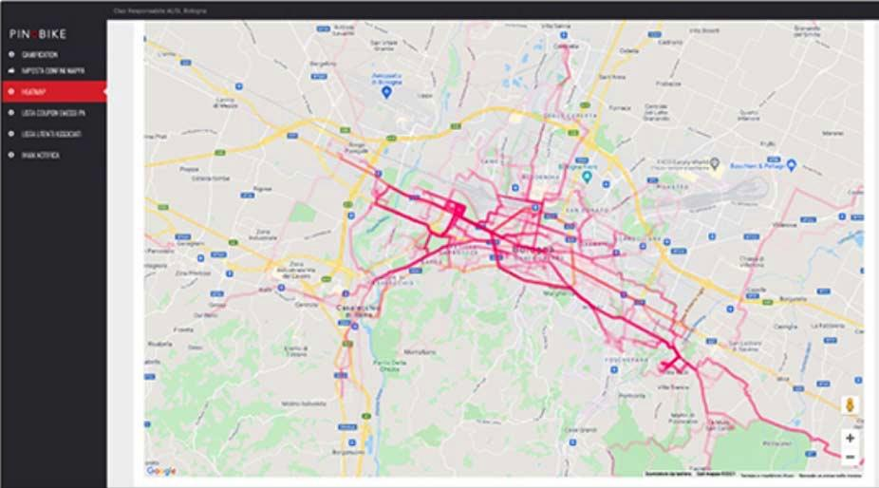
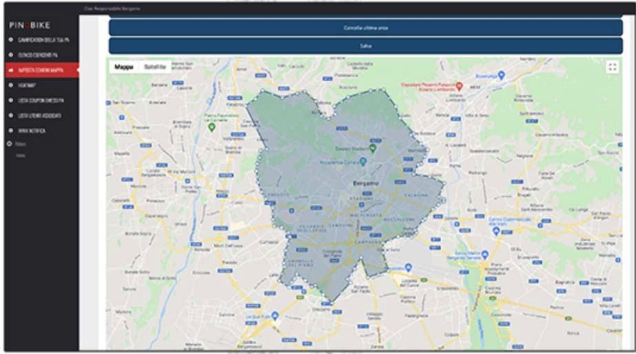
How the dashboard works
31-Dec-21
Notes:
How is it going so far? No. of active users, no. of local shops involved, sessions, km, etc.

Slide 13
BICIFICATION
Thank you!
Annarita Leserri: leserri@pin.bike
Bicification website: https://bicification-project.eu/
Project partners

