Slide 1

n
dock me like you mean it
Future City Tech // June 2022

Slide 2
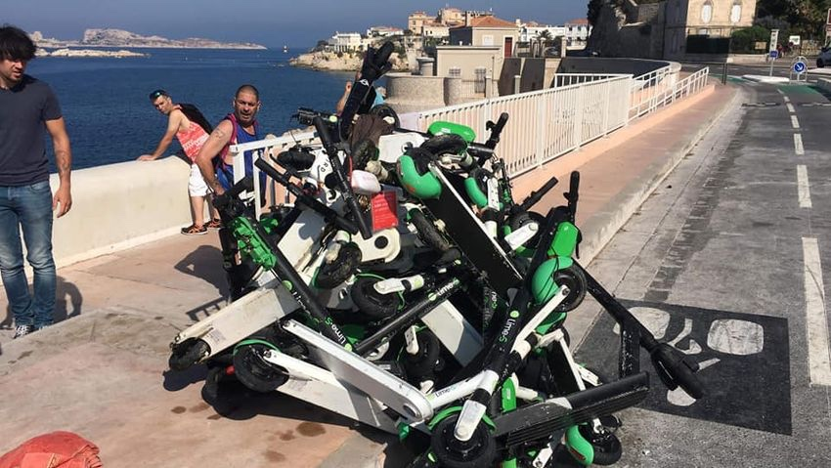
Notes:
Also, many of non-locked scooters have been destroyed or damaged bringing the lifespan of scooters down to 3 month in several cities and destroying the service economy. In Marcel Franc, 150 scooters were found in a see - vandals were just trowing them for fun.

Slide 3
Why docks rock?

Slide 4

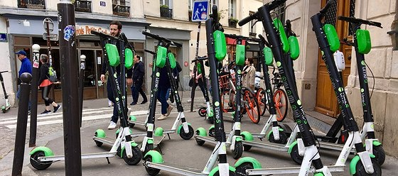
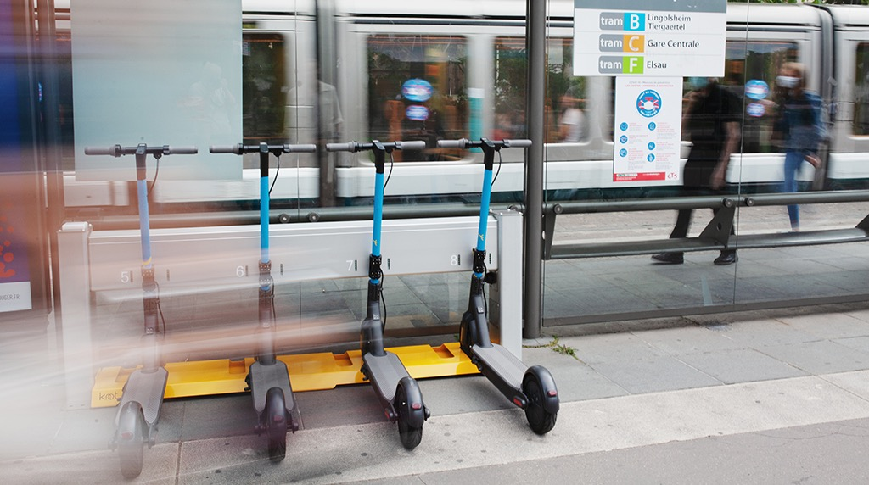

Brings order on city streets

Slide 5
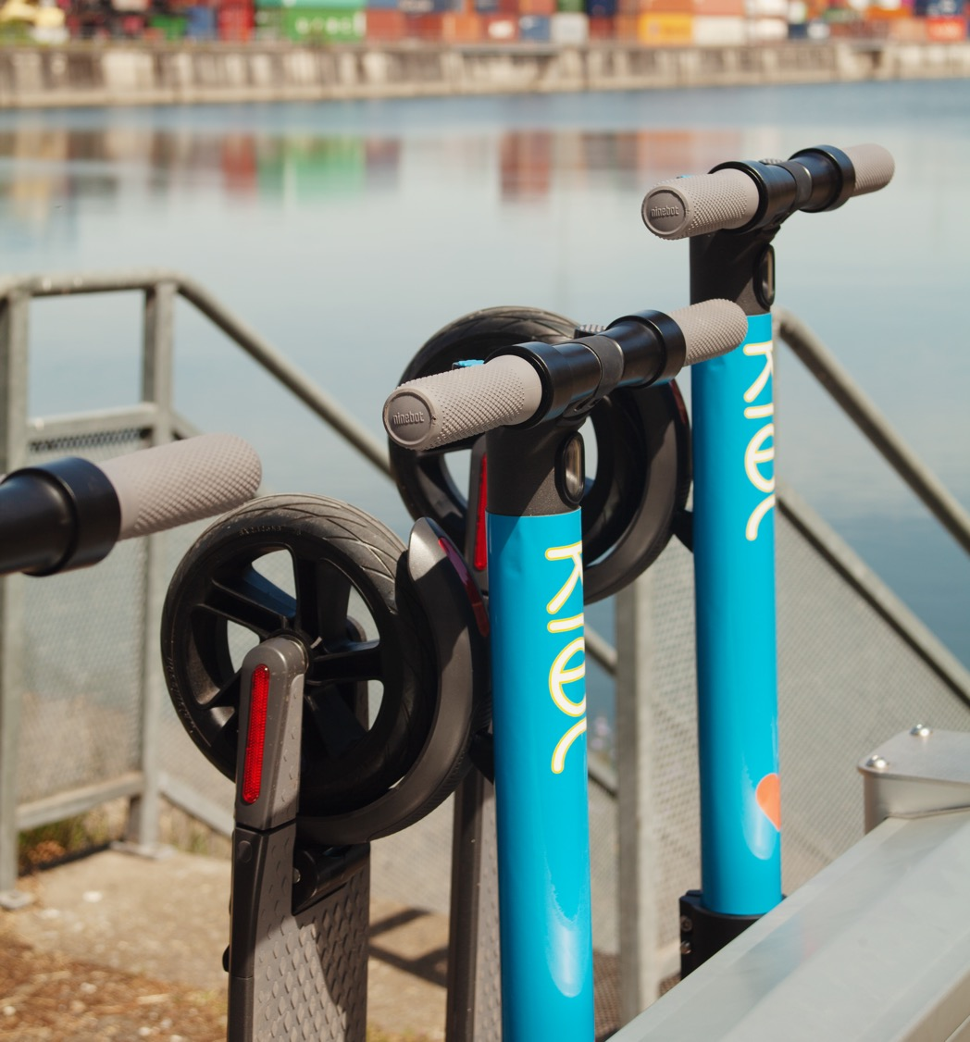
Reduces the vandalism impact

Slide 6
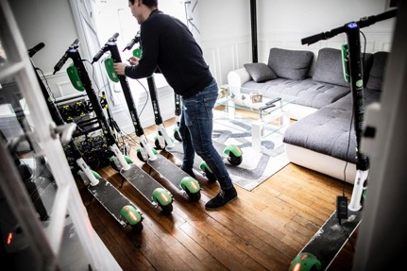
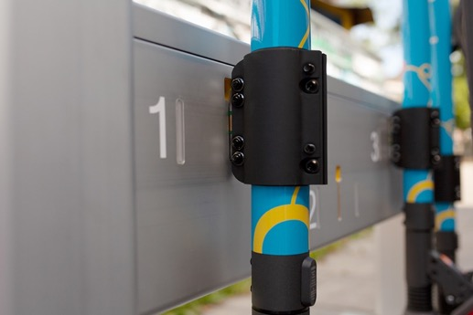
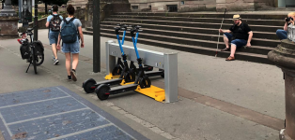
Controls the energy supply

Slide 7
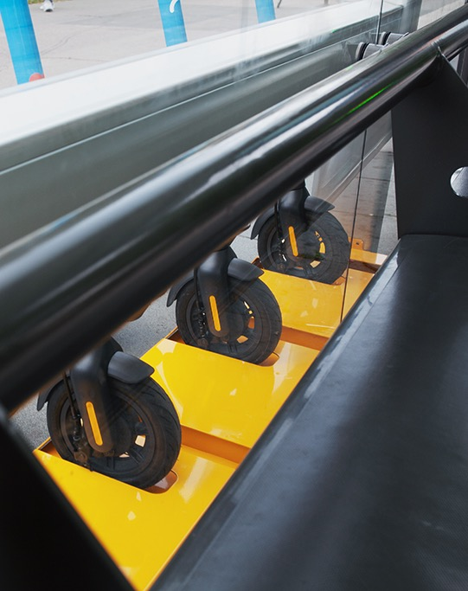
Reduces operational costs to make scooter sharing profitable

Slide 8
Operational costs for dockless vs. dock-based services, €

Slide 9
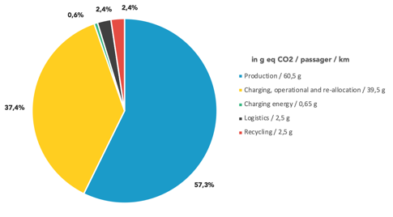
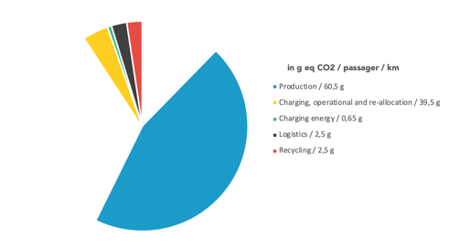
Dockless
Finally environment friendly
Dock-based

Slide 10

KNOT products and services

Slide 11
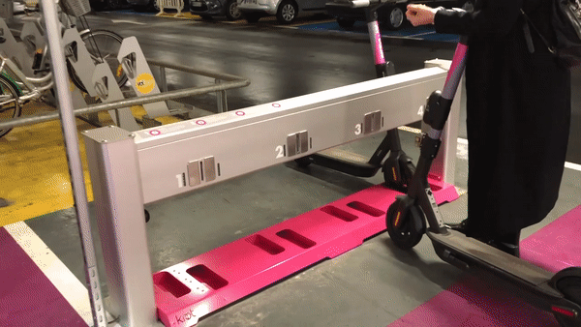
SECURE
DOCK
CHARGE
LOCK
PARK
STORE
CONTROL
CONNECT
OPTIMIZE

Slide 12
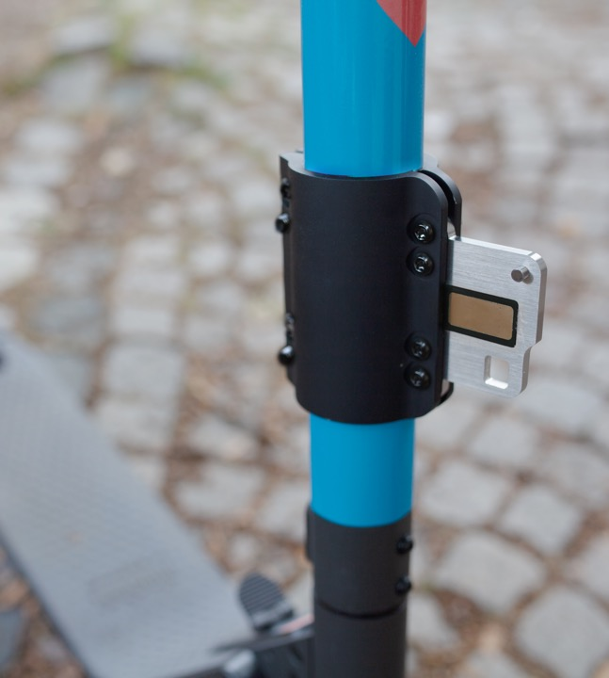

hardware
Universal station you said?

Slide 13

hardware
Universal station you said?
Get the sleeve!

Slide 14

hardware

Slide 15

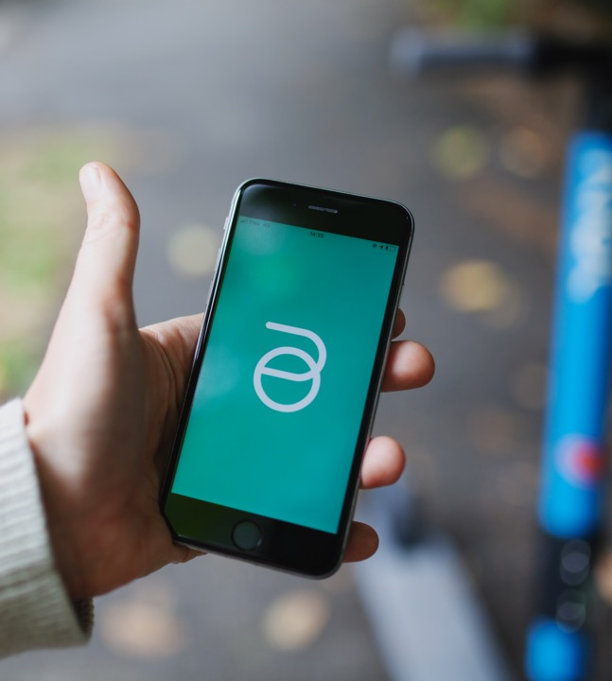
software
Software integrations : station API and MaaS connect

Slide 16
n
Where to KNOT ?

Slide 17
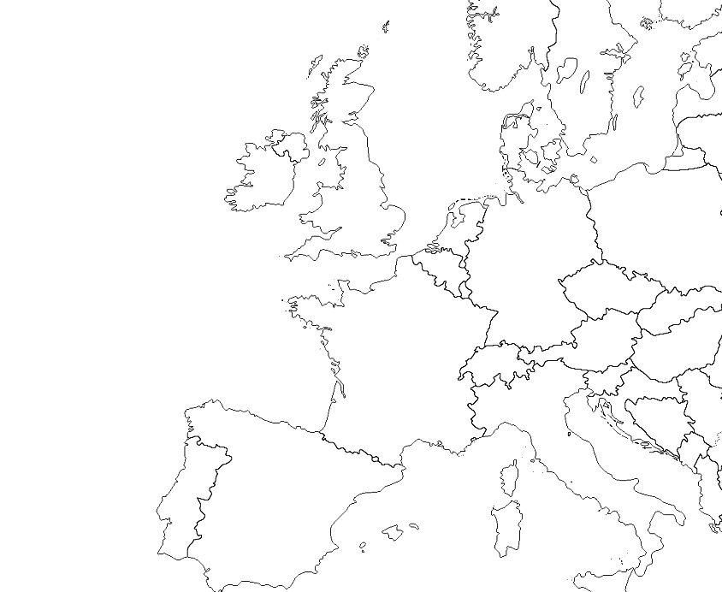







Up and running all around Europe
+200
stations installed
6
countries
15
networks
+50k
trips
+ Tashkent (Uzbekistan)
+ Buffalo (USA)

Slide 18
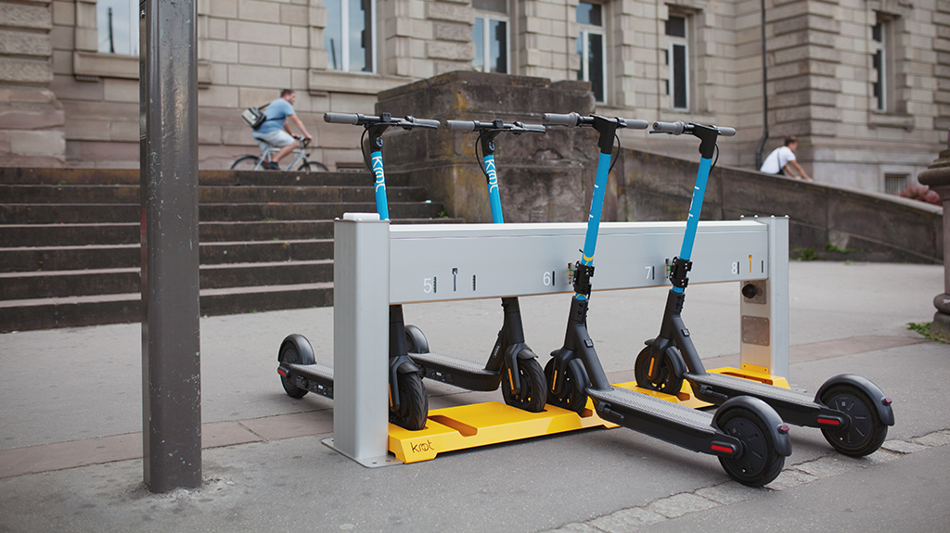
Questions time
hello@knot.city

