Slide 1
FORM08
TRAIN / TRUCK / Infrastructure
Tracking the tracks

Slide 2
Current status
Cargo trucks / trains / wagons have no online tracking
= no data, no control
01
Sometimes goods or tracks get damaged
= technical, legal and PR problems, resources waste
02
We do not know where the problem was (GPS, bump)
= difficult to prevent problems in future
03

Slide 3
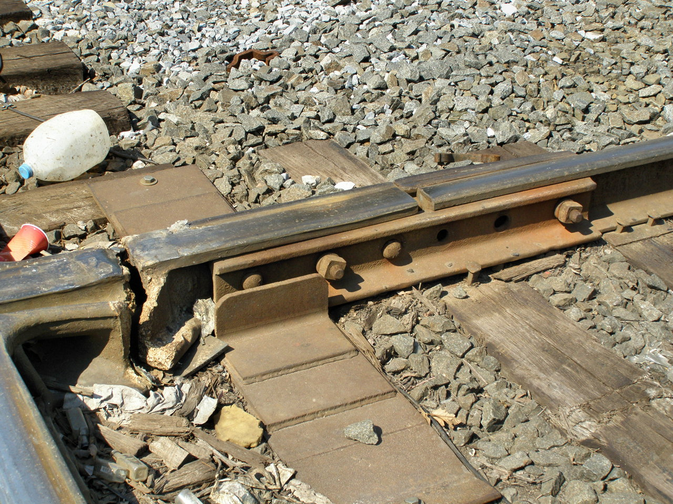
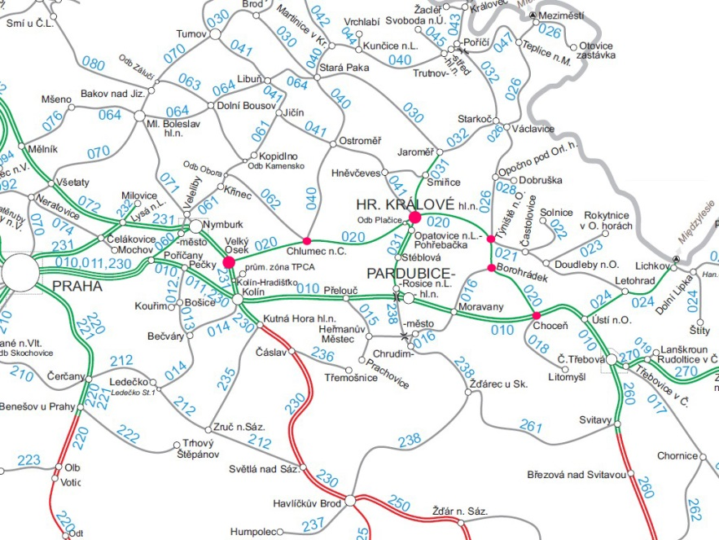

So how do we track damaged tracks in REAL-TIME?

Slide 4
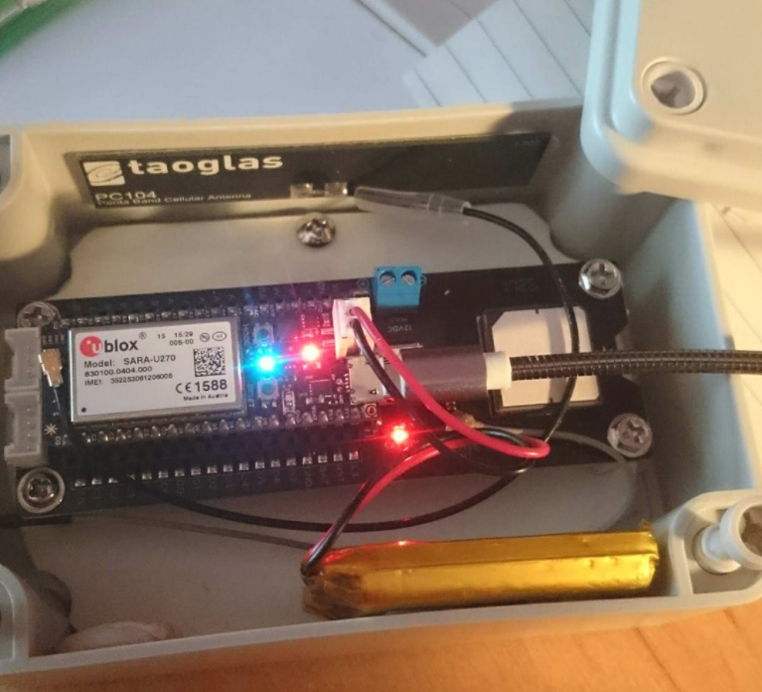
Solution
24/7 online tracking device & platform, also mobile friendly
GPS and gyroscope
Event driven technology
Remotely controlled
One month life battery / AC outlet

Slide 5
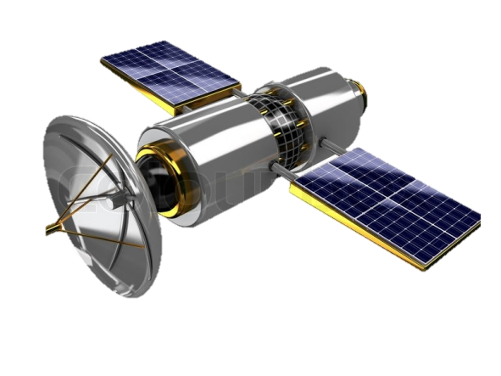
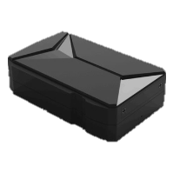
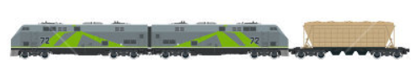

Solution

Slide 6
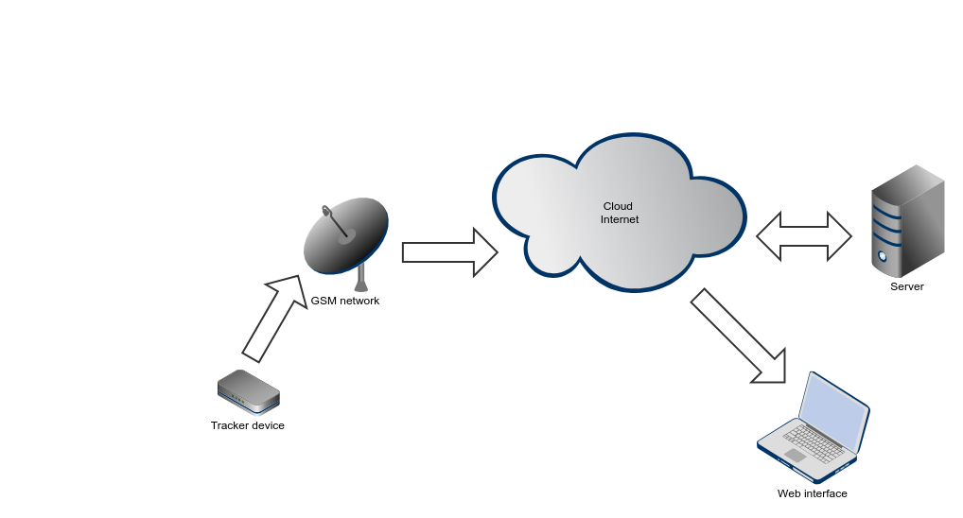
Platform
24/7 availability (GSM data)
High precision location service (GPS data)
Immediate alerting system (TBD)
Mobile friendly view (TBD)

Slide 7
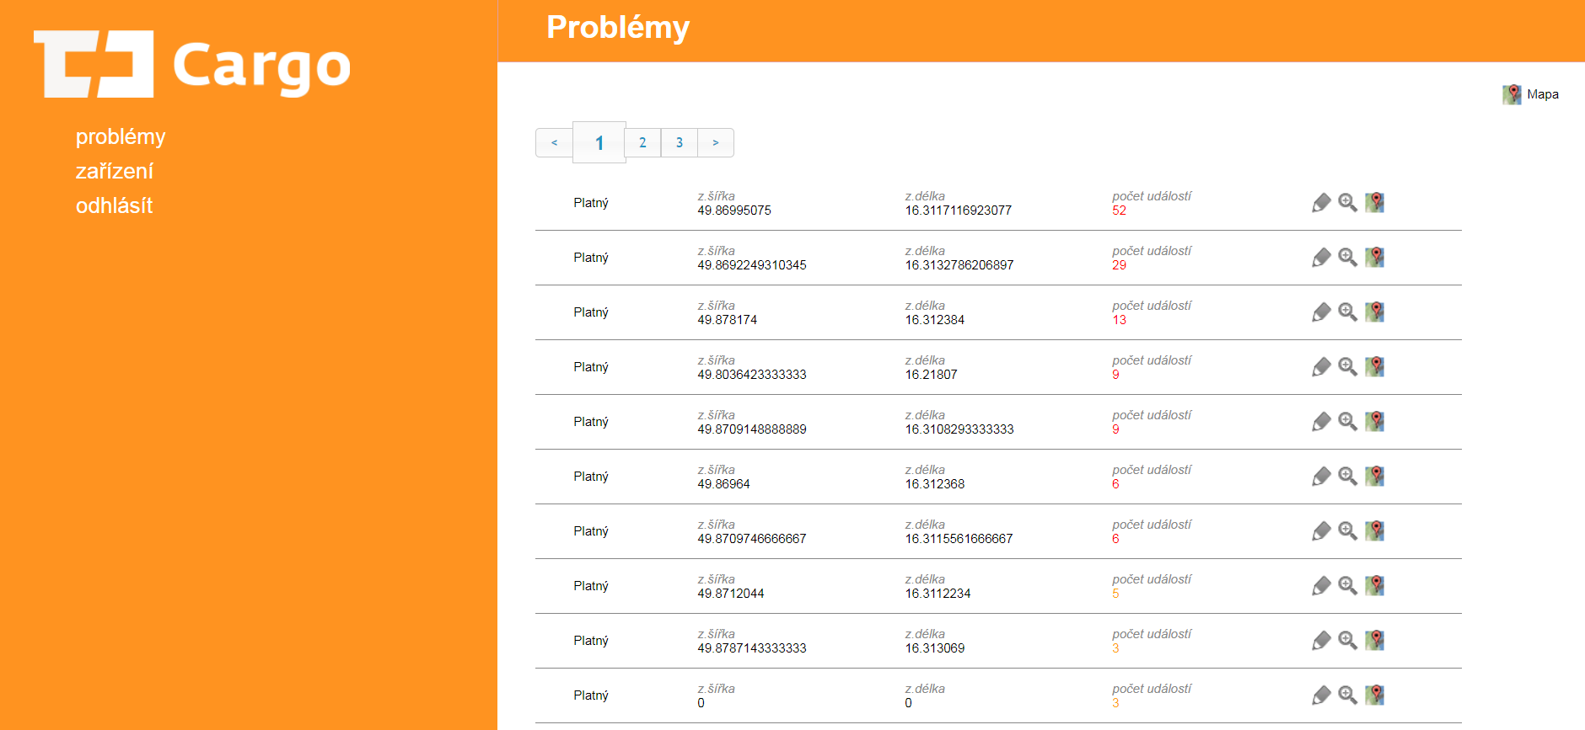

Platform
http://track.y-co.de/cdcargo/

Slide 8
Next steps
Project approval
01
Pilot contract
02
Device Instalation
03
Staff training
04
Testing phase
05
Pilot evaluation
06
Long term contract
(if applicable)
07
Track / Cargo selection
preparation
6 months
1 month
TBD

Slide 9
Questions?
Thank you for your time…
Let‘s go on tracks!
tracking@form08.com

