Slide 1
InnoEnergy PowerHUB CZ
Prague 5
A sustainable energy future for Europe
Prague 5, 30.05.2017 / Petr Bažant

Slide 2
Agenda
InnoEnergy
Business Creation Services
Innovation Projects
Education
PowerAlliance & Acceleration Primer
Tools

Slide 3
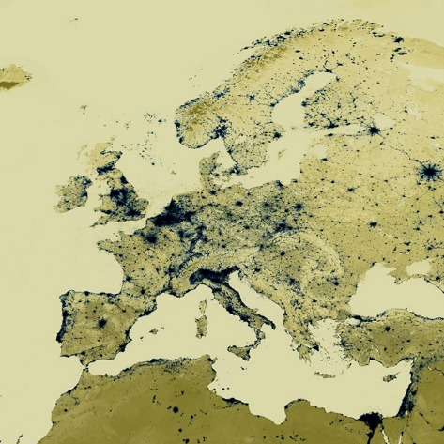
About InnoEnergy
Who we are
Europe’s engine for innovation in sustainable energy
Empowering every stage
of the innovation process
Investing in people,
technologies, businesses
Established 2010:
supported by the EIT
Public-private partnership aiming for financial sustainability
Notes:
Our goal is simple - to achieve a sustainable energy future for Europe:
We do that by encouraging innovation – it is the driving force of InnoEnergy
Everything we do is about creating the right conditions for new ideas to flourish
We have a complete package of solutions and services to support innovation at every stage of the journey – from classroom to customers
We help develop new ideas, products and solutions that make a real difference as well as new businesses and new people to deliver them to market
We were established in 2010 and we are supported by the European Institute of Innovation and Technology (EIT)
We are partly funded by the EIT, by our 26 shareholders across Europe and increasingly by the returns on investment we make in new products and solutions and in new businesses

Slide 4
Innovation in Europe
The Innovation Engine for Europe
InnoEnergy
Students
Education
Tomorrow’s leaders
Research
Innovation
Projects
Innovative solutions
Entrepreneurs
Business
Creation
Services
New businesses
Notes:
We are an engine for innovation
Europe has the people, the ideas, the resources and the skills to create a fully sustainable energy sector
Our job is to bring them together
On one side we work with the most promising students, researchers, innovators and entrepreneurs in Europe
We work with them in three key areas: Education, Business Creation Services and Innovation Projects
We produce highly employable future business leaders and innovation leaders and deepen the talent pool
We produce products and services that will have a real impact and are of genuine commercial interest to the industry
We develop businesses that bring solutions to market and enrich the energy ecosystem

Slide 5

Sustainability for Europe
Our goal: sustainable energy
Ensure security and safety of supply
Reduce costs in the energy value chain
Reduce CO2 emissions
Improve European competitiveness
Remove barriers to innovation
Encourage sustainable growth
Create jobs
Notes:
Developing a sustainable energy sector is one of the biggest challenges facing Europe today
We must ensure supply to all our citizens – without compromising safety
We need to reduce carbon emissions – while remaining competitive with the rest of the world
We need alternatives to depleting fossil fuels that can still satisfy the changing demands of a growing population – and ensure that no one falls into fuel poverty
We also need to encourage sustainable growth and jobs in Europe

Slide 6
Sustainability for Europe
Thematic fields and technology focus
Clean coal and
gas technologies
Energy storage
Energy efficiency
Energy from
chemical fuels
Renewable
energies
Smart and efficient
buildings and cities
Smart
electric grid
Nuclear
instrumentation
Notes:
There is no single solution that can overcome all these issues.
A range of technologies will be needed, each one addressing a different aspect of the energy challenge.
That is why we work in eight critical thematic fields.
Clean coal and gas (details optional)
reduce emissions of CO2, NOx, SOx and particulate matter
Make best use of biomass, waste and unconventional gases as well as fossil fuels
Support CO2 capture and storage
Energy storage (details optional)
integrate renewable energy into the electricity grid
Enable a more distributed and responsive distribution system
Improve stability across the grid
Energy efficiency (details optional)
We are encouraging Energy efficiency in buildings and energy efficiency in industry
Energy from chemical fuels (details optional)
Upgrade and standardise fuels from different feed stocks
Enable these fuels to be used in combustion systems, power plants, distribution and storage chains
Improve fuel conversion processes for greater efficiency
Renewable energies (details optional)
Improves the production, penetration and profitability of renewable energy
Continues to develop all forms of solar technology
Improves reliability, accuracy and integration of onshore and offshore wind
Increase performance, lifespan and scalability of wave power
Smart and efficient buildings and cities (details optional)
Enables energy-positive homes and commercial buildings
Encourages energy-saving behaviours at home and at work
Supports a smart and sustainable transport system
Smart electric grid (details optional)
Enable information, communication and analytics capabilities in large scale
Support enhanced cyber-security and critical infrastructure protection
Increase control over the intermittent sources of electricity
Nuclear instrumentation (details optional)
Improves control and command systems, instrumentation and measurement to ensure reliability and performance
Enables materials, structures and radiation to be monitored under the most extreme conditions
Supports non-destructive testing and informs decision-making to prolong the life of reactors

Slide 7
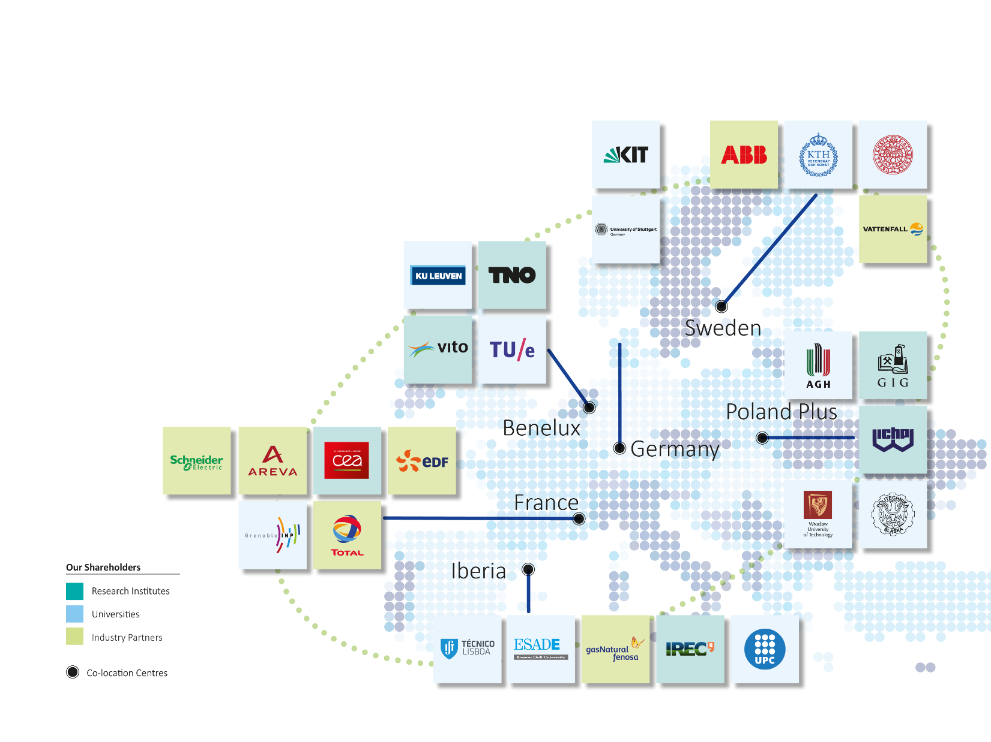
Network and connections
Making connections:
the power of the network
6 co-location centres
26 shareholders
299 additional
partners
Activities in 17
countries
all figures correct as of March 2017
Notes:
We have established co-location centres across Europe
They encourage cooperation between industry, academia and research – as well as innovators and entrepreneurs
Our strength comes from our Europe-wide network of partners
Industry (build)
Universities (build)
Research institutes (build)
They are our experts, our service providers, the early adopters of innovative solutions, and the employers of our graduates.
These 26 partners are also shareholders of InnoEnergy
We have also built a dynamic community of more than 299 associate and project partners who support our entrepreneurs and innovators
Together we are active in 17 countries across Europe

Slide 8
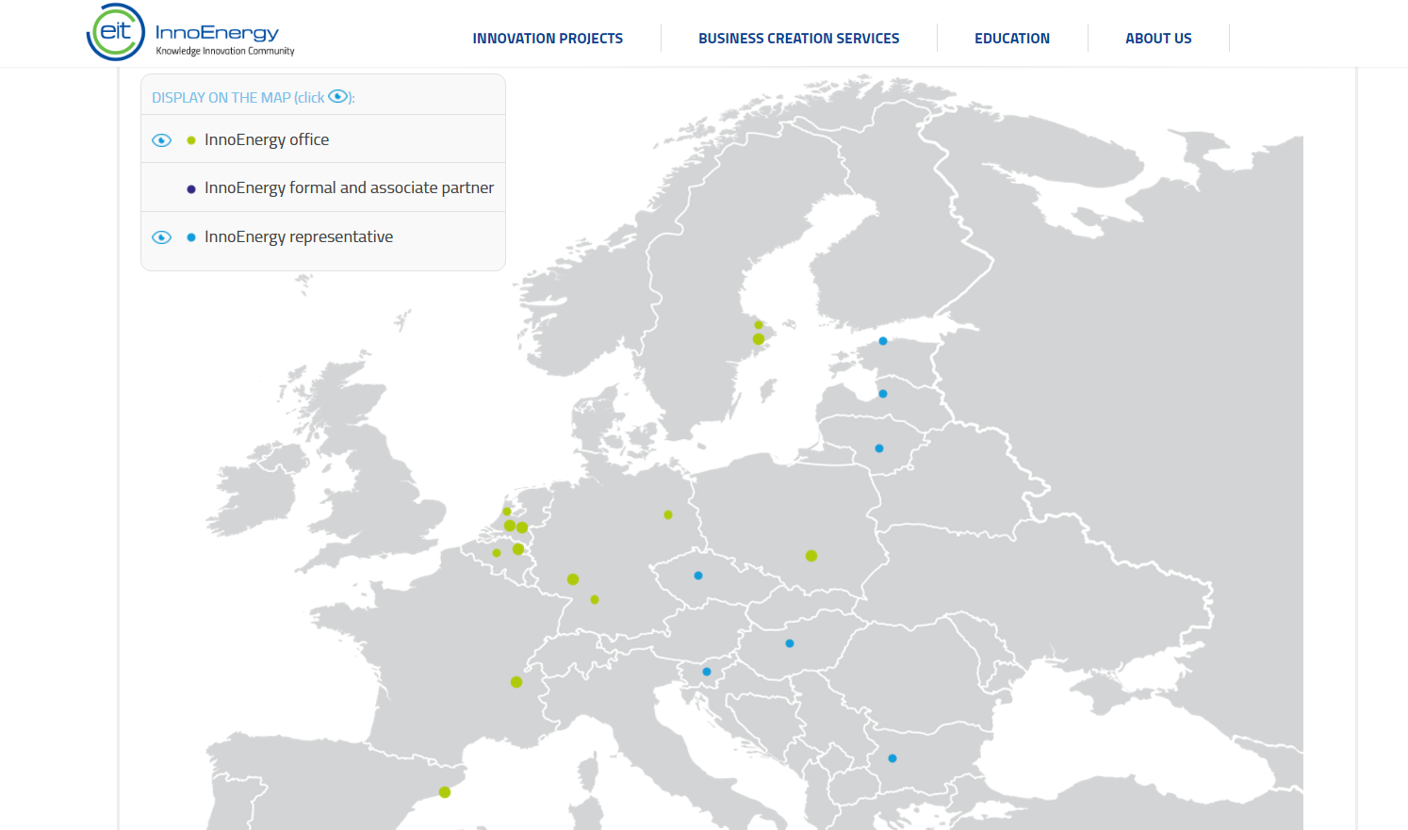
Offices
hubs
Note:
Both office and Hubs should
selected by default

Slide 9
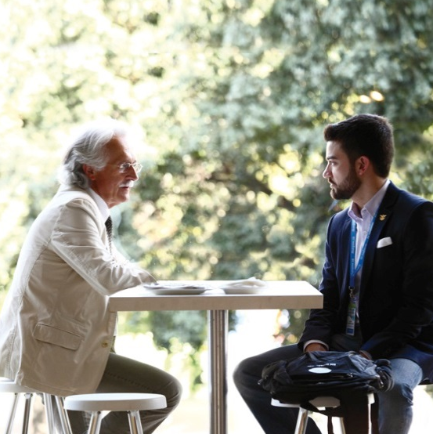
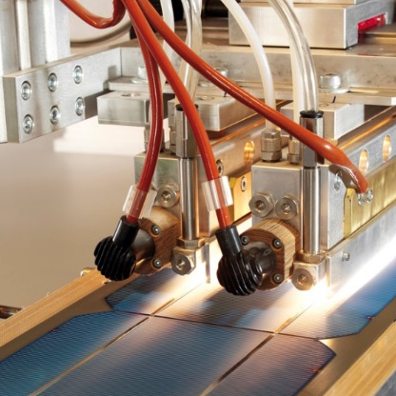
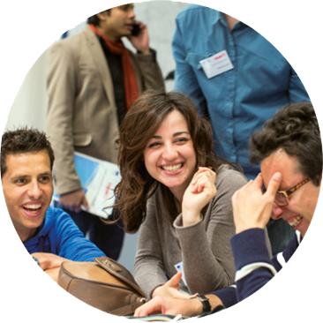
Our services
For every stage of the innovation journey
Innovation
Projects
Business Creation
Services
Education
Notes:
We work in three essential areas of the innovation mix:
Innovation Projects bring together ideas, inventors and industry to create commercially attractive technologies that deliver real results to customers.
Business Creation Services supports entrepreneurs and start-ups who are expanding Europe’s energy ecosystem with their innovative offerings.
Education helps create an informed and ambitious workforce that understands the demands of sustainability and the needs of industry.
Innovation is a continuous process
e.g. - our graduates may end up working for our start-ups or developing ideas that we invest in through Innovation Projects. Technologies that start life in Innovation Projects can then be developed by start-ups we support through Business Creation – and so on

Slide 10
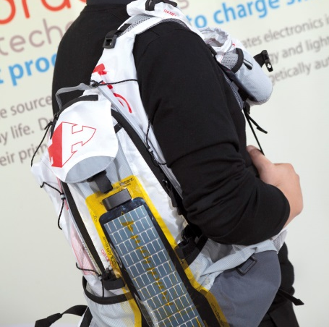
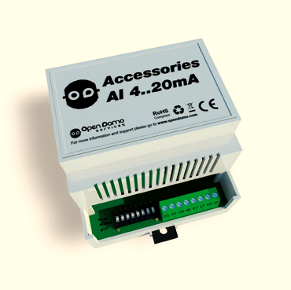

Business Creation Services
171
  Early start-ups
  supported
  95
  Companies created
  55
  Million euros
  of external
  investment raised
2 144
  Business ideas
  captured
Entrepreneurial success
Dracula Technologies
See the light with
printed PV cells
OpenDomo
Measuring energy
consumption with
Artificial Intelligence
GRADIS
A new era
of smart lighting
France
Renewable energy
Iberia
Smart and efficient
buildings and cities
Poland
Smart electric grid
Notes:
Examples of success stories:
Dracula Technologies:
Becoming a leading European player in the production of organic photovoltaic energy
Innovative process for digitally printing photovoltaic cells
Supported by InnoEnergy’s Business Creation Services in France
Introduced to important decision-makers and design and communication advisors
High profile success – featured on a tennis racket launched at this year’s Roland Garros (French Open)
Solar-powered game analytics to help improve player performance
OpenDomo
Initial product is ODEnergy
Uses artificial intelligence to analyse the individual energy consumption of appliances or electric systems
Coaching from InnoEnergy’s Business Creation Service in Barcelona
We supported the company in the search for business backers
We created opportunities for collaboration with other start-ups
We helped find first commercial customer after only 18 months
GRADIS
Started as a project supported by Innovation Projects in Benelux
Scientists from AGH University of Science and Technology created GRADIS
Complete solution for optimising and controlling outdoor lighting systems
Typically reduces lighting costs by 10 to 40 per cent
InnoEnergy took care of the administration details
GRADIS is now in talks with a municipality near Kraków about implementing the project

Slide 11

Business Creation Services
Connecting entrepreneurs and start-ups
to markets and customers
Tailored business support: the InnoEnergy Highway
Product: potential, development, pilot, launch
Market: opportunities, positioning, modelling, planning
People: capabilities, training, support, mentoring
Finance: seed money, VCs, angels, equity
Viable technologies, sustainable businesses,
entrepreneurial spirit
Notes:
The InnoEnergy Highway is a one-stop shop for services that turn business ideas into success
Once on the Highway, start-ups receive individually tailored services
Explain the four areas of the highway
Product: We assess the product’s potential, identify and track possible competitors, and ensure IP is protected. We then support the enhancement, development, pilot, and industrialisation of our start-ups’ solutions.
Market: We identify gaps in the market, assess the opportunity, and help develop a business case and market positioning. We support business modelling, planning, and commercialisation strategy. And we discover and validate that all-important first customer.
People: We assess each start-up’s team and its capabilities, providing training and on-going support and mentoring. We help identify new skills to bring into the business, and help with its legal constitution.
Finance: We provide access to seed money, our venture capital community and our network of business angels. We invest in the start-ups that we believe can make a difference. In return, we acquire an equity stake of five to 15 per cent in the company.

Slide 12
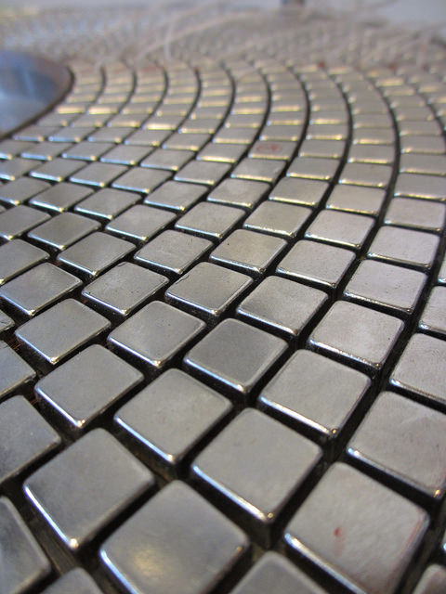

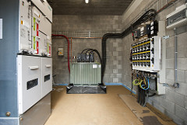
Innovation Projects
160
Innovation success
Project partners across Europe
77
HYMES
Hydroelectric mechanical energy storage
MrCySeMoL
Cyber security tool
Active Substations
Proactive monitoring
Patents filed
78
Products and services supported
3
Manufacturing facilities constructed
147
Million euros of
EIT InnoEnergy investment
1.2
Energy storage
Smart Electric Grid
Smart and efficient buildings and cities
Billion euros in project costs
3
Billion euros in
forecasted sales
Notes:
Examples of success stories:
Dracula Technologies:
Becoming a leading European player in the production of organic photovoltaic energy
Innovative process for digitally printing photovoltaic cells
Supported by InnoEnergy’s Business Creation Services in France
Introduced to important decision-makers and design and communication advisors
High profile success – featured on a tennis racket launched at this year’s Roland Garros (French Open)
Solar-powered game analytics to help improve player performance
OpenDomo
Initial product is ODEnergy
Uses artificial intelligence to analyse the individual energy consumption of appliances or electric systems
Coaching from InnoEnergy’s Business Creation Service in Barcelona
We supported the company in the search for business backers
We created opportunities for collaboration with other start-ups
We helped find first commercial customer after only 18 months
GRADIS
Started as a project supported by Innovation Projects in Benelux
Scientists from AGH University of Science and Technology created GRADIS
Complete solution for optimising and controlling outdoor lighting systems
Typically reduces lighting costs by 10 to 40 per cent
InnoEnergy took care of the administration details
GRADIS is now in talks with a municipality near Kraków about implementing the project

Slide 13

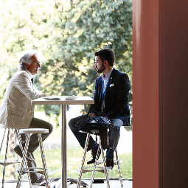
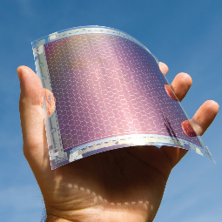
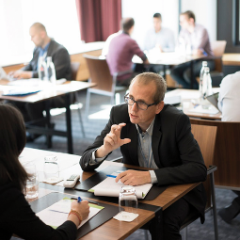
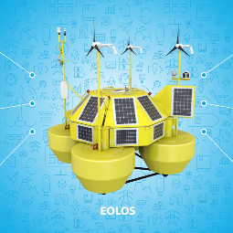


Innovation Projects
About Innovation Projects
Investing in commercially
focused R&D
Finding partners for
product development
Turning prototypes into
viable products
Shortening time
to market
Reducing financial risks of
product development
Supporting on-going
industrialisation
Notes:
Use this slide to show how Innovation Projects supports InnoEnergy’s overall goals
We support InnoEnergy’s goals by
Investing in commercially focused research and development projects
Finding partners for product development
Turning prototypes into viable products
Shortening time to market for those products
Reducing the financial risks of product development
Supporting on-going industrialisation once the product is ready for market

Slide 14
InnovationProjects & Business Creation
Working with InnEnergy
Combining the best of private and public models
0.2-5
61%
5x
0.5-50
Million €
2.6
1x
Average
ratio of
funding
ROI
Expected
overall
Typical value of
participation
Million €
Million €
ROI
Expected
within
5 years
of project
completion
Project
budget range
Average
project
budget
Notes:
Use this and the following slide to talk about the funding model. Emphasise that this is an investment not a grant
Our funding and investment model takes the best of traditional private and public funding models :
We only make money when you do. No need to worry about paying us back to a pre-set deadline.
We take an interest and support projects to increase success and ROI
Our clear ROI goals mean we can carry on investing in future projects
Talk through the numbers in the slide

Slide 15
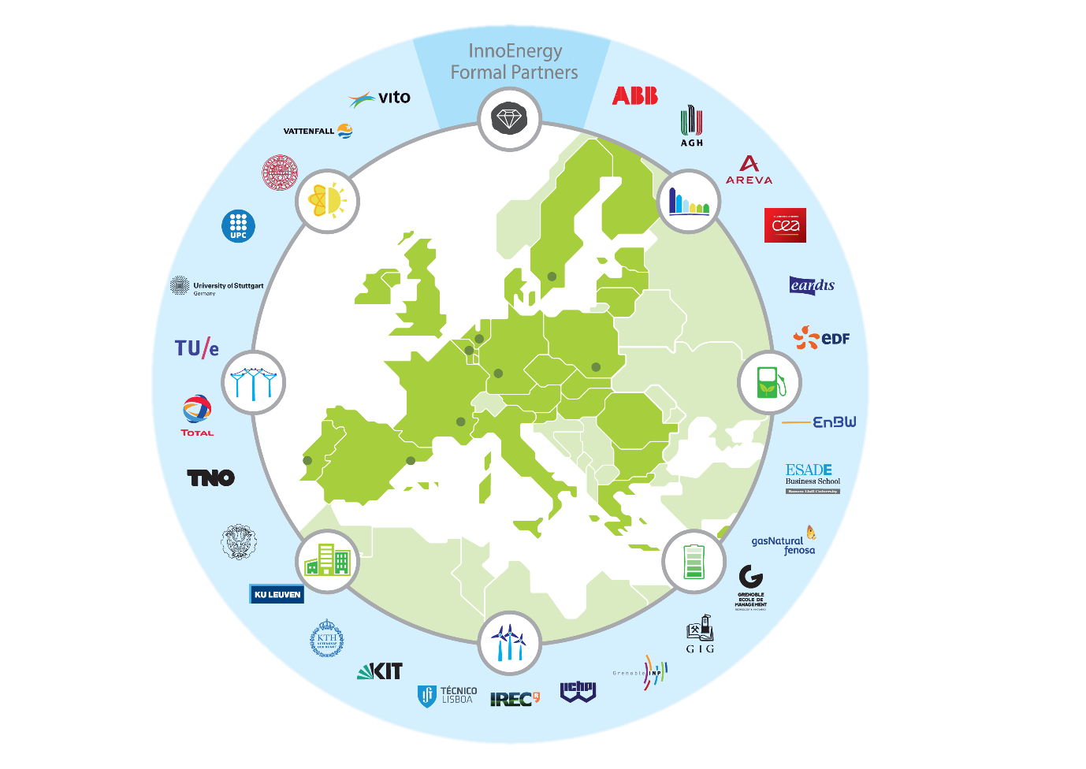
Education - InnoEnergy Master School
What is IE Master School?
12 technical universities
The biggest Energy sector companies.
Innovation and
entrepreneurship training
Summer schools or internships
Double degree
Chance for scholarship (up to 750€)
Notes:
Not typical school.
Why?
- Broader Scope
- Mobility – 2 yeas at 2 different universities
- 11 top tech European universities
- Cooperation with huge energy companies -> industrial participation, real challenges for students, Real market problems, internships
- Engineers, thanks to business training, at the front seats of companies. Engineers become entrepreneurs and innovators. Business and innovation training not only at
- Activities during summer (summer schools, internships)
- Double degree (as you study at 2 univ)

Slide 16
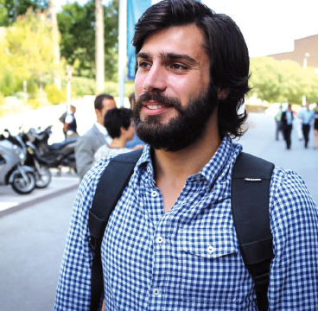
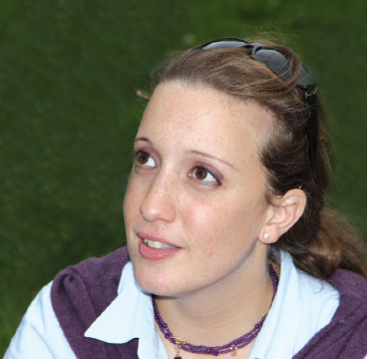
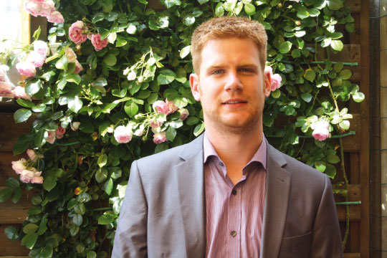
Education - InnoEnergy Master School
Our alumni
352
Graduates from the EIT InnoEnergy Master‘s School
“We need to
invest more
in green power”
"Long-term vision
is the key
to the future"
“Versatility, entrepreneurship and international experience”
9500
Applicants to
EIT InnoEnergy Master‘s School
93%
Graduates who find a job within six months of graduating
15%
Gregory Kotsis,
MSc SENSE
Project engineer at IREC Barcelona
Roberta Cirillo,
MSc EMINE
Research engineer, CEA Grenoble
Joeri Siborgs,
MSc Energy for Smart Cities
R&D project engineer,
Elia Brussels
Average annual salary earnings over graduates of
similar programmes
Notes:
Not typical school.
Why?
- Broader Scope
- Mobility – 2 yeas at 2 different universities
- 11 top tech European universities
- Cooperation with huge energy companies -> industrial participation, real challenges for students, Real market problems, internships
- Engineers, thanks to business training, at the front seats of companies. Engineers become entrepreneurs and innovators. Business and innovation training not only at
- Activities during summer (summer schools, internships)
- Double degree (as you study at 2 univ)

Slide 17
General vision
PowerAlliance
Toolbox for connecting ecosystems
Power lies in the network – general assumption is that the PowerAlliance platform will unlock smooth diffusion of know-how, innovators and investors between dispersed European innovation ecosystems.
Notes:
If you wish, use this slide to expand on these 5 concepts in the way that is most comfortable for you and relevant to your audience.
Some ideas are:
Connected: we are right at the heart of Europe’s energy sector. Our connections enable us to combine the best of Europe’s resources and bring it to all of Europe’s markets.
Collaborative: we enable the right people to come together at the right time in the innovation process and then help them to work together to ensure ideas have real impact
Commercial: we create viable products and services, sustainable businesses, and students with a strong understanding of industry as well as engineering. Our commercial focus is reflected in our own funding and business model
Challenging: we encourage everyone involved to step up to the plate, tackle complex problems and address important issues head on with new ways of thinking
Comprehensive: the power of what we do comes from the depth and breadth of our services, our geographic reach and the diversity of our community

Slide 18


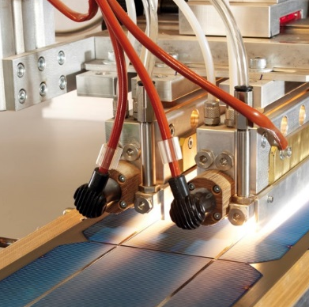
InnoEnergy Tool
For every stage of the innovation journey
Early-stage venture
Early-stage venture
Scale-up
SME
Not everything prepared for HIGHWAY
Has roadmap, solid pitch deck, idea for Business Model
Already has sales and seeks internationalization
Has solution at TRL 5 (or higher). Is looking for rapid commercialization
Acceleration
Primer
HIGHWAYTM
BOOSTWAYTM
Innovation
Projects
Notes:
If you wish, use this slide to expand on these 5 concepts in the way that is most comfortable for you and relevant to your audience.
Some ideas are:
Connected: we are right at the heart of Europe’s energy sector. Our connections enable us to combine the best of Europe’s resources and bring it to all of Europe’s markets.
Collaborative: we enable the right people to come together at the right time in the innovation process and then help them to work together to ensure ideas have real impact
Commercial: we create viable products and services, sustainable businesses, and students with a strong understanding of industry as well as engineering. Our commercial focus is reflected in our own funding and business model
Challenging: we encourage everyone involved to step up to the plate, tackle complex problems and address important issues head on with new ways of thinking
Comprehensive: the power of what we do comes from the depth and breadth of our services, our geographic reach and the diversity of our community

Slide 19
Acceleration Primer - general
InnoEnergy’s
Acceleration Primer
Pre-acceleration/incubation service provided by HUBs, utilizing their know-how and
experience, supported by InnoEnergy’s tools and methodology.
InnoEnergy’s tools:
Workbook 2.0
Library
MOOCs
Dedicated materials
Primer example
Deliverables after completing Acceleration Primer:
Roadmap (BCS Template) *
Pitch Deck *
Go-to-market strategy *
Competitive Landscape
Business Model Canvas
Proof of interest/LOI
Working prorotype is a must-have.
Notes:
If you wish, use this slide to expand on these 5 concepts in the way that is most comfortable for you and relevant to your audience.
Some ideas are:
Connected: we are right at the heart of Europe’s energy sector. Our connections enable us to combine the best of Europe’s resources and bring it to all of Europe’s markets.
Collaborative: we enable the right people to come together at the right time in the innovation process and then help them to work together to ensure ideas have real impact
Commercial: we create viable products and services, sustainable businesses, and students with a strong understanding of industry as well as engineering. Our commercial focus is reflected in our own funding and business model
Challenging: we encourage everyone involved to step up to the plate, tackle complex problems and address important issues head on with new ways of thinking
Comprehensive: the power of what we do comes from the depth and breadth of our services, our geographic reach and the diversity of our community

Slide 20
Power Alliance Structure
and more..
Worbook v 2.0
(ex-KICStart your business)
InnoEnergy’s
Digital Library
Monthly Meeting
of the Ecosystem
The Annual Competition
(Guiding Entrepreneurs to Power)
(where we store more power and charge people when needed)
(where people share power)
(where you can power up your business to a new level)

Slide 21



Power Alliance Structure
PowerHUB CZ – InnoEnergy HUB Czech
Combining Global Approach and Local Knowledge
Innovation projects & PowerHUB for CZ & SK (+V4 & CEE)
Deep knowledge of the CEE Market
CROSS OVER FOCUS – Energy / Communications / Mobility
Based at Prague 5 (and cooperation with CITY)
ABC PowerHUB US Landing Program
Expanding the circle of innovation for energy and cross over projects in Czech and Slovak

Slide 22
PowerHUB CZ
PowerHUB CZ Other Activities
  Innovation Centre Services
  (Legal, Finance, Accounting, Project Management, Production, Mentoring, Couching, US Landing)
  Scouting Projects and Investment tools
  Venture Capital, Investment Funds Management
E-Accelerator Energy Community
2-weekly energy breakfasts – brunches; students-professionals mixture
  Partner‘s PowerHUB PreSeed Fund
  Pre Acceleration Fund; 5 – 10 Mil. CZK/ Year
  Technical Education + Elementary and High School Cooperation

Slide 23
PowerHUB CZ
Partnership with PowerHUB
InnoEnergy PowerUP ! – opening June 2017
- any project suitable for Primer
- closing Date Septemeber 2017
Projects shall be evaluated by unique tool - EIT InnoEnergy Highway (process for evaluation of the projects) and with use of tools and events of EIT InnoEnergy CC Poland Plus Countries
Efficient capacity for 10 new projects per year within CZ and Slovak market (primarily based in Prague, with option in other cities + Prague 5 Project)

Slide 24
PowerHUB CZ
Partnership with PowerHUB
Re/Cobranding of Prague PowerHUB
All activities of E-Accelerator in Czech and Slovak shall be co-branded with Partners Schemes (incl. CZ activities like E-Nergy Club, E-Nergy Fund etc.)
In the case of interest possibility to expand into other CEE countries:
Bulgaria, Croatia, Greece, Hungary, Poland, Romania, Serbia, Slovenia, Montenegro, Baltics
Partnership Level (according to scope of activities)
Activities
Finanical Participation

Slide 25
InnoEnergy Introduction
Petr Bažant
petr@e-accelerator.cz

